Slide 1
The Dispatcher: Saving Power of the New Testament
Joseph Mack, presenter
The SHARE, Ep 22
A READINESS FOR DISPATCH
Saturday, September 9, 2023
Greenville Avenue Church of Christ
Notes:
The Saving Power of the Awesome Dispatcher in the New Testament is my subject for this evening.

Slide 2
Discuss the essence of how God dispatched men and women in the New Testament to bring lost souls into the Kingdom in the Christian Dispensation
Acts 1-19
Notes:
We are going to survey the properties or characteristics, the essence of how the Dispatcher, God, dispatched men/women in the New Testament to bring lost souls into His Kingdom through Jesus.
1. We will define key terms
2. We will discuss some of what we know about God in the context of this discussion
4. We will then design a route by which to discover the Dispatchers Saving Power
5. Finally we will analyze historical accounts (samples) to arrive at the identity of this power

Slide 3
Definitions
essence - a property or group of properties of something (The Dispatcher Saving Power) without which it would not exist or be what it is.
dispatch - the sending of someone (Christians) or something to a destination or for a purpose (soul-saving, making disciples) God can use – Mt. 28:18-20).
dispensation - a certain order, system, or arrangement; administration or management. The divine ordering of the affairs of the world. an appointment, arrangement, or favor, as by God. a divinely appointed order or age: the old Mosaic dispensation; the Christian Dispensation.
Notes:
^{Matt 28:18} And Jesus came and spoke to them, saying, “All authority has been given to Me in heaven and on earth. ¹⁹ Go therefore and make disciples of all the nations, baptizing them in the name of the Father and of the Son and of the Holy Spirit, ²⁰ teaching them to observe all things that I have commanded you; and lo, I am with you always, even to the end of the age.” Amen.

Slide 4
The Dispatcher (God) – What Do We Know?
God has a Kingdom (Acts 1:3)
God does wonderful works (Acts 2:11)
God promised to pour out His Spirit on all flesh (Acts: 2:17)
God performed miracles, wonders, and signs through Jesus (Acts 2:22)
Notes:
Act 1:3 - ³ to whom He also presented Himself alive after His suffering by many infallible proofs, being seen by them during forty days and speaking of the things pertaining to the Kingdom of God.
Act 2:11 - ¹¹ Cretans and Arabs—we hear them speaking in our own tongues the wonderful works of God.”
Act 2:17 - ¹⁷ ‘And it shall come to pass in the last days, says God, That I will pour out of My Spirit on all flesh; Your sons and your daughters shall prophesy, Your young men shall see visions, Your old men shall dream dreams.
Act 2:22 - ²² “Men of Israel, hear these words: Jesus of Nazareth, a Man attested by God to you by miracles, wonders, and signs which God did through Him in your midst, as you yourselves also know—
Act 2:23 - ²³ Him, being delivered by the determined purpose and foreknowledge of God, you ^{[f]}have taken by lawless hands, have crucified, and put to death;
Act 2:24 - ²⁴ whom God raised up, having loosed the pains of death, because it was not possible that He should be held by it.
Acts 2:30 - ³⁰ Therefore, being a prophet, and knowing that God had sworn with an oath to him that of the fruit of his body, according to the flesh, He would raise up the Christ to sit on his throne,
Matt 3:17 - ¹⁷ And suddenly a voice came from heaven, saying, “This is My beloved Son, in whom I am well pleased.”

Slide 5
The Dispatcher (God) – What Do We Know?
God has a determined purpose and foreknowledge of all things (Acts 2:23)
God raised Jesus from the dead (Acts 2:24)
God is in the covenant business (Acts 2:30) and has foretold of the current dispensation
God want us to know that Jesus is His Son (Mt 3:17, Acts 2:30)
Notes:
Act 1:3 - ³ to whom He also presented Himself alive after His suffering by many infallible proofs, being seen by them during forty days and speaking of the things pertaining to the Kingdom of God.
Act 2:11 - ¹¹ Cretans and Arabs—we hear them speaking in our own tongues the wonderful works of God.”
Act 2:17 - ¹⁷ ‘And it shall come to pass in the last days, says God, That I will pour out of My Spirit on all flesh; Your sons and your daughters shall prophesy, Your young men shall see visions, Your old men shall dream dreams.
Act 2:22 - ²² “Men of Israel, hear these words: Jesus of Nazareth, a Man attested by God to you by miracles, wonders, and signs which God did through Him in your midst, as you yourselves also know—
Act 2:23 - ²³ Him, being delivered by the determined purpose and foreknowledge of God, you ^{[f]}have taken by lawless hands, have crucified, and put to death;
Act 2:24 - ²⁴ whom God raised up, having loosed the pains of death, because it was not possible that He should be held by it.
Acts 2:30 - ³⁰ Therefore, being a prophet, and knowing that God had sworn with an oath to him that of the fruit of his body, according to the flesh, He would raise up the Christ to sit on his throne,
Matt 3:17 - ¹⁷ And suddenly a voice came from heaven, saying, “This is My beloved Son, in whom I am well pleased.”

Slide 6
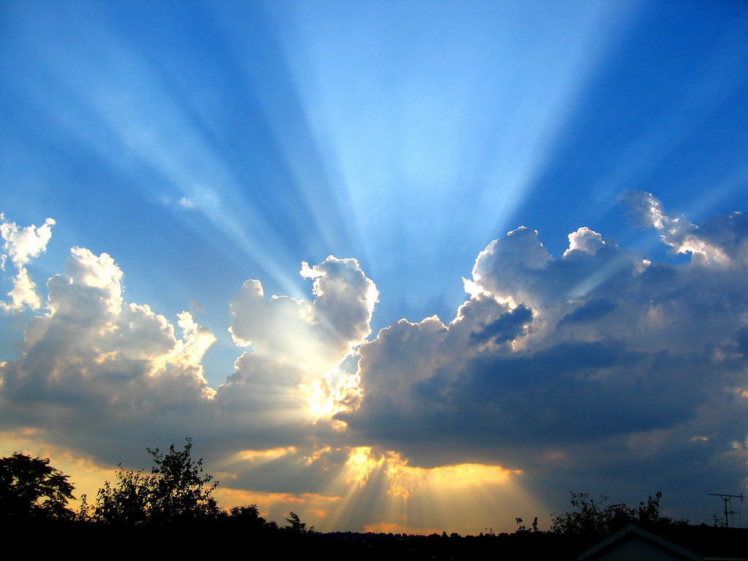
The Dispatcher (God) – What Do We Know?
God keeps His promises through Jesus (again Acts 2:33)
God wants us to know that Jesus is our Lord and Savior. (Acts 2:36)
God wants us to know this is an all-time message for those He calls (Acts 2:39)
God wants to add souls to His Church through His Son (Jesus) (Acts 2:47)
Notes:
Act 2:23 - ²³ Him, being delivered by the determined purpose and foreknowledge of God, you ^{[f]}have taken by lawless hands, have crucified, and put to death;
Act 2:36 - ³⁶ “Therefore let all the house of Israel know assuredly that God has made this Jesus, whom you crucified, both Lord and Christ.”
Act 2:39 - ³⁹ For the promise is to you and to your children, and to all who are afar off, as many as the Lord our God will call.”
Act 2:47 - ⁴⁷ praising God and having favor with all the people. And the Lord added to the church daily those who were being saved.

Slide 7
Plan or Scheme of Salvation
Hear: Ro 10:17, Ac 10:42-43, Matt 7:24-27
Believe: He 11:6, Mk 16:15-16
Repent: Ac 2:38, 17:30, Lu 13:3
Confess: Mt 10:32-33, Ac 8:36-37
Be Baptized: Ac 2:38, Mk 16:15-16, Ac 22:16, 1Pe 3:20-21
Remain Faithful: Re 2:10, Mt 7:21, Mt 28:19-20
Notes:
Hear
^{Rom 10:17} So then faith comes by hearing, and hearing by the word of God.
^{Matt 7: 24} “Therefore whoever hears these sayings of Mine, and does them, I will liken him to a wise man who built his house on the rock: ²⁵ and the rain descended, the floods came, and the winds blew and beat on that house; and it did not fall, for it was founded on the rock.
Believe
^{Hebrew 11:6} But without faith it is impossible to please Him, for he who comes to God must believe that He is, and that He is a rewarder of those who diligently seek Him.
Repent
^{Act 2:38} Then Peter said to them, “Repent, and let every one of you be baptized in the name of Jesus Christ for the ^{[k]}remission of sins; and you shall receive the gift of the Holy Spirit.
Confess
^{Matt 10:32} “Therefore whoever confesses Me before men, him I will also confess before My Father who is in heaven.
Be baptized
^{Act 2:38} Then Peter said to them, “Repent, and let every one of you be baptized in the name of Jesus Christ for the ^{[k]}remission of sins; and you shall receive the gift of the Holy Spirit.
Remain Faithful
^{Rev 2:10} Do not fear any of those things which you are about to suffer. Indeed, the devil is about to throw some of you into prison, that you may be tested, and you will have tribulation ten days. Be faithful until death, and I will give you the crown of life.
This is the Dispatcher Saving Plan

Slide 8
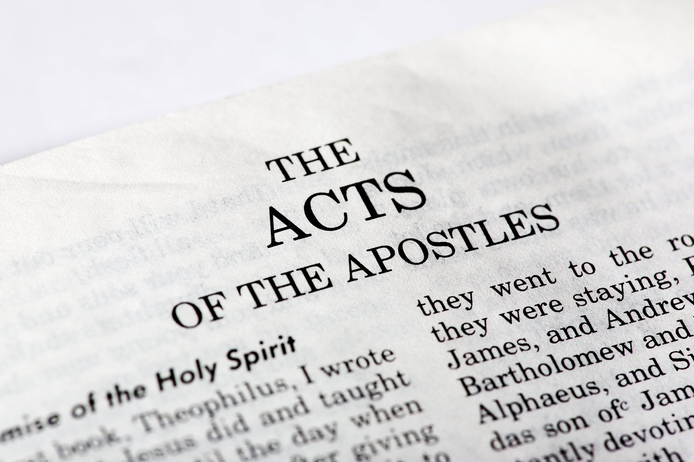
Biblical Design of Experiments
To find the characteristics or properties of how God dispatched men and women in the New Testament to bring lost souls into His Church, we will need to analyze some of the occasions (samples) whereby a soul or souls were saved within Acts 1-19 and identify similar characteristics or properties in God’s dispatching methods using the five Ws
Who, What, Where, Why, When
(2Ti 2:15, 3:16-17, Pr 3:2)

Slide 9
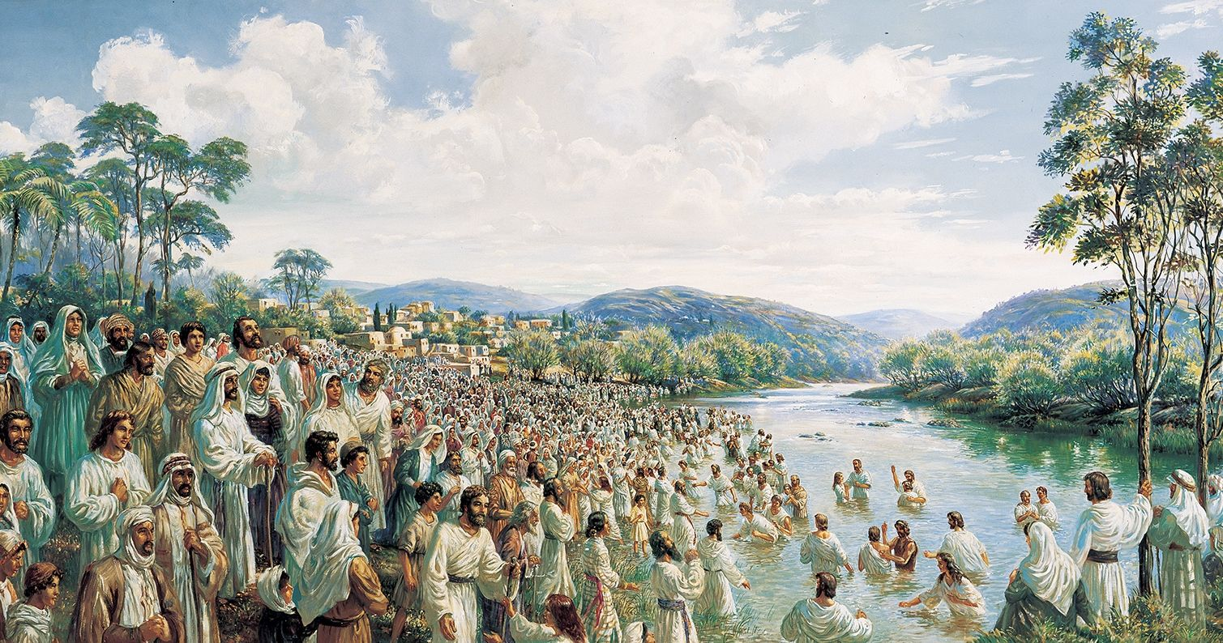
Peter & the Apostles Dispatched on the Day of Pentecost (Acts 2:1-2:41)
Who: Peter, 12 Apostles, and devout men from every nation
What: fellowship (Acts 1:13), prayer (Acts 1:14), preparation (Acts 1: 26 -Matthias added to the 12), preaching (Acts 2:14-38), 3000 souls were added to the Church (Acts 2:41)
Where: Jerusalem, Israel
Notes:
Before the Day of Pentecost:
The Holy Sprit is Promised by Jesus before he ascends to heaven (Act 1:4-8) – It should noted – underlined
⁴ And being assembled together with them, He commanded them not to depart from Jerusalem, but to wait for the Promise of the Father, “which,” He said, “you have heard from Me; ⁵ for John truly baptized with water, but you shall be baptized with the Holy Spirit not many days from now.” ⁶ Therefore, when they had come together, they asked Him, saying, “Lord, will You at this time restore the kingdom to Israel?” ⁷ And He said to them, “It is not for you to know times or seasons which the Father has put in His own authority. ⁸ But you shall receive power when the Holy Spirit has come upon you; and you shall be witnesses to Me in Jerusalem, and in all Judea and Samaria, and to the end of the earth.”
2. The Upper Room Prayer Meeting (Acts 1:12-14) – There seems to be some important prerequisites in order for the Apostles to be ready to receive power. It should be noted -
¹² Then they returned to Jerusalem from the mount called Olivet, which is near Jerusalem, a Sabbath day’s journey. ¹³ And when they had entered, they went up into the upper room where they were staying: Peter, James, John, and Andrew; Philip and Thomas; Bartholomew and Matthew; James the son of Alphaeus and Simon the Zealot; and Judas the son of James. ¹⁴ These all continued with one accord in prayer and supplication, with the women and Mary the mother of Jesus, and with His brothers.
¹⁵ And in those days Peter stood up in the midst of the ^{[f]}disciples (altogether the number of names was about a hundred and twenty), and said, ¹⁶ “Men and brethren, this Scripture had to be fulfilled, which the Holy Spirit spoke before by the mouth of David concerning Judas, who became a guide to those who arrested Jesus.
= Fellowship, Prayer, Study of the Word of God (prerequisites)
3. Receiving of the Holy Spirit (The Dispatchers Saving Power) Acts 2 –
¹When the Day of Pentecost had fully come, they were all with one accord in one place. ² And suddenly there came a sound from heaven, as of a rushing mighty wind, and it filled the whole house where they were sitting. ³ Then there appeared to them ^{[b]}divided tongues, as of fire, and one sat upon each of them. ⁴ And they were all filled with the Holy Spirit and began to speak with other tongues, as the Spirit gave them utterance.
It should be noted – The Crowd’s reaction
⁷ Then they were all amazed and marveled, saying to one another, “Look, are not all these who speak Galileans? ⁸ And how is it that we hear, each in our own language in which we were born? ⁹ Parthians and Medes and Elamites, those dwelling in Mesopotamia, Judea and Cappadocia, Pontus and Asia, ¹⁰ Phrygia and Pamphylia, Egypt and the parts of Libya adjoining Cyrene, visitors from Rome, both Jews and proselytes, ¹¹ Cretans and ^{[d]}Arabs—we hear them speaking in our own tongues the wonderful works of God.” ¹² So they were all amazed and perplexed, saying to one another, “Whatever could this mean?”
4. Peter’s took opportunity to preach the Word
¹⁴ But Peter, standing up with the eleven, raised his voice and said to them, “Men of Judea and all who dwell in Jerusalem, let this be known to you, and heed my words. ¹⁵ For these are not drunk, as you suppose, since it is only the third hour of the day. ¹⁶ But this is what was spoken by the prophet Joel:
²² “Men of Israel, hear these words: Jesus of Nazareth, a Man attested by God to you by miracles, wonders, and signs which God did through Him in your midst, as you yourselves also know—
5. It should be noted again – The Crowd’s reaction
³⁷ Now when they heard this, they were cut to the heart, and said to Peter and the rest of the apostles, “Men and brethren, what shall we do?”
- “The Dispatcher Saving Power is in the Word”

Slide 10
Peter & the Apostles Dispatched on the Day of Pentecost (Acts 2:1-2:41)
Why: The Holy Spirit promised by Jesus (1:8) filled the apostles, and devout men from different nations heard them speak in familiar languages. Peter preached Jesus!
When: The Day of Pentecost, 1st Century (50 days after the Passover –Feast of Weeks/Harvest)
Notes:
Before the Day of Pentecost:
The Holy Sprit is Promised by Jesus before he ascends to heaven (Act 1:4-8) – It should noted – underlined
⁴ And being assembled together with them, He commanded them not to depart from Jerusalem, but to wait for the Promise of the Father, “which,” He said, “you have heard from Me; ⁵ for John truly baptized with water, but you shall be baptized with the Holy Spirit not many days from now.” ⁶ Therefore, when they had come together, they asked Him, saying, “Lord, will You at this time restore the kingdom to Israel?” ⁷ And He said to them, “It is not for you to know times or seasons which the Father has put in His own authority. ⁸ But you shall receive power when the Holy Spirit has come upon you; and you shall be witnesses to Me in Jerusalem, and in all Judea and Samaria, and to the end of the earth.”
2. The Upper Room Prayer Meeting (Acts 1:12-14) – There seems to be some important prerequisites in order for the Apostles to be ready to receive power. It should be noted -
¹² Then they returned to Jerusalem from the mount called Olivet, which is near Jerusalem, a Sabbath day’s journey. ¹³ And when they had entered, they went up into the upper room where they were staying: Peter, James, John, and Andrew; Philip and Thomas; Bartholomew and Matthew; James the son of Alphaeus and Simon the Zealot; and Judas the son of James. ¹⁴ These all continued with one accord in prayer and supplication, with the women and Mary the mother of Jesus, and with His brothers.
¹⁵ And in those days Peter stood up in the midst of the ^{[f]}disciples (altogether the number of names was about a hundred and twenty), and said, ¹⁶ “Men and brethren, this Scripture had to be fulfilled, which the Holy Spirit spoke before by the mouth of David concerning Judas, who became a guide to those who arrested Jesus.
= Fellowship, Prayer, Study of the Word of God (prerequisites)
3. Receiving of the Holy Spirit (The Dispatchers Saving Power) Acts 2 –
¹When the Day of Pentecost had fully come, they were all with one accord in one place. ² And suddenly there came a sound from heaven, as of a rushing mighty wind, and it filled the whole house where they were sitting. ³ Then there appeared to them ^{[b]}divided tongues, as of fire, and one sat upon each of them. ⁴ And they were all filled with the Holy Spirit and began to speak with other tongues, as the Spirit gave them utterance.
It should be noted – The Crowd’s reaction
⁷ Then they were all amazed and marveled, saying to one another, “Look, are not all these who speak Galileans? ⁸ And how is it that we hear, each in our own language in which we were born? ⁹ Parthians and Medes and Elamites, those dwelling in Mesopotamia, Judea and Cappadocia, Pontus and Asia, ¹⁰ Phrygia and Pamphylia, Egypt and the parts of Libya adjoining Cyrene, visitors from Rome, both Jews and proselytes, ¹¹ Cretans and ^{[d]}Arabs—we hear them speaking in our own tongues the wonderful works of God.” ¹² So they were all amazed and perplexed, saying to one another, “Whatever could this mean?”
4. Peter’s took opportunity to preach the Word
¹⁴ But Peter, standing up with the eleven, raised his voice and said to them, “Men of Judea and all who dwell in Jerusalem, let this be known to you, and heed my words. ¹⁵ For these are not drunk, as you suppose, since it is only the third hour of the day. ¹⁶ But this is what was spoken by the prophet Joel:
²² “Men of Israel, hear these words: Jesus of Nazareth, a Man attested by God to you by miracles, wonders, and signs which God did through Him in your midst, as you yourselves also know—
5. It should be noted again – The Crowd’s reaction
³⁷ Now when they heard this, they were cut to the heart, and said to Peter and the rest of the apostles, “Men and brethren, what shall we do?”
- “The Dispatcher Saving Power is in the Word”

Slide 11
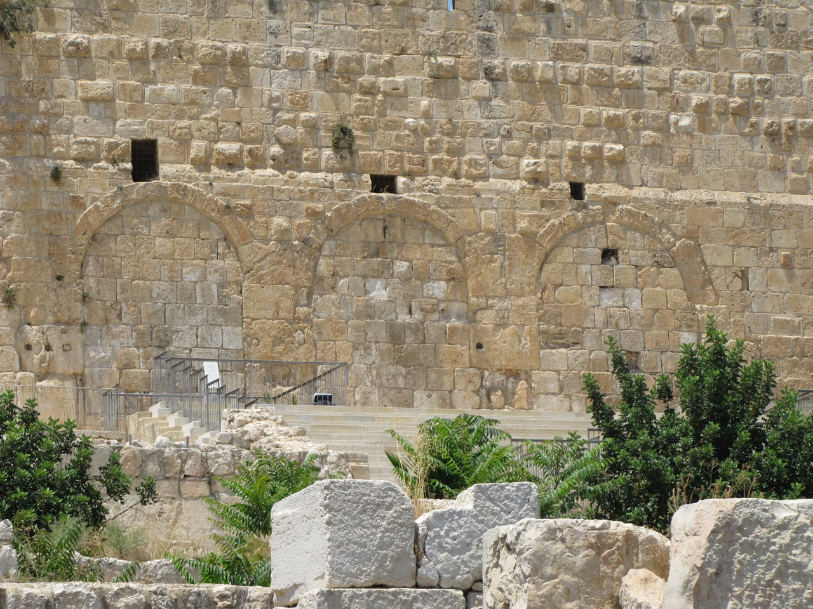
Peter and John Dispatched to Heal a Lame Man (2:42-4:4)
Who: The Church, Peter and John
What: Continued teaching, fellowship, prayer (2:41-42), preparation (2:44-45), praise (2:47), wonders, signs (2:43), healing! and about 5,000 men believed the Word! (4:4)
Where: Jerusalem, house-to-house, Beautiful Gate of the Temple
Notes:
Prior to the healing of the lame man:
³⁸ Then Peter said to them, “Repent, and let every one of you be baptized in the name of Jesus Christ for the remission of sins; and you shall receive the gift of the Holy Spirit. ³⁹ For the promise is to you and to your children, and to all who are afar off, as many as the Lord our God will call.”
A Vital Church Grows
2. It should be noted again there seems to be some important prerequisites to get ready to receive the power:
⁴⁰ And with many other words he testified and exhorted them, saying, “Be saved from this perverse generation.” ⁴¹ Then those who gladly received his word were baptized; and that day about three thousand souls were added to them. ⁴² And they continued steadfastly in the apostles’ doctrine and fellowship, in the breaking of bread, and in prayers. ⁴³ Then fear came upon every soul, and many wonders and signs were done through the apostles. ⁴⁴ Now all who believed were together, and had all things in common, ⁴⁵ and sold their possessions and goods, and divided them among all, as anyone had need.
⁴⁶ So continuing daily with one accord in the temple, and breaking bread from house to house, they ate their food with gladness and simplicity of heart, ⁴⁷ praising God and having favor with all the people. And the Lord added to the church daily those who were being saved.
= Fellowship, Prayer, Study of the Word of God (prerequisites)
3. A Lame Man Healed in the name of Jesus
3 Now Peter and John went up together to the temple at the hour of prayer, the ninth hour. ² And a certain man lame from his mother’s womb was carried, whom they laid daily at the gate of the temple which is called Beautiful, to ^{[a]}ask alms from those who entered the temple; ³ who, seeing Peter and John about to go into the temple, asked for alms. ⁴ And fixing his eyes on him, with John, Peter said, “Look at us.” ⁵ So he gave them his attention, expecting to receive something from them. ⁶ Then Peter said, “Silver and gold I do not have, but what I do have I give you: In the name of Jesus Christ of Nazareth, rise up and walk.” ⁷ And he took him by the right hand and lifted him up, and immediately his feet and ankle bones received strength. ⁸ So he, leaping up, stood and walked and entered the temple with them—walking, leaping, and praising God. ⁹ And all the people saw him walking and praising God. ¹⁰ Then they knew that it was he who sat begging alms at the Beautiful Gate of the temple; and they were filled with wonder and amazement at what had happened to him.
¹¹ Now as the lame man who was healed held on to Peter and John, all the people ran together to them in the porch which is called Solomon’s, greatly amazed
4. Peter took this opportunity to preach Jesus (Acts 3:12-26)
Acts 4:4 ⁴ However, many of those who heard the word believed; and the number of the men came to be about five thousand.
- “The Dispatcher Saving Power is in the Word”

Slide 12
Peter and John Dispatched to Heal a Lame Man (2:42-4:4)
Why: The people are amazed at the healing of a commonly known lame man, by Peter, in the name of Jesus. Peter preached Jesus (4:11-26)
When: Ninth hour – 3 p.m.(3:1), the hour of prayer
Notes:
Prior to the healing of the lame man:
³⁸ Then Peter said to them, “Repent, and let every one of you be baptized in the name of Jesus Christ for the remission of sins; and you shall receive the gift of the Holy Spirit. ³⁹ For the promise is to you and to your children, and to all who are afar off, as many as the Lord our God will call.”
A Vital Church Grows
2. It should be noted again there seems to be some important prerequisites to get ready to receive the power:
⁴⁰ And with many other words he testified and exhorted them, saying, “Be saved from this perverse generation.” ⁴¹ Then those who gladly received his word were baptized; and that day about three thousand souls were added to them. ⁴² And they continued steadfastly in the apostles’ doctrine and fellowship, in the breaking of bread, and in prayers. ⁴³ Then fear came upon every soul, and many wonders and signs were done through the apostles. ⁴⁴ Now all who believed were together, and had all things in common, ⁴⁵ and sold their possessions and goods, and divided them among all, as anyone had need.
⁴⁶ So continuing daily with one accord in the temple, and breaking bread from house to house, they ate their food with gladness and simplicity of heart, ⁴⁷ praising God and having favor with all the people. And the Lord added to the church daily those who were being saved.
= Fellowship, Prayer, Study of the Word of God (prerequisites)
3. A Lame Man Healed in the name of Jesus
3 Now Peter and John went up together to the temple at the hour of prayer, the ninth hour. ² And a certain man lame from his mother’s womb was carried, whom they laid daily at the gate of the temple which is called Beautiful, to ^{[a]}ask alms from those who entered the temple; ³ who, seeing Peter and John about to go into the temple, asked for alms. ⁴ And fixing his eyes on him, with John, Peter said, “Look at us.” ⁵ So he gave them his attention, expecting to receive something from them. ⁶ Then Peter said, “Silver and gold I do not have, but what I do have I give you: In the name of Jesus Christ of Nazareth, rise up and walk.” ⁷ And he took him by the right hand and lifted him up, and immediately his feet and ankle bones received strength. ⁸ So he, leaping up, stood and walked and entered the temple with them—walking, leaping, and praising God. ⁹ And all the people saw him walking and praising God. ¹⁰ Then they knew that it was he who sat begging alms at the Beautiful Gate of the temple; and they were filled with wonder and amazement at what had happened to him.
¹¹ Now as the lame man who was healed held on to Peter and John, all the people ran together to them in the porch which is called Solomon’s, greatly amazed
4. Peter took this opportunity to preach Jesus (Acts 3:12-26)
Acts 4:4 ⁴ However, many of those who heard the word believed; and the number of the men came to be about five thousand.
- “The Dispatcher Saving Power is in the Word”

Slide 13
Peter and John Dispatched to Address the Sanhedrin (4:1-4:4)
Who: The Sanhedrin, Peter and John
What: Peter and John are arrested and placed in custody; the next day, in the Court of the High Council, they are questioned concerning what power or by what name they healed the lame man (4:5-7)
Where: Jerusalem, the Temple, the Court of the High Council
Notes:
1. After Peter and John healed the lame man, preached to the the people, were arrested, and spent the night in jail, the tank was still full (full of the Holy Spirit) – It is very important to say full of the spirit (prayer, fellowship, and living in the Word of God)
Acts 4:8 - ⁸ Then Peter, filled with the Holy Spirit, said to them: “Rulers and elders of the people!
Acts 4 ¹Now as they spoke to the people, the priests, the captain of the temple, and the Sadducees came upon them, ² being greatly disturbed that they taught the people and preached in Jesus the resurrection from the dead. ³ And they laid hands on them, and put them in custody until the next day, for it was already evening. ⁴ However, many of those who heard the word believed; and the number of the men came to be about five thousand.
2. The next day in court Peter and John are question by the High Council (4:5-7) and asked by what power, or what name they have healed the lame man.
⁵ And it came to pass, on the next day, that their rulers, elders, and scribes, ⁶ as well as Annas the high priest, Caiaphas, John, and Alexander, and as many as were of the family of the high priest, were gathered together at Jerusalem. ⁷ And when they had set them in the midst, they asked, “By what power or by what name have you done this?”
Why did the Council ask them a question they already had the answer to (4:1-2)?
Have you ever asked somebody a question you already had the answer to, why?
The sought to expose some fear of Jewish Authority, or fear of those who had Jesus killed.
3. Peter took this opportunities to preach Jesus (Act 4:8-12)
⁸ Then Peter, filled with the Holy Spirit, said to them, “Rulers of the people and elders of Israel: ⁹ If we this day are judged for a good deed done to a helpless man, by what means he has been made well, ¹⁰ let it be known to you all, and to all the people of Israel, that by the name of Jesus Christ of Nazareth, whom you crucified, whom God raised from the dead, by Him this man stands here before you whole. ¹¹ This is the ‘stone which was rejected by you builders, which has become the chief cornerstone.’ ¹² Nor is there salvation in any other, for there is no other name under heaven given among men by which we must be saved.”
4. The Sanhedrin Response is amazement but they do not believe
¹³ Now when they saw the boldness of Peter and John, and perceived that they were uneducated and untrained men, they marveled. And they realized that they had been with Jesus. ¹⁴ And seeing the man who had been healed standing with them, they could say nothing against it. ¹⁵ But when they had commanded them to go aside out of the council, they conferred among themselves, ¹⁶ saying, “What shall we do to these men? For, indeed, that a ^{[a]}notable miracle has been done through them is evident^{[b]} to all who dwell in Jerusalem, and we cannot deny it.
- “The Dispatcher Saving Power is in the Word”
It is our responsibility to always be prepared to deliver it.
²³ And being let go, they went to their own companions and reported all that the chief priests and elders had said to them. ²⁴ So when they heard that, they raised their voice to God with one accord and said: “Lord, You are God, who made heaven and earth and the sea, and all that is in them, ²⁵ who ^{[c]}by the mouth of Your servant David have said:
‘Why did the nations rage, And the people plot vain things? ²⁶ The kings of the earth took their stand, And the rulers were gathered together Against the Lord and against His Christ.’
²⁷ “For truly against Your holy Servant Jesus, whom You anointed, both Herod and Pontius Pilate, with the Gentiles and the people of Israel, were gathered together ²⁸ to do whatever Your hand and Your purpose determined before to be done. ²⁹ Now, Lord, look on their threats, and grant to Your servants that with all boldness they may speak Your word, ³⁰ by stretching out Your hand to heal, and that signs and wonders may be done through the name of Your holy Servant Jesus.”
³¹ And when they had prayed, the place where they were assembled together was shaken; and they were all filled with the Holy Spirit, and they spoke the word of God with boldness.

Slide 14
Peter and John Dispatched to Address the Sanhedrin (4:1-4:4)
Why: arrested for teaching and preaching to the people, through Jesus, the resurrection from the dead (4:1-3)
When: evening (4:3)
Notes:
1. After Peter and John healed the lame man, preached to the the people, were arrested, and spent the night in jail, the tank was still full (full of the Holy Spirit) – It is very important to say full of the spirit (prayer, fellowship, and living in the Word of God)
Acts 4:8 - ⁸ Then Peter, filled with the Holy Spirit, said to them: “Rulers and elders of the people!
Acts 4 ¹Now as they spoke to the people, the priests, the captain of the temple, and the Sadducees came upon them, ² being greatly disturbed that they taught the people and preached in Jesus the resurrection from the dead. ³ And they laid hands on them, and put them in custody until the next day, for it was already evening. ⁴ However, many of those who heard the word believed; and the number of the men came to be about five thousand.
2. The next day in court Peter and John are question by the High Council (4:5-7) and asked by what power, or what name they have healed the lame man.
⁵ And it came to pass, on the next day, that their rulers, elders, and scribes, ⁶ as well as Annas the high priest, Caiaphas, John, and Alexander, and as many as were of the family of the high priest, were gathered together at Jerusalem. ⁷ And when they had set them in the midst, they asked, “By what power or by what name have you done this?”
Why did the Council ask them a question they already had the answer to (4:1-2)?
Have you ever asked somebody a question you already had the answer to, why?
The sought to expose some fear of Jewish Authority, or fear of those who had Jesus killed.
3. Peter took this opportunities to preach Jesus (Act 4:8-12)
⁸ Then Peter, filled with the Holy Spirit, said to them, “Rulers of the people and elders of Israel: ⁹ If we this day are judged for a good deed done to a helpless man, by what means he has been made well, ¹⁰ let it be known to you all, and to all the people of Israel, that by the name of Jesus Christ of Nazareth, whom you crucified, whom God raised from the dead, by Him this man stands here before you whole. ¹¹ This is the ‘stone which was rejected by you builders, which has become the chief cornerstone.’ ¹² Nor is there salvation in any other, for there is no other name under heaven given among men by which we must be saved.”
4. The Sanhedrin Response is amazement but they do not believe
¹³ Now when they saw the boldness of Peter and John, and perceived that they were uneducated and untrained men, they marveled. And they realized that they had been with Jesus. ¹⁴ And seeing the man who had been healed standing with them, they could say nothing against it. ¹⁵ But when they had commanded them to go aside out of the council, they conferred among themselves, ¹⁶ saying, “What shall we do to these men? For, indeed, that a ^{[a]}notable miracle has been done through them is evident^{[b]} to all who dwell in Jerusalem, and we cannot deny it.
- “The Dispatcher Saving Power is in the Word”
It is our responsibility to always be prepared to deliver it.
²³ And being let go, they went to their own companions and reported all that the chief priests and elders had said to them. ²⁴ So when they heard that, they raised their voice to God with one accord and said: “Lord, You are God, who made heaven and earth and the sea, and all that is in them, ²⁵ who ^{[c]}by the mouth of Your servant David have said:
‘Why did the nations rage, And the people plot vain things? ²⁶ The kings of the earth took their stand, And the rulers were gathered together Against the Lord and against His Christ.’
²⁷ “For truly against Your holy Servant Jesus, whom You anointed, both Herod and Pontius Pilate, with the Gentiles and the people of Israel, were gathered together ²⁸ to do whatever Your hand and Your purpose determined before to be done. ²⁹ Now, Lord, look on their threats, and grant to Your servants that with all boldness they may speak Your word, ³⁰ by stretching out Your hand to heal, and that signs and wonders may be done through the name of Your holy Servant Jesus.”
³¹ And when they had prayed, the place where they were assembled together was shaken; and they were all filled with the Holy Spirit, and they spoke the word of God with boldness.

Slide 15
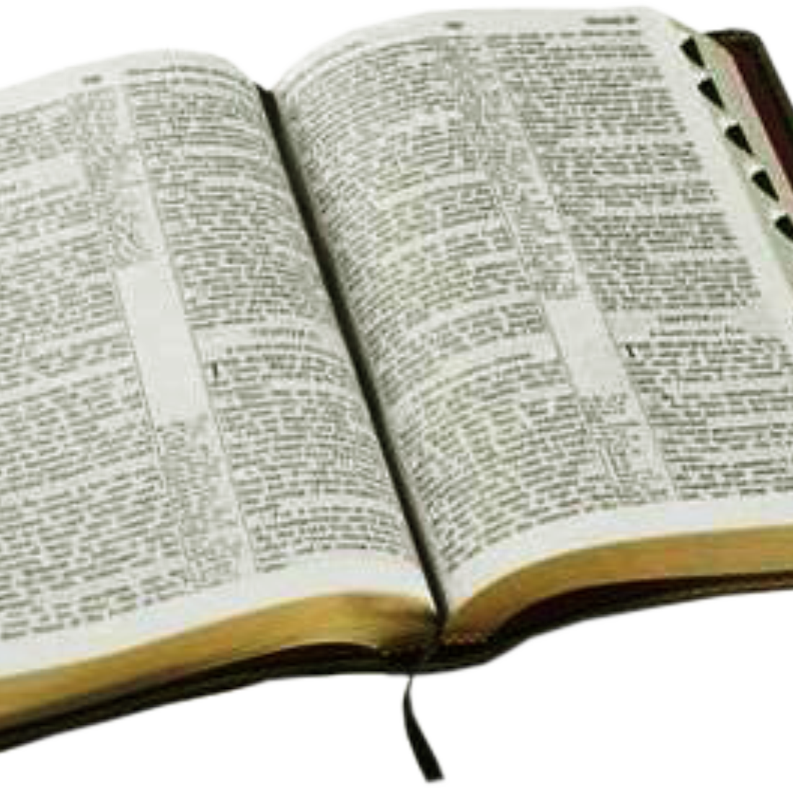
The Dispatcher Saving Power
The saving power is in the word of God
As Christians, we should always be ready for an opportunity to deliver the word
Prayer, fellowship, and time spent in the word keep us filled with the Holy Spirit. (This has been historically proven)
In the Christian Dispensation, this is the way.

Slide 16
Thank you.

