Slide 1
The Dangers of a House Divided Against Itself
Presenter: James R. Wright
Saturday, June 11, 2022

Slide 2
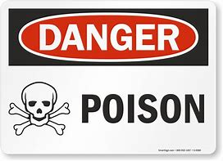
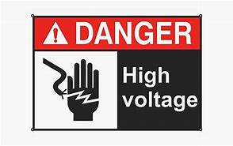
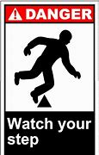
DANGER | BEWARE
Slippery when wet | High Voltage
Flammable | Poison
Contagion | Dogs
Smith & Wesson | At Your Own Risk

Slide 3
The “First” Family’s House
Genesis 4

Slide 4
Acceptable Sacrifice (Worship)
ABEL offered his sacrifice by faith
Obedience = Better Sacrifice = Acceptance
= Righteous Works

Slide 5
FAITH
“So then faith comes by hearing, and hearing by the word of God.”
Romans 10:17
“Show me your faith apart from works [obedience], and I, by my works [obedience] will show you faith.”
James 2:18
”By faith Abel brought God a better offering than Cain did. By faith he was commended as righteous, when God spoke well of his offerings. And by faith Abel still speaks, even though he is dead.”
Hebrews 11:4

Slide 6
Unacceptable Sacrifice (Worship)
CAIN's sacrifice was NOT by faith.
Disobedience = Sin = Rejection = Evil Works

Slide 7
Lack of FAITH
“ not as Cain who was of the wicked one and murdered his brother. And why did he murder him? Because his works were evil and his brother’s righteous.”
1 John 3:12

Slide 8
No Substitutes Accepted
The Problem?
Cain’s Way!

Slide 9
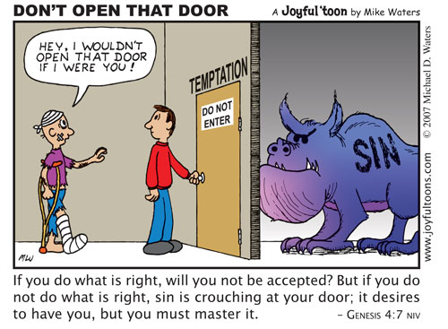
It Can Be Fixed…

Slide 10
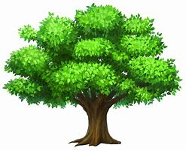
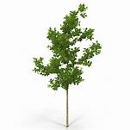
Sin Grows
Envy Genesis 4:4
Anger Genesis 4:5-6
Pride Genesis 4:7
Murder Genesis 4:8

Slide 11
God is merciful to us, too!
Like Cain, we, too, can “master” our temptations…
“No temptation has overtaken you except such as is common to man; but God is faithful, who will not allow you to be tempted beyond what you are able, but with the temptation will also make the way of escape, that you may be able to bear it.” — 1 Corinthians 10:13

Slide 12
DANGER!
“I didn’t know . . .”
“I’m good . . . He’s forgiving.”
“He didn’t tell me NOT to do it!”
Remember Nadab and Abihu in Leviticus 10:1-2
“God knows my heart!”

Slide 13
The consequences can be FATAL
Not everyone who says to Me, ‘Lord, Lord,’ shall enter the kingdom of heaven, but he who does the WILL of My Father in heaven. Many will say to Me in that day, ‘Lord, Lord, have we not prophesied in Your name, cast out demons in Your name, and done many wonders in Your name?’ And then I will declare to them, ‘I NEVER knew you; depart from Me, you who practice lawlessness!’—Matthew 7:21-23

Slide 14
LESSONS LEARNED
Faith comes with ACTION
Follow God's instructions in "the obedience of faith"
See Romans 16:25-27; Hebrews 11:7-8, 17, 28, 30

Slide 15
LESSONS LEARNED
Obeying God is a CHOICE
“I call heaven and earth as witnesses today against you, that I have set before you life and death, blessing and cursing; therefore choose life, that both you and your descendants may live.“
Deuteronomy30:19
Abel chose LIFE
Cain chose DEATH
How about you? Which will you choose?
Notes:
God gives us the test AND He also gives us the answers to the test. (Deuteronomy30:19)
# 2 - How about you? What will you choose?

Slide 16
LESSONS LEARNED
We must worship God according to HIS WORD
“But the hour is coming, and now is, when the true worshipers will worship the Father in spirit and truth; for the Father is seeking such to worship Him. God is Spirit, and those who worship Him must worship in spirit and truth.”
John 4:23-24
Does my worship meet the WORD test?

Slide 17
The answers are in the Book . . .
“Now all these things happened to them as examples, and they were written for our admonition, upon whom the ends of the ages have come.”
1 Corinthians 10:11
“For whatever things were written before were written for our learning, that we through the patience and comfort of the Scriptures might have hope.”
Romans 15:4

Slide 18
CONCLUSION
May we take the lesson of Cain & Abel and see our worship is FOR God and not for us and that it must be according to HIS word!
Just as the difference in the “sacrifice” offered led to division in the 1st Family, don’t let the difference in our “sacrifice” lead to division in God’s Kingdom, the Church

Slide 19
CONCLUSION
Jesus prayed for unity in John 17:20-23
"I do not pray for these alone, but also for those who will believe in Me through their word; that they all may be one, as You, Father, are in Me, and I in You; that they also may be one in Us, that the world may believe that You sent Me. And the glory which You gave Me I have given them, that they may be one just as We are one: I in them, and You in Me; that they may be made perfect in one, and that the world may know that You have sent Me, and have loved them as You have loved Me.”
How will you answer His prayer?

Slide 20
THANK YOU FOR YOUR ATTENTION

