Slide 1
Episode 21: The Saving Power of Christ
God’s Purpose Is the Church
Presenter—Tyrone Jones
Saturday, April 8, 2023

Slide 2
Mission Statement
The mission of the Greenville Avenue Church of Christ is to uphold and defend the sound preaching and teaching of the gospel of Christ, to expose lost souls to God’s plan for salvation, and to assist and encourage individuals to live fully in accordance with the will and glory of God.
Ref: Matthew 28:18-20
2

Slide 3
Today’s Theme
The Saving Power of Christ
3

Slide 4
Romans 8:28-29 NIV
And we know that in all things God works for the good of those who love him, who have been called according to his purpose. For those God foreknew he also predestined to be conformed to the image of his Son, that he might be the firstborn among many brothers and sisters.
4
Notes:
I want to begin by

Slide 5
God’s Purpose Is The Church Romans 8:28
When Christians are faithful to God, He works all circumstances together for their spiritual good.
Those who love God are those who love Him, believe in Him, and obey Him.
Those who were called according to His purpose were called by the Gospel and obeyed it.
God wants every man and woman to become righteous and go to Heaven.
Man must live right, believe, trust, and obey God; God will work all things for man’s ultimate good.
This is a promise!
5
Notes:
This passage is teaching that God is working out His plan. The question is How? Example is Joseph.

Slide 6
God’s Purpose Is the Church Romans 8:29
To understand clearly this context of according to his purpose in verse 28, before man was created, God foresaw that man would sin.
God’s eternal purpose was that man would be saved by the gospel (Romans 16:25-26).
6

Slide 7
We Are Living in the Church Age
The question is what impact will the church have on the generations to come?
How will civilization look back on the church of Christ?
The world must identify something that will separate us from the world’s view of Christianity.
7
Notes:
Something that is scripturally driven and non-negotiable. Today I will share with you some core values.

Slide 8
Core Values
The Saving Power of Christ
8

Slide 9
Core Values
What are core values? They are traits or qualities that are not just worthwhile, but represent an individual's or an organization's highest priorities, deeply held beliefs, and core, fundamental driving forces. They are the heart of what your organization (home) and its employees (family) stand for in the world.
9
Notes:
Therefore the topic today is God’s Purpose is The Church. There are core values or traits that the Church stands firm on and we will discuss these core values today.

Slide 10
Core Value #1 Ephesians 1:22-23
There is only one church for all people. Christ is the only head of the church. The church is the body of Christ.
Even though there are 360 religious groups in the world, one must be in the church to be saved. The church of Christ was established on the day of Pentecost.
Salute one another with an holy kiss. The churches of Christ salute you. Romans 16:16
We have to stand firm, and straight, and teach that there is one church.
10
Notes:
The scriptures does not say or state the church of Baptist, catholic, Pentecostal, methodist, st john, salvation army,.

Slide 11
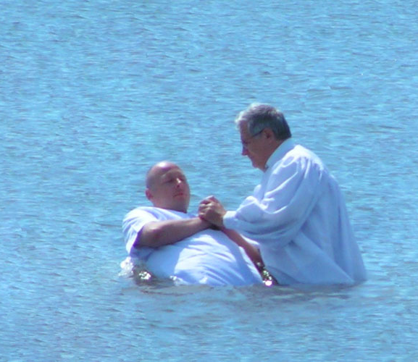
Core Value #2 Baptism
Baptism is for the remission of sins; baptism is essential. In other words, it is mandatory, with no exceptions. Acts 2:38
He that believeth and is baptized shall be saved; but he that believeth not shall be damned. Mark 16:16
11
Notes:
As we move the church forward, we must press the point that baptism is essential – This is non-negotiable.

Slide 12
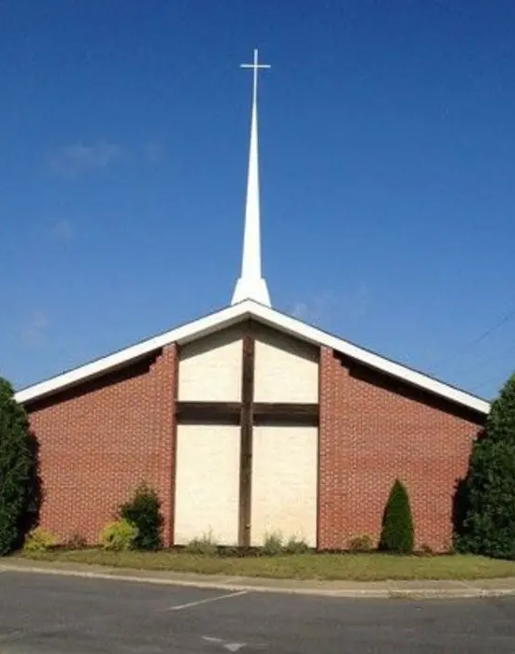
Core Value #3 Assembly
Christians must assemble on the 1st day of the week.
Hebrews 10:25 Not forsaking the assembling of ourselves together, as the manner of some is; but exhorting one another: and so much the more, as ye see the day approaching.
12
Notes:
The assembly is to worship God together, Study God’s word to grow spiritually, and commune with our lord and savior Jesus Christ. This is how we exhort one another. On the contrary, when you do not assemble you can or will be tempted to backslide.

Slide 13
Core Value #4 Communion
The Lord’s Supper is to be administered on the 1st day of every week. There are no exceptions.
Acts 20:7
And upon the first day of the week, when the disciples came together to break bread, Paul preached unto them, ready to depart on the morrow; and continued his speech until midnight.
13
Notes:
The 1st day of the week is a special day of worship for Christians, 2. Christians are to give upon the 1st day of the week. 3. Christians are to partake of the Lord’s supper upon the 1st day of every week.

Slide 14
Core Value #5 The Gospel
The Gospel is the only power on earth to save a lost soul. There is no other power that can save. 1 Corinthians 15-1-4
¹ Moreover, brethren, I declare unto you the gospel which I preached unto you, which also ye have received, and wherein ye stand;
² By which also ye are saved, if ye keep in memory what I preached unto you, unless ye have believed in vain.
³ For I delivered unto you first of all that which I also received, how that Christ died for our sins according to the scriptures;
⁴ And that he was buried, and that he rose again the third day according to the scriptures:

Slide 15
The Gospel Saved
The Saving Power of Christ
15

Slide 16
The Gospel Saved
Pentecost-Acts 2:22 & 36-47
Samaria-Acts 8:4-13
Ethiopian Eunuch- Acts 8:26-39
Paul (Saul)-Acts 9:1-20 & 22:6-16
Cornelius-Acts 10:1-48 & 11:1-18
Lydia-Acts 16:13-15
Philippian jailer- Acts 16:23-34
Corinthians-Acts 18:8
16
Notes:
What did the Gospel do in the 1st century? The Gospel is doing the same thing today in the 21st century.

Slide 17
The Plan of Salvation
The Saving Power of Christ
17

Slide 18
The Plan of Salvation
Hear
Romans 10:17, Matthew 7:24-27
Believe
Hebrews 11:6, Mark 16:15-16 (Not faith only-James 2:24, John 12:42)
Repent
Acts 2:38, 17:30, Luke 13:3
Confess
Matthew 10:32-33, Acts 8:36-37
Be
Be Baptized: See “Baptism "Acts 2:38, Mark 16:16
Remain
Remain Faithful: Revelation 2:10 (See also “Obedience” & “Conversion”)
18

Slide 19
Conclusion
The Saving Power of Christ
19

Slide 20
Conclusion/God’s Purpose Is the Church
Stand firm in the teaching of the Apostles’ Doctrine. Acts 2:42
And they continued stedfastly in the apostles' doctrine and fellowship, and in breaking of bread, and in prayers.
20
Notes:
This is what we must do to continue to press the point that God’s purpose is the Church

Slide 21
Man-Made Doctrines
Founder | Religion
Boniface III | Roman Catholic
Muhammad | Islam
Martin Luther | Lutheran
Henry VIII | Episcopalian
John Calvin | Presbyterian
Robert Browne | Congregational
John Smyth | Baptist
John Wesley | Methodist
Richard Allen | African Methodist
Joseph Smith | Mormon
Charles Taze Russell | Jehovah’s Witnesses
William Miller | Seventh-Day Adventists
Mary Eddy | Christian Science
Stephen Munford | Pentecostal
D.S Warner
C.H Mason
21
Notes:
The apostles continued in the teaching of Jesus Christ.

Slide 22
Core Values of the Church
# One
There is but One Church; Ephesians 1:22-23
# Two
Baptism is essential; Acts 2:38; Mark 16:16
# Three
The Assembly of the saints is vital; Hebrews 10:25
# Four
Communion is on the 1st day of every week; Acts 20:7
# Five
The Gospel is the Saving Power of Christ; 1st Cor 15:1-4
POS
The Plan of Salvation is: Hear, Believe, Repent, Confess, Be Baptized, and Remain Faithful.
22

Slide 23
Thank You for Your Attendance Today!
Receive a Bible answer for a Bible question
Contact Tyrone Jones
Email: tjones@gacoc.org or call: 972.677.2437

