Slide 1
François Ransom
The Power of the Gospel

Slide 2
THE POWER OF THE GOSPEL

Slide 3
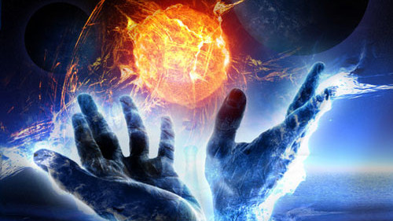
THE GOSPEL DEFINED = GOOD NEWS
Good news is finding a job after you’ve been unemployed for a year
Good news is closing on your first house
Good news is the birth of your first child
Good news is that your covid test came back negative
Good news is the doctor giving you a “clean bill of health”
Good news is finding a suitable donor

Slide 4
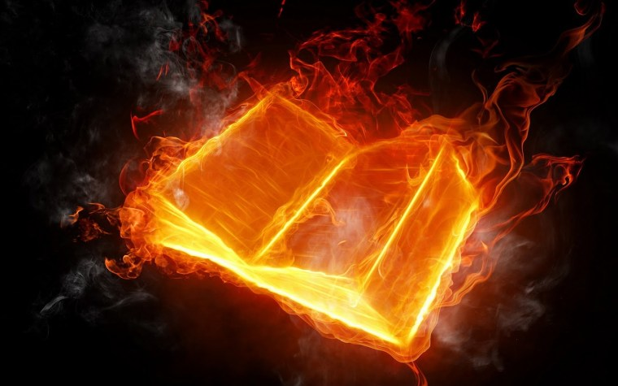
THE POWER BEHIND THE GOOD NEWS
The Power behind the Good News
God
In the Beginning
In Creation
His Word
He Spoke
His Word will never pass away

Slide 5
GENESIS 3:15
And I will put enmity (Hostility / Deep Seated Dislike) between thee and the woman, and between thy seed and her seed; it shall bruise thy head and thou shall bruise his heel.
“First Good News”
First foretelling of The Gospel of Christ
A descendant would deal the Serpent (Satan) a fatal blow to the head
The assertion that the snake would only strike his opponent’s heel foreshadows that Christ’s wounding on the Cross would NOT be permanently fatal

Slide 6
GENESIS 49:10
The Scepter shall not depart from Judah, nor a lawgiver from between his feet, until Shiloh come; and unto him shall the gathering of the people be. (KJV)
Kept by the Elders of all 12 Tribes and was engraved with the name of each Tribe
Symbolized National Sovereignty and the judicial power of God’s people
As long as the Scepter was in place, the Jews could govern themselves, excommunicate one of their own, and administer capital punishment
The legal power of The Sanhedrin was restricted 23 years BEFORE The Trial of Jesus

Slide 7
2ND SAMUEL 7:12-13
God promised David that The Messiah (Jesus) would come through his seed
Jesus would be referred to as “The Son of David” (Mark 10:47-48)
He will build a House for my name
His Throne will be established Forever
The word Forever is repeated twice in 2 Samuel 7:16, which emphasizes that this Prophecy looks beyond The Kings Of Judah and The House Of David
It embraces The Throne of Christ according to the Angel’s interpretation in Luke 1:31-33 . . . The reference to 2nd Samuel is IRREFUTABLE . . .

Slide 8
For I am not ashamed of the Gospel of Christ: for it is the power of God unto salvation to every one that believeth; to the Jew first, and also to the Greek. ~Romans 1:16

Slide 9
CONCLUSION
We have Good News that’s backed up by GOD and his Word
This Good News is the Gospel that comes to us is from Christ himself
How do I access this Good News?
1st Corinthians 15:1-4
The Death
The Burial
The Resurrection

