Slide 1
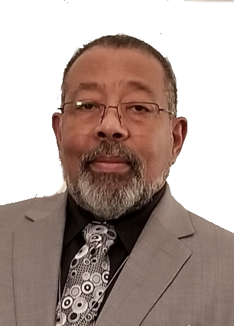
The Power of Faith
Johnny Moore Jr.
The SHARE, Episode 20
Saturday, December 10, 2022

Slide 2
The Power of Faith
Hebrews 11:3
Through faith we understand that the worlds were framed by the word of God, so that things which are seen were not made of things which do appear.

Slide 3
What is faith?

Slide 4
Hebrews 11:1
Now faith is the substance of things hoped for, the evidence of things not seen.
We have heard this scripture all our Christian lives, but what does it mean?
To the New Testament Christian, faith is an act by which he avails himself of the gifts of God and submits himself totally in obedience to God’s will, as it is said in 2 Corinthians 4:2 . . .

Slide 5
2 Corinthians 4:2
But having renounced the hidden things of dishonesty not walking in craftiness nor handling the word of God deceitfully, but by manifestation of the truth commending ourselves to every man’s conscience in the sight of God.

Slide 6
Meaning he rid himself of all thoughts of self and dropped all the things that were done before. He became a child of God and now puts complete trust in God’s holy and divine will; he allows himself to be led by God in all that he does, all that he says, and everywhere he goes.
Without fear of any man, in faith he speaks God’s word because he knows no one can stop him or hurt him if God does not will it; he also has faith that if God allows him to lose his life while serving him, he will find his life.
Notice Matthew 10:28 & 39

Slide 7
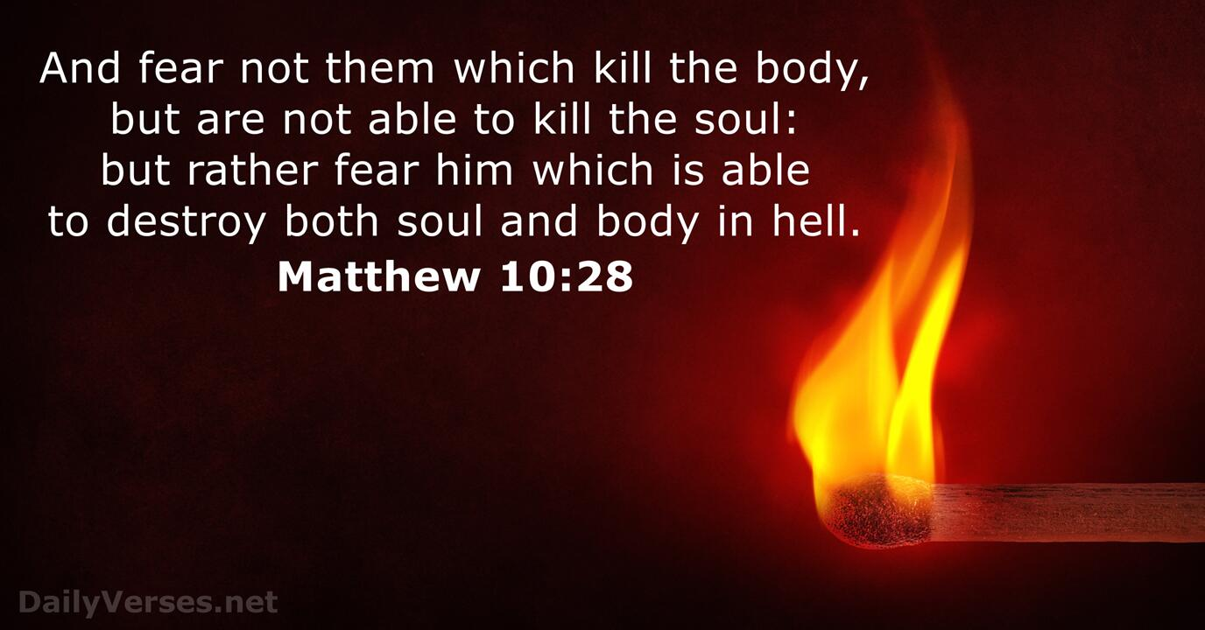

Slide 9
Can faith be misapplied?

Slide 11
James 2:14-17
¹⁴ What does it profit, my brethren, if someone says he has faith but does not have works? Can faith save him? ¹⁵ If a brother or sister is naked and destitute of daily food, ¹⁶ and one of you says to them, “Depart in peace, be warmed and filled,” but you do not give them the things which are needed for the body, what does it profit? ¹⁷ Thus also faith by itself, if it does not have works, is dead.
Most of us have done it.

Slide 12
What do we gain by faith?

Slide 13
Romans 5:1-4
¹ Therefore being justified by faith, we have peace with God through our Lord Jesus Christ: ² By whom also we have access by faith into this grace wherein we stand, and rejoice in hope of the glory of God.
³ And not only so, but we glory in tribulations also: knowing that tribulation worketh patience; ⁴ And patience, experience; and experience, hope:”

Slide 14
Ephesians 2:8 & 9
⁸ For by grace are ye saved through faith; and that not of yourselves: it is the gift of God:
⁹ Not of works, lest any man should boast.

Slide 15
How do we know if we have true faith?

Slide 16
Matthew 21:21-22
²¹ Jesus answered and said unto them, Verily I say unto you, If ye have faith, and doubt not, ye shall not only do this which is done to the fig tree, but also if ye shall say unto this mountain, Be thou removed, and be thou cast into the sea; it shall be done.
²² And all things, whatsoever ye shall ask in prayer, believing, ye shall receive.
*My emphasis*

Slide 17
James 1:5-8
⁵ If any of you lack wisdom, let him ask of God, that giveth to all men liberally, and upbraideth not; and it shall be given him.
⁶ But let him ask in faith, nothing wavering. For he that wavereth is like a wave of the sea driven with the wind and tossed.
⁷ For let not that man think that he shall receive any thing of the Lord. ⁸ A double minded man is unstable in all his ways.

Slide 18
Acts of faith

Slide 19
Acts of Faith
Hebrews 11
⁷ By faith, Noah built an ark.
⁸ By faith, Abraham moved without knowing where he was going.
¹¹ By faith, Sarah had a baby when she was past the age of conception.
¹⁷ By faith, Abraham was ready to sacrifice his son, Isaac.
²³ By faith, Moses’ mother, Jochebed, put him in a basket and put it in the river.
²⁴ By faith, Moses defied Pharaoh.

Slide 20
Acts of Faith
Matthew 9:20
By faith, a woman with an issue of blood for 12 years was healed.
Acts 16:23-34
Paul and Silas were beaten and put in stocks and sat in jail singing, praying, and praising God; they didn’t try to escape when the opportunity came because they had a job to do. This had to be faith.
If you have ever had questions about what true faith is, these are just a few examples.

Slide 21
Conclusion

Slide 22
Faith Plays a Vital Role in God’s Righteousness
Romans 3:21-31
²¹ But now the righteousness of God without the law is manifested, being witnessed by the law and the prophets;
²² Even the righteousness of God which is by faith of Jesus Christ unto all and upon all them that believe: for there is no difference:
²³ For all have sinned, and come short of the glory of God;
²⁴ Being justified freely by his grace through the redemption that is in Christ Jesus:

Slide 23
²⁵ Whom God hath set forth to be a propitiation through faith in his blood, to declare his righteousness for the remission of sins that are past, through the forbearance of God;
²⁶ To declare, I say, at this time his righteousness: that he might be just, and the justifier of him which believeth in Jesus.
²⁷ Where is boasting then? It is excluded. By what law? of works? Nay: but by the law of faith.
²⁸ Therefore we conclude that a man is justified by faith without the deeds of the law.

Slide 24
²⁹ Is he the God of the Jews only? is he not also of the Gentiles? Yes, of the Gentiles also:
³⁰ Seeing it is one God, which shall justify the circumcision by faith, and uncircumcision through faith.
³¹ Do we then make void the law through faith? God forbid: yea, we establish the law.

Slide 25
2 Corinthians 5:20 & 21
²⁰ Now then we are ambassadors for Christ, as though God did beseech you by us: we pray you in Christ's stead, be ye reconciled to God.
²¹ For he hath made him to be sin for us, who knew no sin; that we might be made the righteousness of God in him.”
Hebrews 11:6
⁶ But without faith it is impossible to please him: for he that cometh to God must believe that he is, and that he is a rewarder of them that diligently seek him.”

Slide 26
Thank You!

