Slide 1
The Family of God In the New Testament Acts 2:41-47
Joseph Palmore, presenter Saturday, June 11, 2022 Episode 18

Slide 2
Acts 2:41-44
A growing church

Slide 3
Luke describes the early church in Jerusalem beginning at verse 41 in the second chapter of Acts:
⁴¹ Then they that gladly received his word were baptized: and the same day there were added unto them about three thousand souls.
3,000 were baptized on the day of Pentecost and daily increases to their number occurred thereafter

Slide 4
Verse 42: They continued steadfastly in:
Apostles’ Doctrine
Fellowship
Breaking Bread
Prayers

Slide 5
And fear came upon every soul: and many wonders and signs were done by the apostles.
Acts 2:43

Slide 6
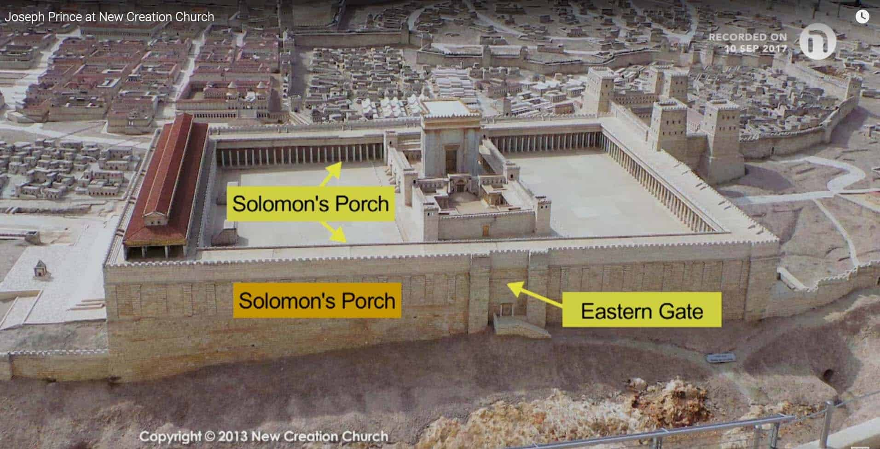
And by the hands of the apostles were many signs and wonders wrought among the people; (and they were all with one accord in Solomon's porch. And believers were the more added to the Lord, multitudes both of men and women.)
Acts 5:12, 14

Slide 7
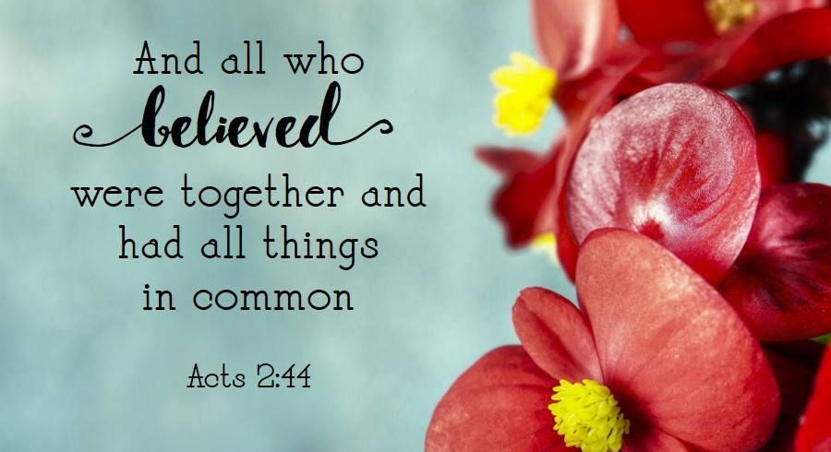

Slide 8
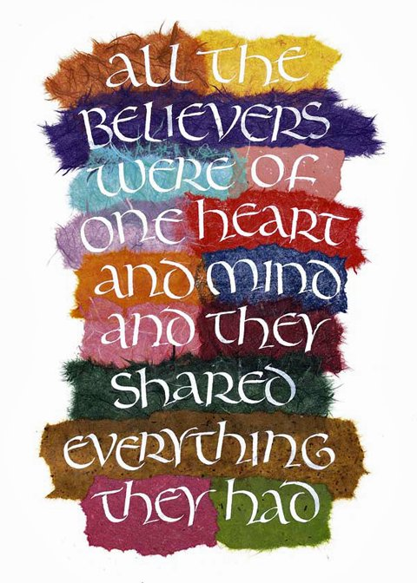
And the multitude of them that believed were of one heart and of one soul: neither said any of them that ought of the things which he possessed was his own; but they had all things common.
Acts 4:32

Slide 9
Acts 2:45-47
A Generous church

Slide 10
Neither was there any among them that lacked: for as many as were possessors of lands or houses sold them, and brought the prices of the things that were sold
Acts 4: 34

Slide 11
And laid them down at the apostles’ feet: and distribution was made unto every man according as he had need.
Acts 4: 35

Slide 12
And sold their possessions and goods, and parted them to all men, as every man had need.
Acts 2:45

Slide 13
They continued daily with one accord in the temple, and breaking of bread from house to house, did eat their meat with gladness and singleness of heart.
Acts 2:46

Slide 14
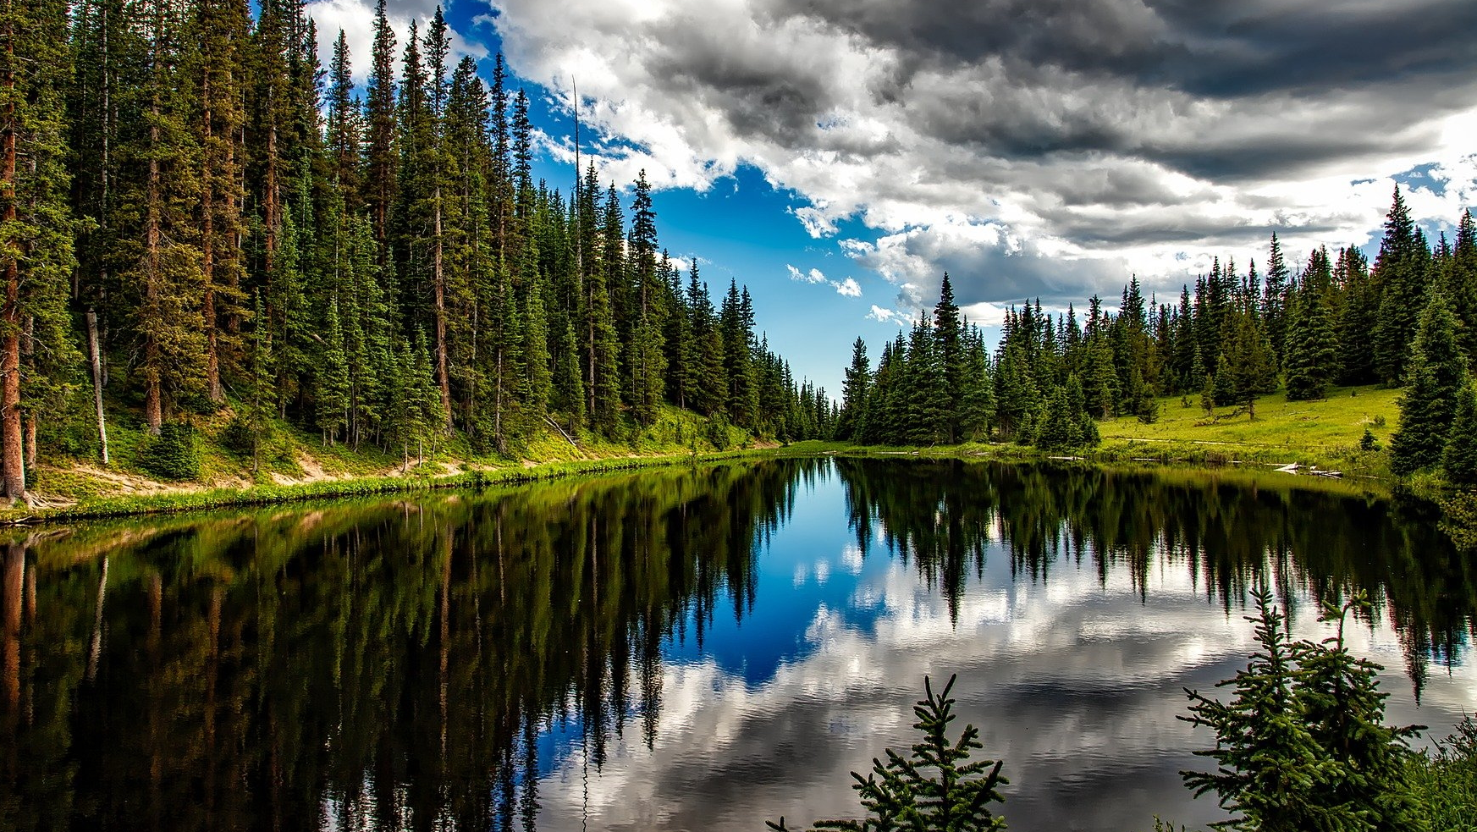
Praising God, and having favor with all the people. And the lord added to the church daily such as should be saved.
Acts 2:47

Slide 15
APPLICATIONS FOR TODAY

Slide 16
Allow God to work in you

Slide 17
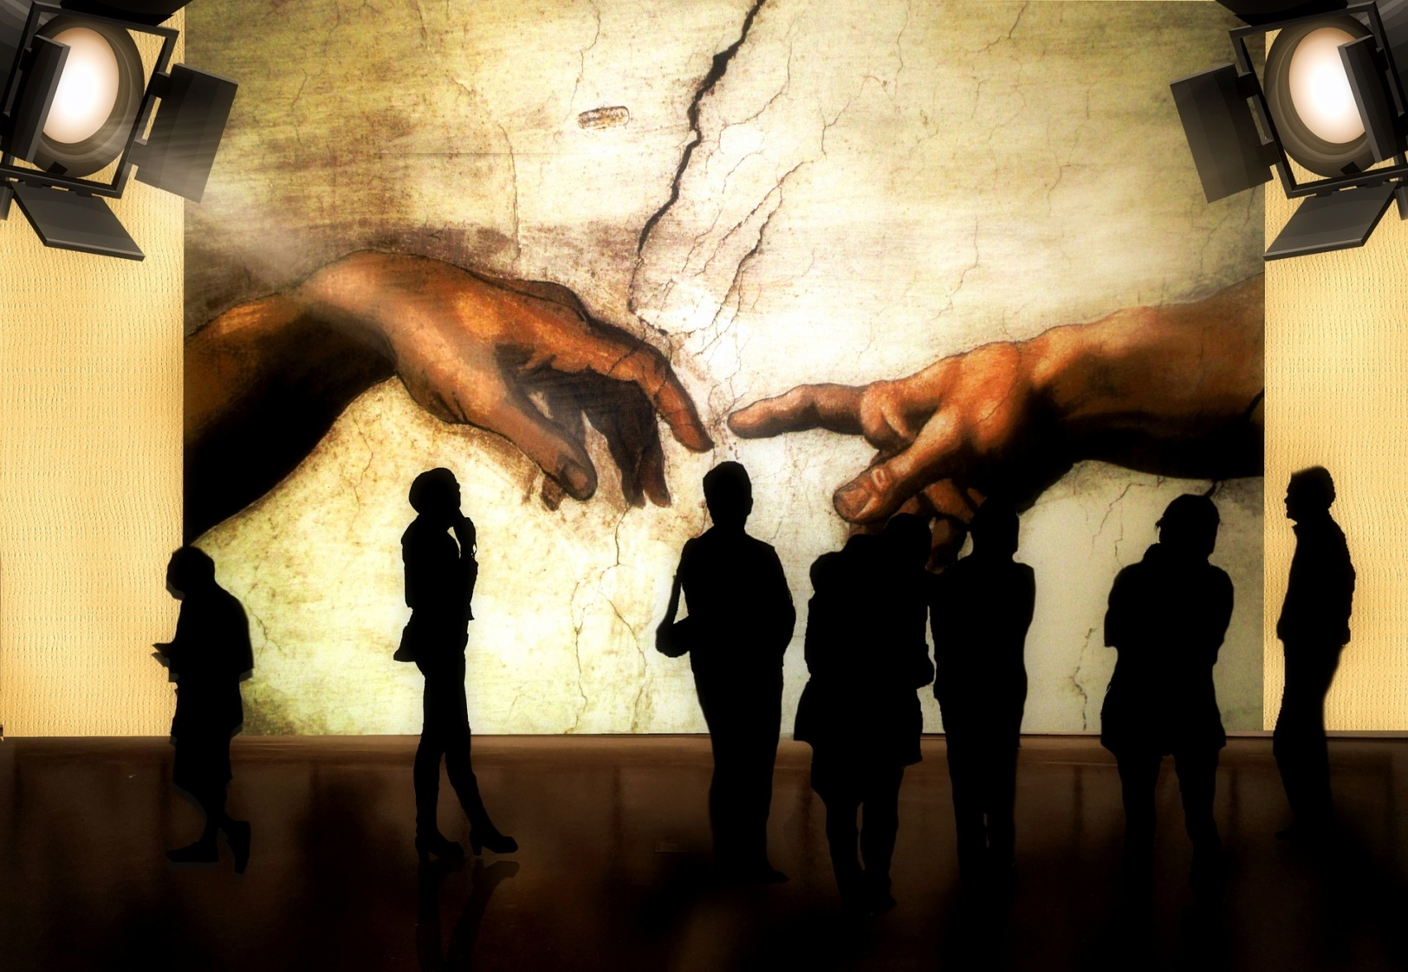
For it is God which worketh in you both to will and to do of his good pleasure. Do all things without murmurings and disputings.
Philippians 2:13-14

Slide 18
Participate in the collection

Slide 19
Will a man rob God? Yet ye have robbed me. But ye say, Wherein have we robbed thee? In tithes and offerings.
Malachi 3:8

Slide 20
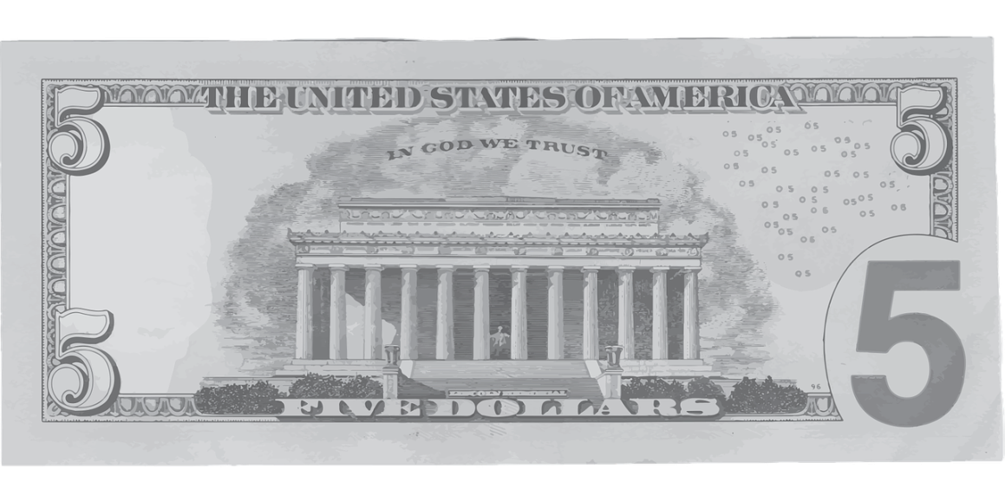
But this I say, He which soweth sparingly shall reap also sparingly; and he which soweth bountifully shall reap also bountifully.
Every man according as he purposeth in his heart, so let him give; not grudgingly, or of necessity: for God loveth a cheerful giver.
2 Corinthians 9:6-7

Slide 21
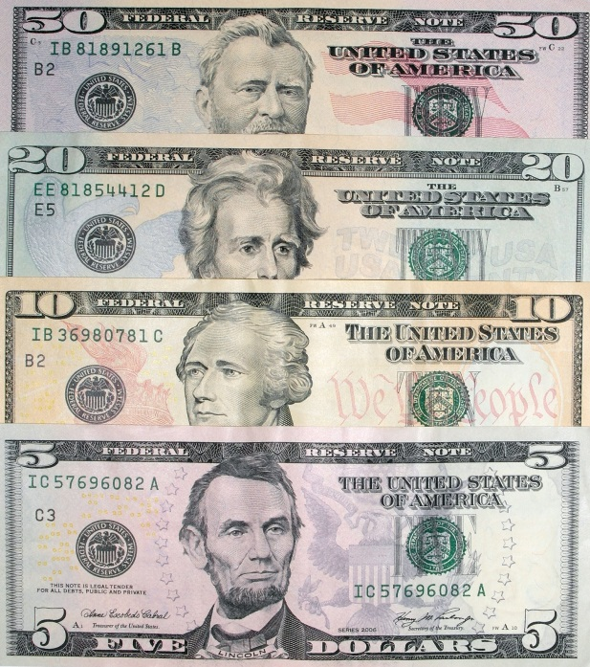
And God is able to make all grace abound toward you; that ye, always having all sufficiency in all things, may abound to every good work:
(As it is written, He hath dispersed abroad; he hath given to the poor: his righteousness remaineth for ever.
2 Corinthians 9:8-9
Sow Bountifully, Give Cheerfully, Abound in EVERY Good Work

Slide 22
Participate in the works of the church

Slide 23
But wilt thou know, o vain man, that faith without works is dead?
James 2:20

Slide 24
seize the opportunity to evangelize

Slide 25
Jesus said . . .
Matthew 28:18-20
All authority has been given to me in heaven and in earth
Go
teach all nations

Slide 26
Jesus said . . .
Matthew 28:18-20
Make disciples
Baptizing them in the name of the Father and of the Son and of the Holy Ghost:

Slide 27
Jesus said . . .
Matthew 28:18-20
teaching them to observe all things I have commanded
And lo I am with you always even to the end of the world.

Slide 28
Thank you

