Slide 1
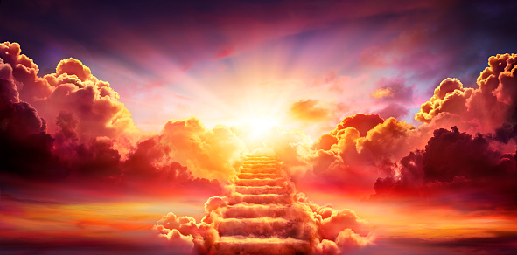
What Trip Are You Planning For?
Larry Washington, presenter
Saturday, March 12, 2022

Slide 2
What Trip Are You Planning For? Luke 16:19-31
Most important-introductory destination decision of your life—Which One Way Trip?
Assigned sub-topics (Destinations)
Heaven
Perdition
Paradise

Slide 3
Destination 1: HEAVEN—A very popular destination
**1. : the expanse of space that seems to be over the earth like a dome : firmament
**2. : a spiritual state of everlasting communion with God
3. : a place or condition of utmost happiness : something that is very pleasant or enjoyable
**NIV – Bible app. mentions Heaven = 346 times in OT; 274 times in NT
Number of Mentions in Bible
 | KJV | NIV | NRSV
OT | 327 | 186 | 246
NT | 255 | 236 | 248
“Heaven.” Merriam-Webster.com Dictionary, Merriam-Webster, https://www.merriam-webster.com/dictionary/heaven. Accessed 10 Mar. 2022.

Slide 4
Destination 2: PERDITION—Not a very popular destination
1a : eternal damnation
b : HELL
2a archaic : utter destruction
b obsolete : LOSS
Number of Mentions in Bible
 | KJV | KJ21 | ASV | AMP/C | NRSV
OT |  |  |  |  | 2
NT | 8 | 1 | 2 | 10
“Perdition.” Merriam-Webster.com Dictionary, Merriam-Webster, https://www.merriam-webster.com/dictionary/perdition. Accessed 11 Mar. 2022.

Slide 5
Destination 3: PARADISE—Another very popular destination
“Paradise.” Merriam-Webster.com Dictionary, Merriam-Webster, https://www.merriam-webster.com/dictionary/paradise. Accessed 11 Mar. 2022.
1a : EDEN
b : an intermediate place or state where the souls of the righteous await resurrection and the final judgment
c : HEAVEN
2 : a place or state of bliss, felicity, or delight
NIV – Bible app. mentions Paradise 3 times, only in NT
Number of Mentions in Bible
 | Voice | TLB | YLT | TPT | MSG | AMP | ERV
OT | 2 | 1 | 2 | 4 | 3 | 1
NT |  | 1 |  |  | 1 | 6 | 1

Slide 6
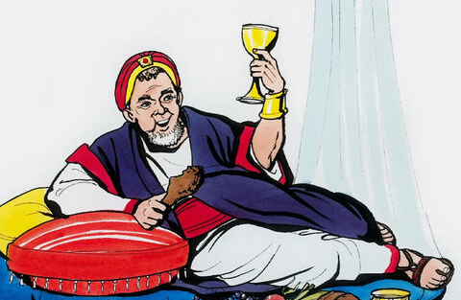
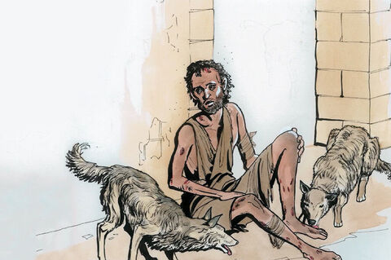
19 “There was a rich man who was dressed in purple and fine linen and lived in luxury every day. 20 At his gate was laid a beggar named Lazarus, covered with sores 21 and longing to eat what fell from the rich man's table. Even the dogs came and licked his sores. 22 "The time came when the beggar died and the angels carried him to Abraham's side. The rich man also died and was buried.
The Rich Man & Lazarus
Luke 16:19-31

Slide 7
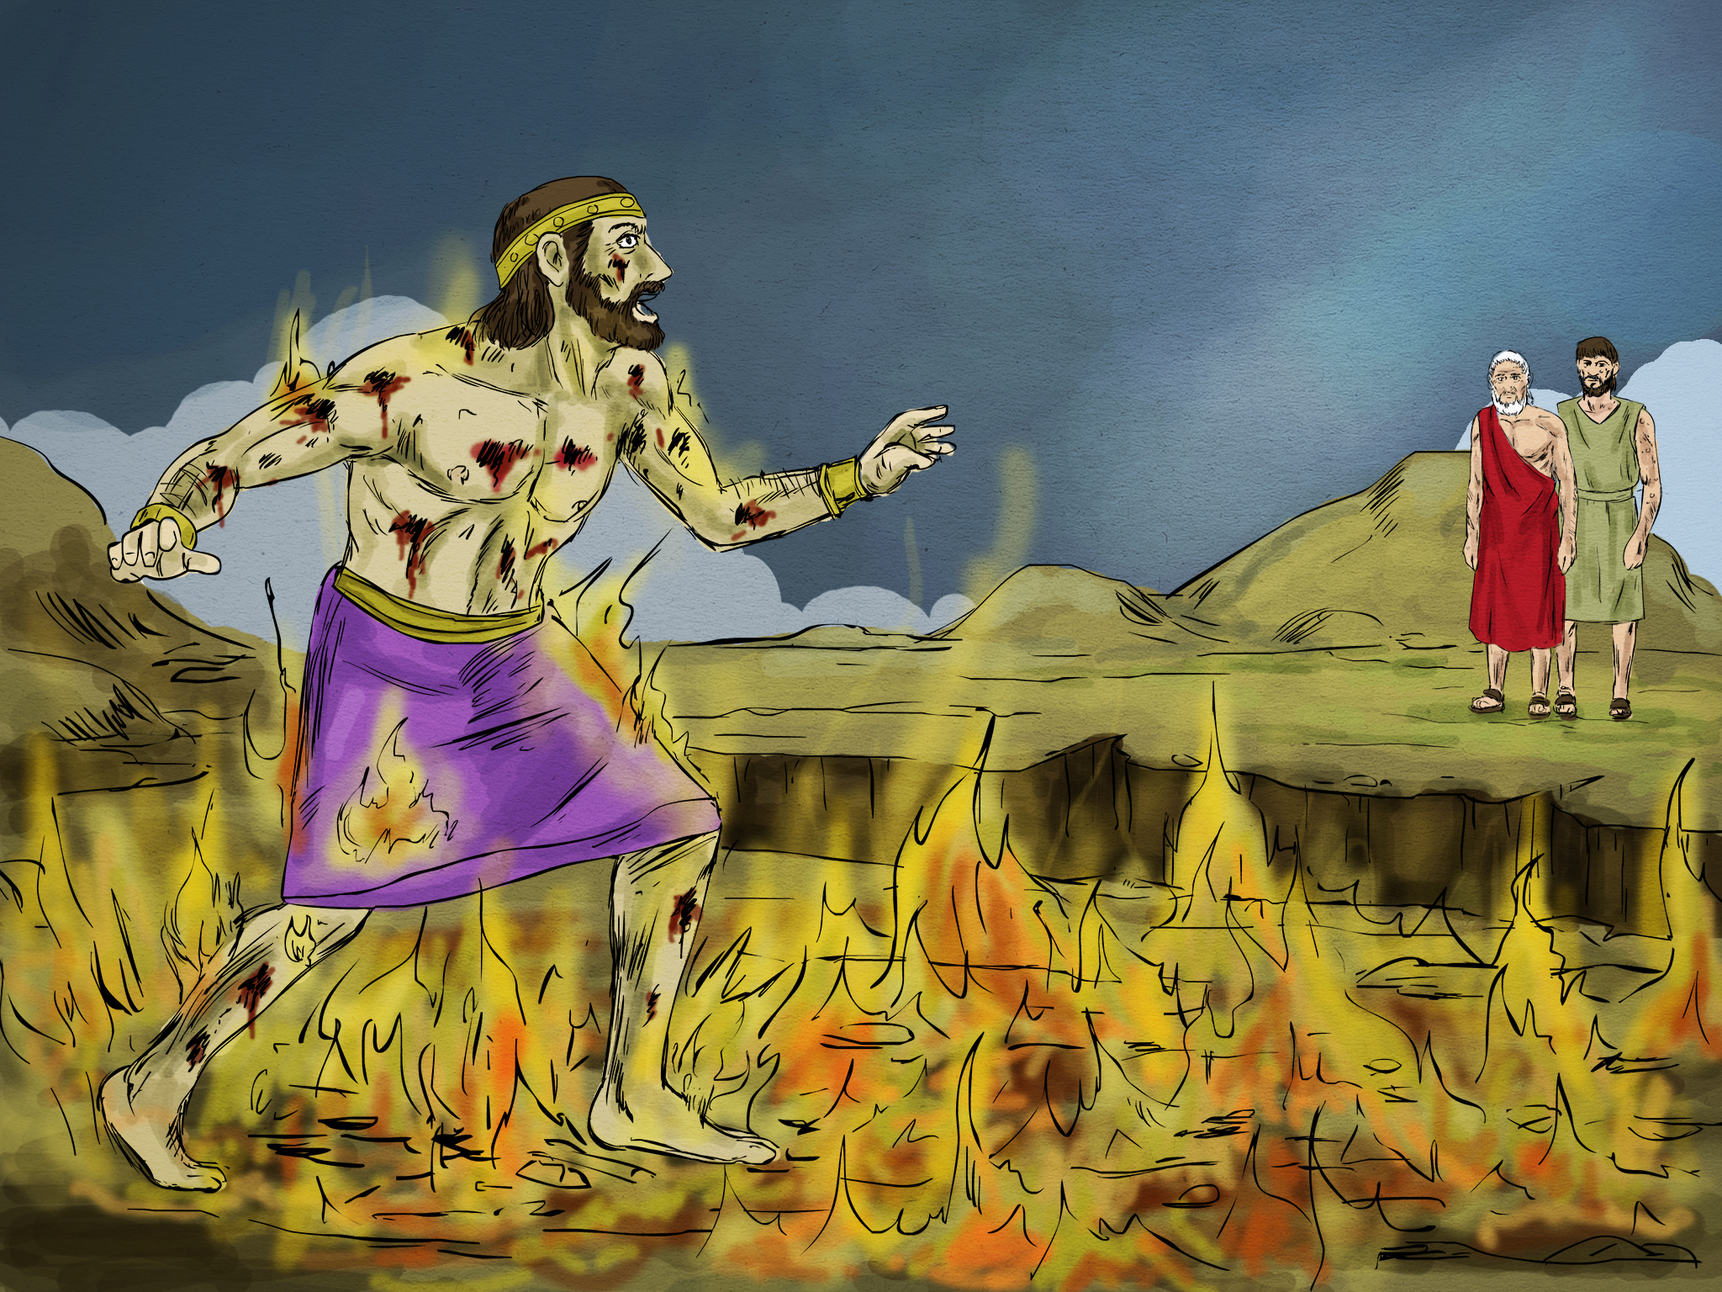
23 In Hades, where he was in torment, he looked up and saw Abraham far away, with Lazarus by his side.
24 So he called to him, 'Father Abraham, have pity on me and send Lazarus to dip the tip of his finger in water and cool my tongue, because I am in agony in this fire.’ 25 "But Abraham replied, 'Son, remember that in your lifetime you received your good things, while Lazarus received bad things, but now he is comforted here and you are in agony. 26 And besides all this, between us and you a great chasm has been set in place, so that those who want to go from here to you cannot, nor can anyone cross over from there to us.'

Slide 8
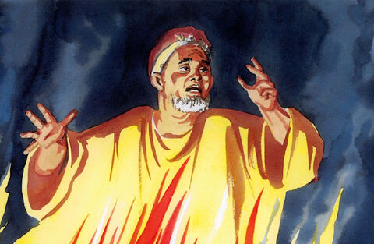
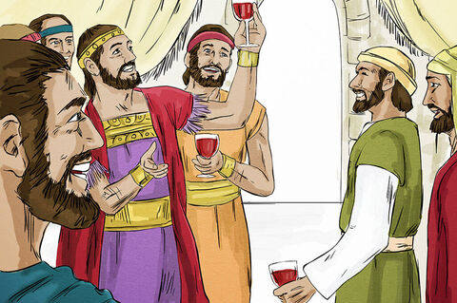
27 “He answered, 'Then I beg you, father, send Lazarus to my family, 28 For I have five brothers. Let him warn them, so that they will not come to this place of torment’ 29 “Abraham replied, ‘They have Moses and the Prophets, let them listen to them” 30 " 'No, father Abraham,' he said, 'but if someone from the dead goes to them, they will repent.' 31 "He said to him, 'If they do not listen to Moses and the Prophets, they will not be convinced even if someone rises from the dead.'

Slide 9
Regarding your most important destination, remember Jesus speaking in Matthew 7:21-23—
21 "Not everyone who says to me, 'Lord, Lord,' will enter the kingdom of heaven, but only the one who does the will of my Father who is in heaven. 22 Many will say to me on that day, 'Lord, Lord, did we not prophesy in your name and in your name drive out demons and in your name perform many miracles?’ 23 Then I will tell them plainly, 'I never knew you. Away from me, you evildoers!‘”

Slide 10
CONCLUSION Which journey are you on? Q&A — 2 mins, if time permits

