Slide 1
The Two-Step Plan
The SHARE Lectures
Tyrone Jones, presenter Saturday, March 12, 2022

Slide 2
The Rescue Mission: Lifeguard
This Photo by Unknown Author is licensed under CC BY-SA

Slide 3
The Emergency Call
First Responders

Slide 4
The Two-Step Plan
Purpose: To bring a person out of what they are going through in order to bring them into a path of righteousness

Slide 5
Looking Back into History
Noah / Family—Genesis Chapters 6-9 (Act of Wickedness)
Abraham / Lot-Sodom and Gomorrah— Genesis 19:1-28 (Act of Wickedness)
Joseph / Family—Genesis 37 (Joseph sold into Slavery as a result of Envy and Jealousy)
Children of Israel / Freed from Egyptian Bondage Exodus 11-12
This principle is also relevant to those who are not in the body of Christ.
FACT: There are invariably challenges that God uses to bring His people out of circumstances in order to lead them into a better situation

Slide 6
The Nation of Israel / Better Known as the National Religion
The Nation was disobedient to God’s word
They experienced the “Stagnant Syndrome,” a terrible state to be in

Slide 7
What Occurs in a Stagnant State of Mind:
The perfect time to think and reflect
You’re in a state of frustration
You’re angry
You’re disappointed
You’re experiencing anxiety

Slide 8
Saul of Tarsus—Who Is This Person?
Paul, orig. Saul, (born 5 AD, Tarsus in Cilicia—died 67 AD, Rome); early Christian missionary and theologian, known as the Apostle to the Gentiles
Born a Jew in Tarsus, Asia Minor
He was trained as a rabbi but earned his living as a tentmaker
A Jewish scholar or teacher, especially one who studies or teaches Jewish law
A ZEALOUS Pharisee
He persecuted the first Christians until a vision of Jesus, experienced on the road to Damascus, converted him to Christianity Acts: 9:1-19

Slide 9
Zeal, Zealous, Zealot Defined
Zeal noun \ \ ˈzēl: eagerness and ardent interest in pursuit of something : fervor
Zeal implies energetic and unflagging pursuit of an aim or devotion to a cause.
Zealous adjective \ \ ˈze-ləs: marked by fervent partisanship for a person, a cause, or an ideal : filled with or characterized by zeal
Zealot noun \ \ ˈze-lət: : a zealous person especially a fanatical partisan
Capitalized : a member of a fanatical sect arising in Judea during the first century A.D. and militantly opposing the Roman domination of Palestine
Merriam-Webster.com Dictionary, Merriam-Webster, https://www.merriam-webster.com/dictionary/zealot. Accessed 9 Mar. 2022.

Slide 10
Saul of Tarsus
At his circumcision, he was given the Hebrew name Saul; at a young age his parents sent him to Jerusalem to be instructed in the Mosaic Law under the greatest Rabbi of his time, Gamaliel
Saul was an excellent student and as a Pharisee was respected for his great intellect and ZEAL for the Jewish faith and traditions
Because the Jews had a rule that their children should learn a trade along with their studies, Saul learned to make tents
Again, Saul was Zealous

Slide 11
Saul Was a ZEALOUS Jew
Because of Saul’s great zeal for Jewish law and traditions, he was very upset about his Jewish brethren who were following the New Way, as Christianity was first called
Thinking that he was serving God, Saul became the worst enemy of Christians
He hunted them down and dragged them out of their homes, imprisoning them and even having them killed

Slide 12
Romans 10:1-3
Brothers, my heart’s desire and prayer to God for the Israelites is for their salvation.
For I testify about them that they are zealous for God, but not on the basis of knowledge.
Because they were ignorant of God’s righteousness and sought to establish their own, they did not submit to God’s righteousness.

Slide 13
Obedience Is Paramount: The Mosaical Dispensation
Obedience commanded-Deuteronomy 4:1
Now, Israel, hear the decrees and laws I am about to teach you. Follow them so that you may live and may go in and take possession of the land the Lord, the God of your ancestors, is giving you.
Walk in obedience -Deuteronomy 5:33
Do all that the Lord your God has commanded you, so that you may live and prosper and prolong your days in the land that you will possess.
Deuteronomy 8:6
Observe the commands of the Lord your God, walking in obedience to him and revering him.

Slide 14
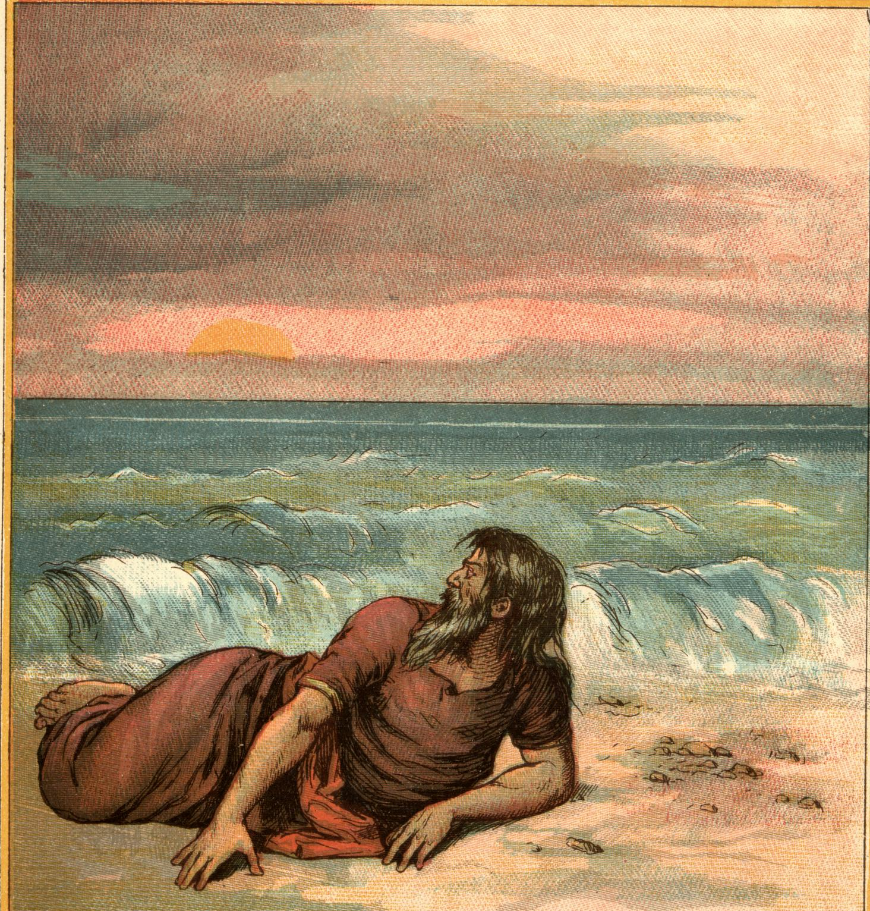
Personal Plans vs God’s Plan: Jonah 1-4
Jonah
People Can Run, But They Cannot Hide From God

Slide 15
Obedience Is Paramount: The Christian Dispensation
Romans 1:5
Through him we received grace and apostleship to call all the Gentiles to the obedience that comes from faith for his name’s sake.
Romans 5:19
For just as through the disobedience of the one man the many were made sinners, so also through the obedience of the one man the many will be made righteous.
Romans 16:26
but now revealed and made known through the prophetic writings by the command of the eternal God, so that all the Gentiles might come to the obedience that comes from faith—

Slide 16
Common Struggles of Life 1 John 2:16
PRIDE: Unrestrained appreciation of our own worth
GREED: Immoderate desire for earthly goods
LUST: Hankering for impure pleasures
ANGER: Inordinate desire for revenge
GLUTTONY: Unrestrained use of food and drink

Slide 17
Let Go, Let God
FACT- You’ve tried everything, and you still don’t know where you are going or how to resolve your problem
Maybe you thought a good education would make a way for you
Maybe you thought your friends would make a way for you
Maybe you thought your family would make a way for you
Maybe you thought your boss would make a way for you
It’s time to give God the opportunity to show you what He is capable of doing in His way. You’ve tried everything else
God is ready to bring you out that He might bring you in!

Slide 18
The Road to Perdition
Are you on the road to Damascus thinking you are doing the right thing as Saul of Tarsus thought. If so . . .
You have a ZEAL for doing right, but you lack knowledge.
Matthew 7:21-23
²¹ “Not everyone who says to me, ‘Lord, Lord,’ will enter the kingdom of heaven, but only the one who does the will of my Father who is in heaven. ²² Many will say to me on that day, ‘Lord, Lord, did we not prophesy in your name and in your name drive out demons and, in your name, perform many miracles?’ ²³ Then I will tell them plainly, ‘I never knew you. Away from me, you evildoers!’

Slide 19
The Circle of Influence/Opposition
If a person is not going your way, they are in your way.
Get out of there!!!!
Let It Go!!!
Proverbs 4:14-15
^{14.} Do not set foot on the path of the wicked or walk in the way of evildoers. ¹⁵ Avoid it, do not travel on it; turn from it and go on your way.

Slide 20
Conclusion
The Two-Step Plan
Attention!
God is on deck, and He wants to bring you out that He might bring you in.

Slide 21
Establish a Strong Foundation
HEARING: Romans 10:17—So then faith cometh by hearing, and hearing by the word of God.
BELIEVING: Hebrews 11:6—But without faith it is impossible to please him: for he that cometh to God must believe that he is, and that he is a rewarder of them that diligently seek him.
FOUNDATION: 1 Corinthians 3:11—For other foundation can no man lay than that is laid, which is Jesus Christ.
REWARDER: Hebrews 11:6—He is a rewarder of them that diligently seek him.

Slide 22
Thank You for Your Attendance Today!
Continue to Pray for our Church Family

