Slide 1
THE TERRIBLE STATE OF SIN
Genesis 12-19; Genesis 6
Jim Adams, presenter
Saturday, March 12, 2022

Slide 2
Notes:
INTRO: We are all sojourners on the road of life. All along the way, we keep running into tons of forks and bumps in the road, which leads from earth to glory or eternal damnation. So, whatever you do or think, please make no mistake--we all stumble and sometimes we will fall.
Matthew 7:13-14; 2 gates the wide/broad and the strait/narrow
Today, I would like to invite your attention to a very familiar story of a biblical family much like yours and mine.
For the sake of time, I will paraphrase many of the scriptures.

Slide 3
1. Missing the Mark
a. Reasons for Missing the Mark
1. Mentally Unprepared
2. Physically Unprepared
3. Tactically Unprepared
2. Transgressing the Law
a. God’s Covenant
1. I Will Do This
2. You Will Do That
3. If Not, I Will or Will Not Do This or That
3. The Sting of Death (Iniquity)

Slide 4
However, before I continue, let me insert a
Disclaimer

Slide 5
Please don't judge me for the things I am about to say. Much of what I will say is from my experience. Thank God many of us are not what we used to be, and many of us are still a work in PROGRESS.
Paul writes in I Timothy 1:15 about being a sinner, of which he said he was the chief; many of us can relate. So, you see, Paul didn't have any false illusions about who he was, nor WHOSE he was because he knew where he came from.

Slide 6
In Life, We Have One Main Responsibility
Often people get caught up in situations unbeknownst to them through
1. Following the Wrong Advice
2. Curiosity
3. Unexpected Circumstances
4. Being Too Smart for Our Good
5. Lack of Knowledge (Ecclesiastes 12:13)

Slide 7
The State of Conditions

Slide 8
What is the commonality of the current State of
Emotions?
Affairs?
Being?
(the) Union?
Mind?
Finances?
Texas?
SIN
They all refer to current conditions. However, with time and commitment, most things can change.

Slide 9
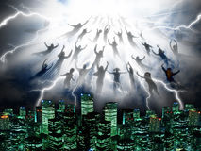
Picture the Reality of the Sting of Death
Notes:
A brief story of the Children of Israel headed to the Promised Land and how only two completed the journey (Deuteronomy 1:35-36)
Achan, after the great battle, lost to the small country of Ai (Joshua 7:1-5) after being instructed what to do and not to do

Slide 10
Sometimes we will ‘Miss the Mark’
Seek Ye the Strait Way
Seek Ye First the Kingdom of God
The Terrible State of Sin (TTSOS) Allured Folks During Biblical Days
David

Slide 11
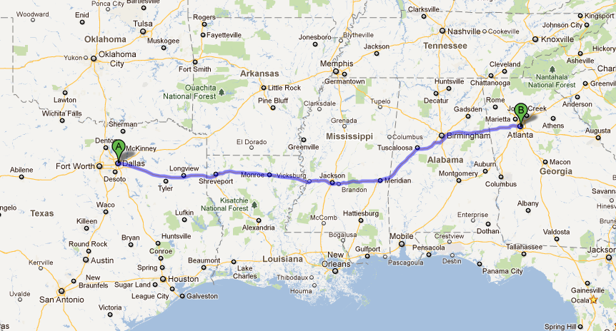
A Simple Road Trip from Dallas, TX to Atlanta, GA

Slide 12
You Need to Make Plans for Your Trip . . .
Where are you going, and how long do you plan to stay?
How will you get there? Drive? Fly? Hike?
What will you to take with you? Cash? (How much?) Credit cards? (Which ones?) Clothes? (How’s the weather?)
Best source of directions? Map? GPS? Memory?
Planned pit stops?
In case of emergencies?

Slide 13
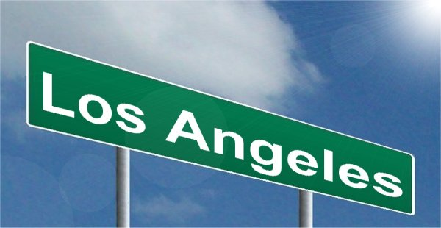
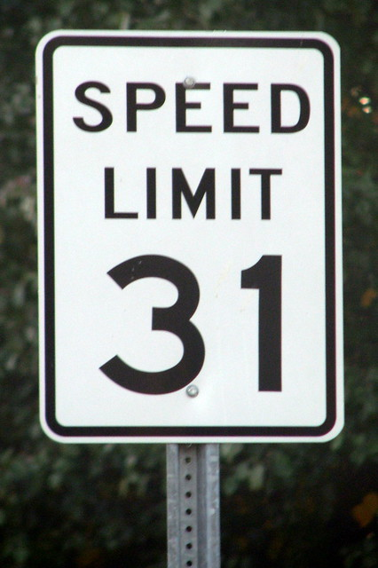
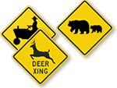
On the road, you must pay attention to road signs

Slide 14
Once we hit the great state of Alabama, we MAY FIND ourselves in TTSOS

Slide 16
NOW YOU FIND YOURSELF IN A BIG BALL OF CONFUSION, WHICH BECOMES THE RESCUE MISSION

Slide 17
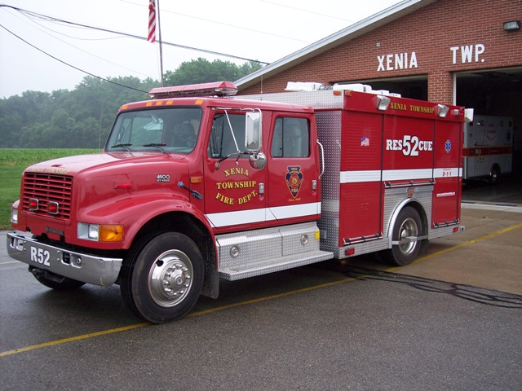
911 CALL FOR HELP

Slide 18
THE RESCUE MISSION
THE TERRIBLE STATE OF SIN
(Ball of Confusion)

Slide 19
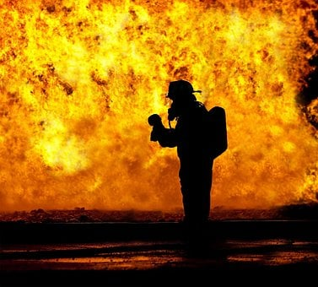
WHAT IS A RESCUE MISSION? Answering the call for help.

Slide 20
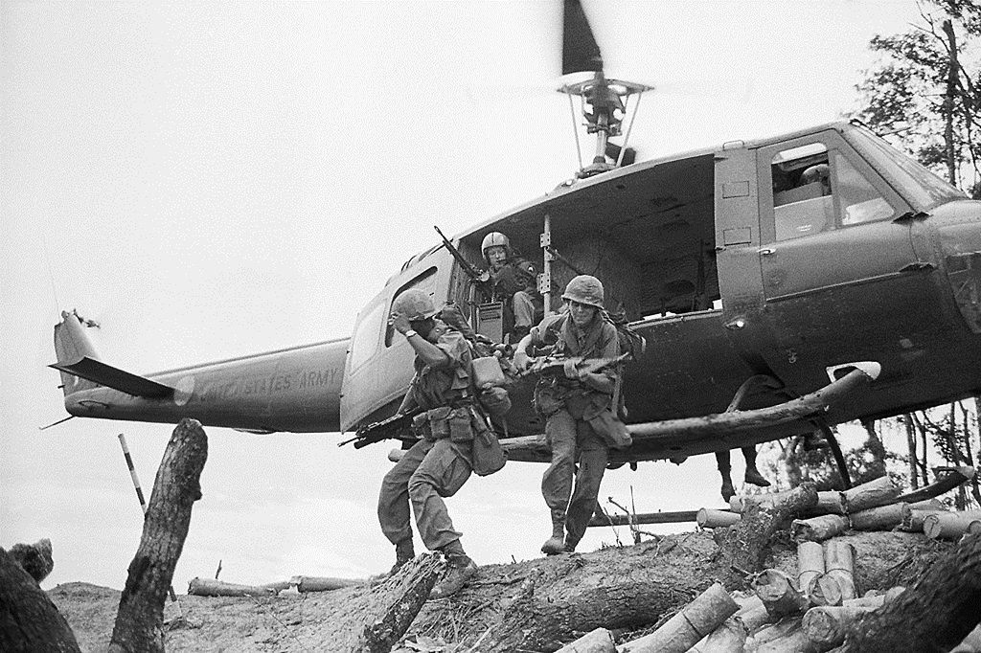
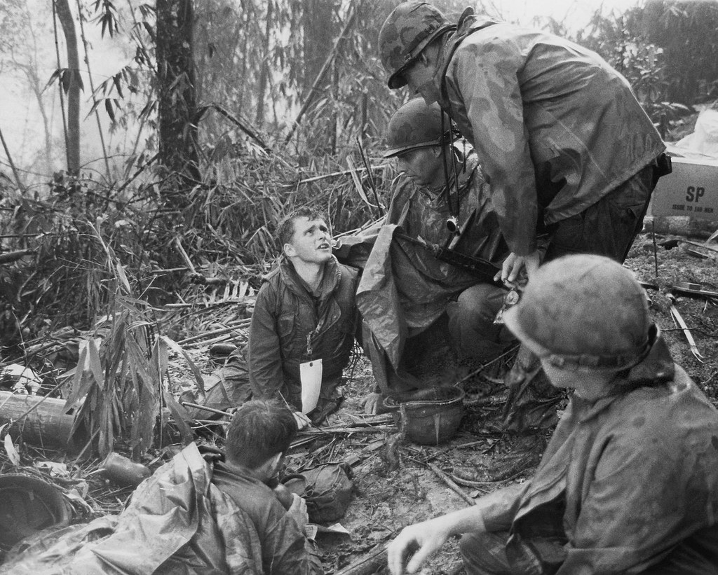
VIETNAM 1969
This Photo by Unknown author is licensed under CC BY.
On May 10, 1969, a small scout team was sent out to observe reported North Vietnamese moving south along the Ho Chi Minh Trail in the jungles of the mountain range. This observation led to the battle of Hamburger Hill, which started as a recon mission and changed to a rescue mission, one of the most significant battles of the Vietnam Conflict/War.
This Photo by Unknown author is licensed under CC BY.
This Photo by Unknown author is licensed under CC BY.

Slide 21
The Battle of Hamburger Hill

Slide 22
What was observed during the RECON part of the mission?
Nothing was as it appeared to be
Underground bunkers, caves, and tunnels
Large numbers of regular soldiers

Slide 23
Getting Ready for the Mission
Prepare for the Journey God always has a way of preparing us for what is ahead
(Observe the Warning Signs) Equipment Destination Pit stops

Slide 24
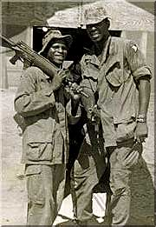
Knowledge of the Mission
Understand Your Mission: Deuteronomy 4
Put on the Whole Armor of God
Many Times, There Are No Repeats or Reset Buttons in Life
COMMUNICATION SIGNALS

Slide 25
Life’s Journey NUGGETS
Job, “Man born of a woman . . .”
James, “Life is like a vapor . . .”
Moses refused to be called the son of Pharaoh’s daughter. Instead, he chose to suffer affliction rather than enjoy the pleasure of sin for a season
Luke, “The Prodigal Son”
Making Preparation for the Journey
God always has a way of preparing us for what is ahead. (Observe the warning signs)
Equipment
Destination
Pit stops

Slide 26
“
We must see success not only as a destination but also as a journey that is constantly filled with adventure and challenges. If we are willing to meet those challenges, then we can live life to the fullest.
Dr. Willie Jolley, Motivational Speaker

Slide 27
Every morning, a gazelle wakes up. It knows it must outrun the fastest lion or it will be killed.
Every morning, a lion wakes up. It knows it must run faster than the slowest gazelle, or it will starve.
It doesn't matter whether you're the lion or the gazelle—when the sun comes up, you'd better be running.
- African Proverb

Slide 28
How does one get into TTSOS? BY NOT RECOGNIZING THE SIGNS!
Fishing Lures of Sin
False Delusion Psalm 62:9
Lifestyle, Illusion
A Sheep in Wolf’s Clothing
Perception
Sometimes MLM can give you a false illusion. The old folk used to say, “Everything that glitters ain’t gold.”
One size fits all
THE TRAPPINGS OF SIN
Idle Time: “An idle mind is the devil’s workshop.”
Something the eyes can see and desire
Satan knows our weaknesses

Slide 29
The Rescue Process
SELF EXAMINATION
“Brothers and sisters, if a person gets trapped by wrongdoing, those of you who are spiritual should help that person turn away from doing wrong. Do it in a gentle way. At the same time watch yourself so that you also are not tempted.”‭‭
Galatians‬ ‭6:1‬ ‭GW‬‬2
Be Ready to Tell Your Story of How God Brought You Out
For we all have sinned and come short of the glory of God
Romans 3:23

Slide 30
Put on All the Armor That God Supplies.
“
Ephesians 6:11

Slide 31
“In this way you can take a stand against the devil’s strategies. This is not a wrestling match against a human opponent. We are wrestling with rulers, authorities, the powers who govern this world of darkness, and spiritual forces that control evil in the heavenly world. For this reason, take up all the armor that God supplies. Then you will be able to take a stand during these evil days. Once you have overcome all obstacles, you will be able to stand your ground. So then, take your stand! Fasten truth around your waist like a belt. Put on God’s approval as your breastplate. Put on your shoes so that you are ready to spread the Good News that gives peace. In addition to all these, take the Christian faith as your shield. With it you can put out all the flaming arrows of the evil one. Also take salvation as your helmet and God’s word as the sword that the Spirit supplies.”‭‭
Ephesians‬ ‭6:12-17‬ ‭GW‬‬2

Slide 32
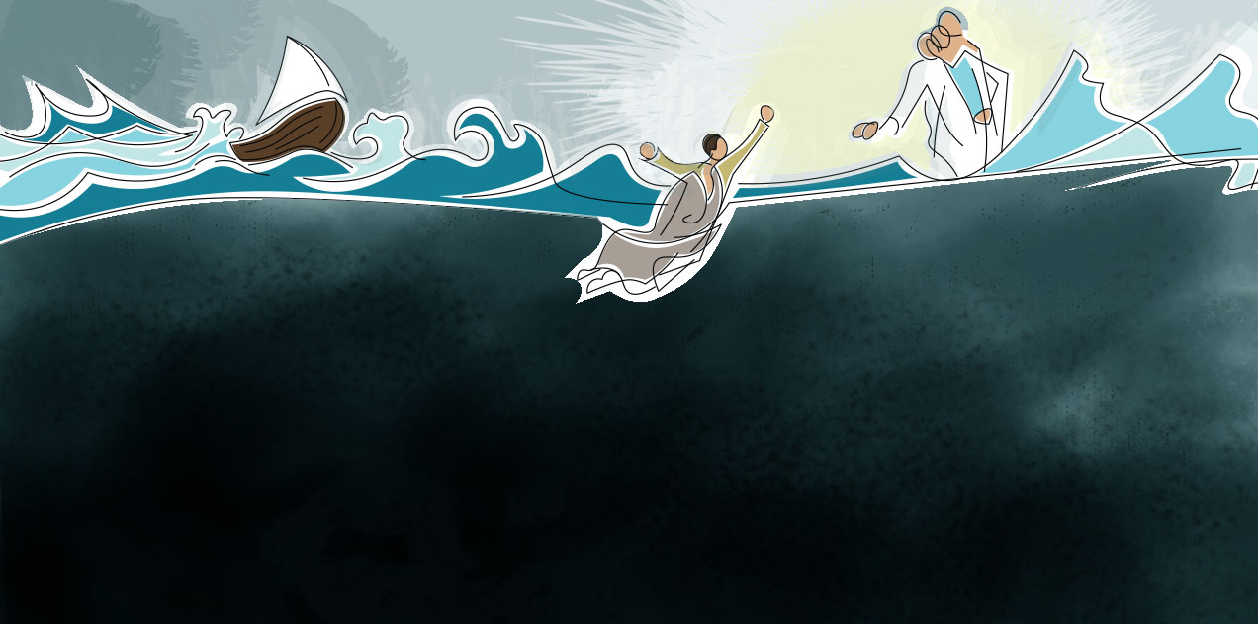
He said, “Come.” So Peter got out of the boat and walked on the water and came to Jesus. But when he saw the wind, he was afraid, and beginning to sink he cried out, “Lord, save me.” Jesus immediately reached out his hand and took hold of him, saying to him, “O you of little faith, why did you doubt?” And when they got into the boat, the wind ceased.
Matthew 14:29-32

Slide 33
The Recovery Process, part 1
Repent. Seek God’s forgiveness.
It may take some time before you are ready to hit the playing field.
Try not to concern yourself with what others may say or think.
Observe/Listen to older people. Nine times out of 10, they have been where you are trying to go. Plus, they are duty-bound to share the path they laid with you.

Slide 34
The Recovery Process, part 2
Know I Corinthians 10:13
1. God is faithful
2. He will always make a way of escape. Revisit your first principles.
Get a Prayer Partner
You might try meditating or fasting
Toughen your spiritual skin. Sometimes church people have a hard time forgiving or letting you live down your past.

Slide 35
CONCLUSION
When you get tired of fighting the will of God,
When you get tired of the humdrum rat race on the hamster wheel,
When you get tired of climbing the ladder of success to find once you get to the top, your ladder was on the wrong building,
When you get tired of failed relationships,
When you get tired of those sleepless nights worrying about things that are out of your control,

Slide 36
CONCLUSION
When you get tired of just being tired!!!!!
Remember the words of Jesus
1. Matthew 11: 28-30 “Come unto me,”
2. Revelation 3:20 “Behold, I stand at the door”
Finally, the story of the “Ball of Life”
The moral of the story is “Keep that ball rolling!”

Slide 37
THERE IS A WAY TO ESCAPE I Corinthians 10:13
You must be willing to do your part to assist in the Rescue Mission.
Can’t you hear the small, quiet voice? The call coming through the brick wall of sin, just across the state line?
THE GOOD

Slide 38
Mission Complete: RECOMMENDATIONS
Know what sin is
Study, Know, and Understand God’s word and Plan for your life
Observe/Listen to older people. Nine times out 10 they have been where you are trying to go. Plus, they are duty-bound to share the path they laid.
Know I Corinthians 10:13
1. God is faithful
2. There is a way of escape

Slide 39
Mission Complete: RECOMMENDATIONS
Maintain a healthy diet
I Corinthians 3:1-2 – Milk rather than Meat
I Peter 2:1-3 – the Sincere Milk of the word
Hebrews 5:12-14 – Milk not Strong Meat

Slide 40
