Slide 1
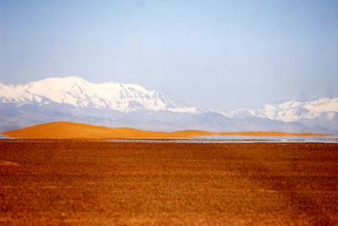
Defending the Gospel
Against False Prophets
Safeguarding the Faith
II Thessalonians 2:3-4 I Timothy 4:1-16
Chad Stoker, presenter

Slide 2
Learning Targets
Participants will examine the Gospel and its tremendous value
Participants will explore what the Old and New Testaments say regarding False Teachers / False Doctrine
Participants will review biblical truths that can equip in protecting the Gospel

Slide 3
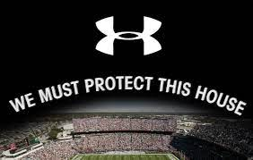

Slide 4
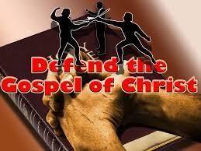
Why Should We Defend the Gospel?
God’s Grace is revealed in the Gospel

Slide 5
Romans 5:6-8
For when we were still without strength, in due time Christ died for the ungodly. For scarcely for a righteous man will one die; yet perhaps for a good man someone would even dare to die. But God demonstrates His own love toward us, in that while we were still sinners, Christ died for us.

Slide 6
Why Should We Defend the Gospel?
The Gospel Has the Power to Save the World
Romans 1:16-17
For I am not ashamed of the gospel of Christ, for it is the power of God to salvation for everyone who believes, for the Jew first and also for the Greek. For in it the righteousness of God is revealed from faith to faith; as it is written, “The just shall live by faith.”

Slide 7
Will you allow the Grace of God and the Hope of Salvation to
a) Inspire b) Trigger c) Persuade d) Stimulate you to defend the Gospel of Christ?

Slide 8
False Prophets in the Old Testament
Prophet - a prophet (or seer) is one inspired by God through the Holy Spirit to deliver a message
False Prophets - people who claim to speak on behalf of God but have their own agendas

Slide 9
What Makes False Prophets/Teachers Popular Then and Now?
Isaiah 30:9-11
9 That this is a rebellious people, lying children, children who will not hear the law of the Lord;
10 Who say to the seers, “Do not see,” And to the prophets, “Do not prophesy to us right things; speak to us smooth things, prophesy deceits.
11 Get out of the way, turn aside from the path, cause the Holy One of Israel to cease from before us.”

Slide 10
How Were False Prophets Described in the Old Testament?
Jeremiah 14
12 When they fast, I will not hear their cry; and when they offer burnt offering and grain offering, I will not accept them. But I will consume them by the sword, by the famine, and by the pestilence.”
13 Then I said, “Ah, Lord God! Behold, the prophets say to them, ‘You shall not see the sword, nor shall you have famine, but I will give you assured peace in this place.’ ”
14 And the Lord said to me, “The prophets prophesy lies in My name. I have not sent them, commanded them, nor spoken to them; they prophesy to you a false vision, divination, a worthless thing, and the deceit of their heart”

Slide 11
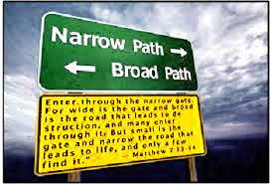
The Words of Jesus Regarding False Teachers
Mathew 7:13-15
13 “Enter by the narrow gate; for wide is the gate and broad is the way that leads to destruction, and there are many who go in by it.
14 “Because narrow is the gate and difficult is the way which leads to life, and there are few who find it.
15 “Beware of false prophets, who come to you in sheep’s clothing, but inwardly they are ravenous wolves.”

Slide 12
The Apostles Address False Teachers
Peter - 2 Peter 2:1-3
Paul - 2 Thessolonians 2:1-4, 13-15
Paul to Timothy - 1 Timothy 4:1-8

Slide 13
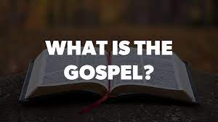
The Gospel. Is There Another?
1 Corinthians 15:1-5
Moreover, brethren, I declare to you the gospel which I preached to you, which also you received and in which you stand, by which also you are saved, if you hold fast that word which I preached to you—unless you believed in vain. For I delivered to you first of all that which I also received: that Christ died for our sins according to the Scriptures, and that He was buried, and that He rose again the third day according to the Scriptures, and that He was seen by Cephas, then by the twelve.

Slide 14
The Gospel. Is There Another?
Galatians 1:6
I marvel that you are turning away so soon from Him who called you in the grace of Christ, to a different gospel, which is not another; but there are some who trouble you and want to pervert the gospel of Christ. But even if we, or an angel from heaven, preach any other gospel to you than what we have preached to you, let him be accursed. As we have said before, so now I say again, if anyone preaches any other gospel to you than what you have received, let him be accursed.

Slide 15
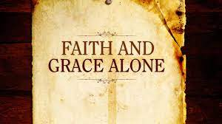
Another Gospel: Grace Alone/Faith Alone
Paul writes to the church at Ephesus with a focus on the process of their salavation.
Ephesians 2:8-9
For by grace you have been saved through faith, and that not of yourselves; it is the gift of God, not of works, lest anyone should boast.

Slide 16
Defending the Gospel
Titus 2:11-12
For the grace of God that brings salvation has appeared to all men, teaching us that, denying ungodliness and worldly lusts, we should live soberly, righteously, and godly in the present age.
Romans 6:1-4
Grace teaching us in Action
Romans 6:14-17
Galatians 3:26-28 “Through Faith”

Slide 17
Exercising Our Knowledge of God’s Word
HOLD
THAT
LINE
1 Timothy 4:6-8
If you instruct the brethren in these things, you will be a good minister of Jesus Christ, nourished in the words of faith and of the good doctrine which you have carefully followed. But reject profane and old wives’ fables, and exercise yourself toward godliness. For bodily exercise profits a little, but godliness is profitable for all things, having promise of the life that now is and of that which is to come.
Acts 17:11
Now these people were more noble and open-minded than those in Thessalonica, so they received the message [of salvation through faith in the Christ] with great eagerness, examining the Scriptures daily to see if these things were so.

Slide 18
Exercising Our Knowledge of God’s Word
HOLD
THAT
LINE
2nd Timothy 2:15-16
Be diligent to present yourself approved to God, a worker who does not need to be ashamed, rightly dividing the word of truth. But shun profane and idle babblings, for they will increase to more ungodliness.
1 Peter 3:15
But sanctify the Lord God in your hearts, and always be ready to give a defense to everyone who asks you a reason for the hope that is in you, with meekness and fear;
Luke 24:47
The true teacher of God will preach repentance and the forgiveness of sins through baptism. Then He opened their minds to [help them] understand the Scriptures, 46 and said, “And so it is written, that the Christ (the Messiah, the Anointed) would suffer and rise from the dead on the third day, 47 and that repentance [necessary] for forgiveness of sins would be preached in His name to all the nations, beginning from Jerusalem.

Slide 19
Final Thoughts
Who will we place our confidence in, whose words will prick our hearts? Whose words are perfect?
Psalms 19:7-8
The law of the Lord is perfect, converting the soul;
The testimony of the Lord is sure, making wise the simple; The statutes of the Lord are right, rejoicing the heart; The commandment of the Lord is pure, enlightening the eyes
Does my current commitment to gaining a true working knowledge of God’s word place me at an advantage when it comes to Defending the Gospel against false teaching?

