Slide 1
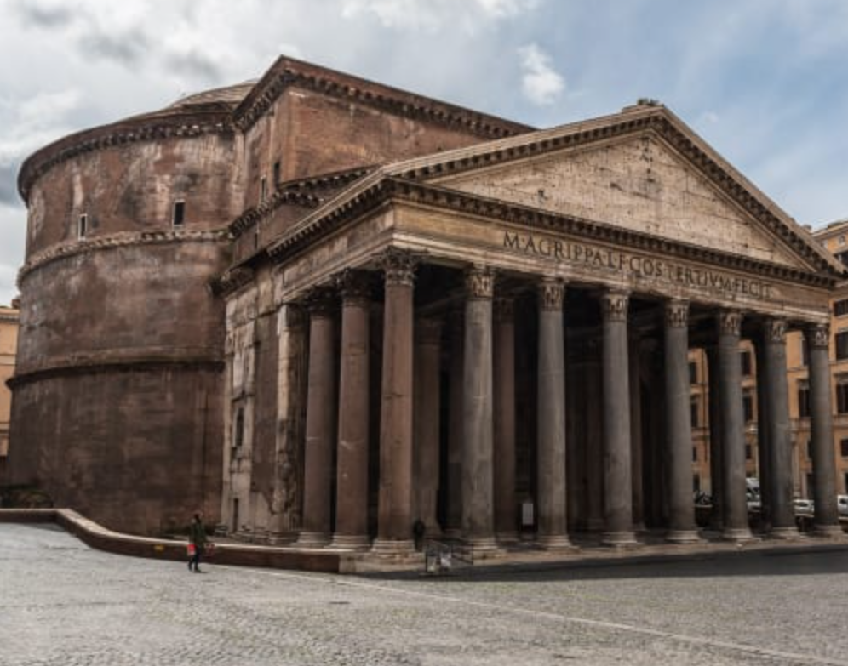
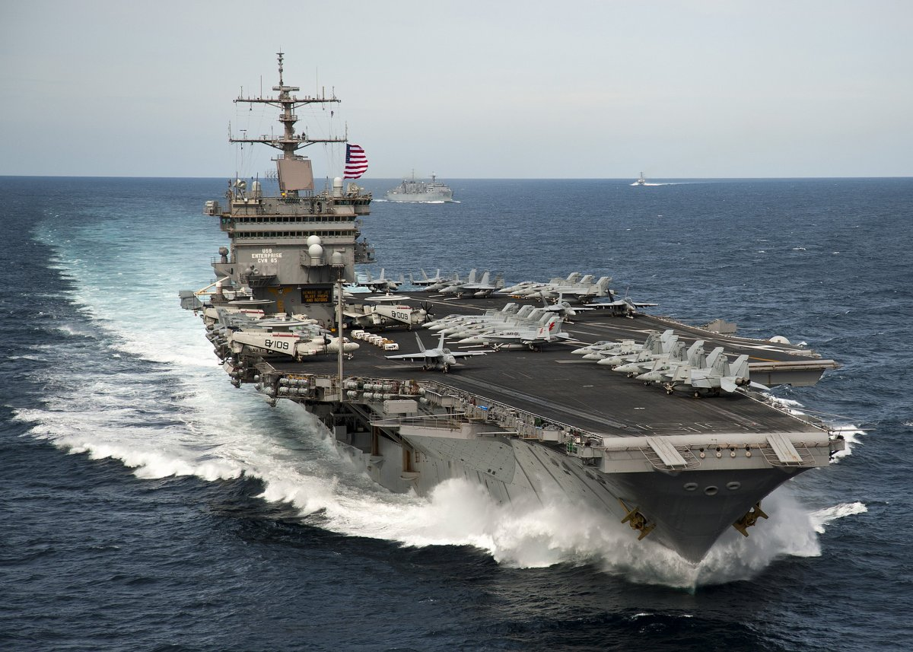
Eon Meusa, presenter
A Strong Foundation = Unsinkable Faith
z

Slide 2
Romans 10:17 Hebrews 11:6 Matthew 7:21-23 Matthew 14:22-33
A Strong Foundation = Unsinkable Faith
z

Slide 3
BUILD ON THE ROCK Matthew 7:24-27, NKJV
“Therefore whoever hears these sayings of Mine, and does them, I will liken him to a wise man who built his house on the rock: and the rain descended, the floods came, and the winds blew and beat on that house; and it did not fall, for it was founded on the rock. “But everyone who hears these sayings of Mine, and does not do them, will be like a foolish man who built his house on the sand: and the rain descended, the floods came, and the winds blew and beat on that house; and it fell. And great was its fall.”
What is your faith built on?
What is your foundation made of?

Slide 4
Roman Concrete in the 1st Century EXAMPLE: Strong Foundation
Widely used and known to be strong and durable; formulated 350 BC–150 BC.
Incorporated volcanic ash, which prevents structural cracks from spreading.
It grew in internal strength over time rather than falling apart even in harsh marine environments.
Strong foundations matter!
Do time and life challenges make your spiritual foundation stronger, or do you crack and fall apart?
The Pantheon – 2000-year-old structure
Built in 126 AD; still used in Rome today

Slide 5
Christians Make Up GOD’s SPIRITUAL HOUSE 1 PETER 2:5, NKJV
“you also, as living stones, are being built up a spiritual house, a holy priesthood, to offer up spiritual sacrifices acceptable to God through Jesus Christ.”
What is the foundation of our spiritual house?
What is the material used to build such a spiritual foundation?

Slide 6
NO BETTER Source Than THE WORD of GOD Romans 10:17 - NKJV
"So then faith comes by hearing, and hearing by the word of God.“
How do we receive the word?
The word of God to the 1st century church was delivered by inspiration by the Holy Spirit Himself into the minds of many empowered Christians and shared.
Today the word of God is delivered via perspiration based on diligent study of the scripture record. We are also expected to share this knowledge.

Slide 7
The Solid Foundation of God ALWAYS Stands 2 Timothy 2:14-19 NKJV
Remind them of these things, charging them before the Lord not to strive about words to no profit, to the ruin of the hearers. Be diligent to present yourself approved to God, a worker who does not need to be ashamed, rightly dividing the word of truth. But shun profane and idle babblings, for they will increase to more ungodliness. And their message will spread like cancer (translates - gangrene).

Slide 8
The Solid Foundation of God ALWAYS Stands 2 Timothy 2:14-19 NKJV
Hymenaeus and Philetus (YOUR NAME HERE?) are of this sort, who have strayed concerning the truth, saying that the resurrection is already past; and they overthrow the faith of some. Nevertheless the solid foundation of God stands, having this seal: “The Lord knows those who are His,” and, “Let everyone who names the name of Christ depart from iniquity.”

Slide 9
WHY SEEK GOD IN Faith? HE WILL REWARD! Hebrews 11:6 - NKJV
"But without faith it is impossible to please Him, for he who comes to God must believe that He is, and that He is a rewarder of those who diligently seek Him.“
The ability to seek after God separates us from all other living creatures. In itself this is a blessing.
We must believe what is written in proper context and in faith. This is an ongoing lifetime iterative process.

Slide 10
SIMPLE QUESTION - Does JESUS EVEN KNOW You? Matthew 7:21-23 - NKJV
"Not everyone who says to Me, ‘Lord, Lord,’ shall enter the kingdom of heaven, but he who does the will of My Father in heaven. Many will say to Me in that day, ‘Lord, Lord, have we not prophesied in Your name, cast out demons in Your name, and done many wonders in Your name?’ And then I will declare to them, ‘I never knew you; depart from Me, you who practice lawlessness!’” – Three groups addressed
DAY OF JUDGEMENT?

Slide 11
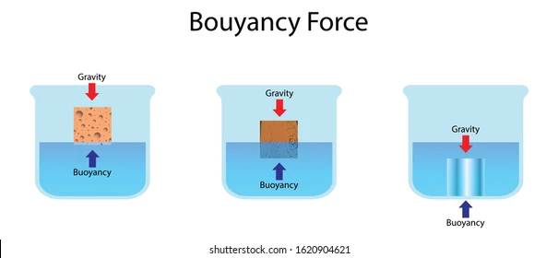
ARE YOU TRULY HIS? Are You on the List? DOES YOUR FAITH FLOAT WHEN TESTED?
High Faith Survivable Faith Weak/No Faith
WHETHER NATURALLY OR BY PURPOSEFUL EFFORT, WE MUST RISE ABOVE!

Slide 12
JUST Like Gravity, FEAR SINKS FAITH Matthew 14:22-33 - NKJV
"Immediately Jesus made His disciples get into the boat and go before Him to the other side, while He sent the multitudes away. And when He had sent the multitudes away, He went up on the mountain by Himself to pray. Now when evening came, He was alone there. But the boat was now in the middle of the sea, tossed by the waves, for the wind was contrary. Now in the fourth watch of the night Jesus went to them, walking on the sea. And when the disciples saw Him walking on the sea, they were troubled, saying, “It is a ghost!” And they cried out for fear. But immediately Jesus spoke to them, saying, “Be of good cheer! It is I; do not be afraid.”

Slide 13
JUST Like Gravity, FEAR SINKS FAITH Matthew 14:22-33 - NKJV
And Peter answered Him and said, “Lord, if it is You, command me to come to You on the water.” So He said, “Come.” And when Peter had come down out of the boat, he walked on the water to go to Jesus. But when he saw that the wind was boisterous, he was afraid; and beginning to sink he cried out, saying, “Lord, save me!” And immediately Jesus stretched out His hand and caught him, and said to him, “O you of little faith, why did you doubt?” And when they got into the boat, the wind ceased. Then those who were in the boat came and worshiped Him, saying, “Truly You are the Son of God.”

Slide 14
JUST Like Gravity, FEAR SINKS FAITH Matthew 14:22-33 - NKJV
Be Thorough - The Apostle Thomas was wise to verify the scars on Jesus.
God did not call us to blind faith with no evidence. The 1st century had miraculous works.

Slide 15
We have the . . .
Bible!
Nature!
History!
The question is do we believe the evidence?

Slide 16
Unsinkable FAITH IN CHRIST What does that look like?
HAVE YOU TAKEN THE TIME TO BUILD UP a Faith That is UNSINKABLE?
Are You using all your resources? Are you PREPARED IN ADVANCE?

Slide 17
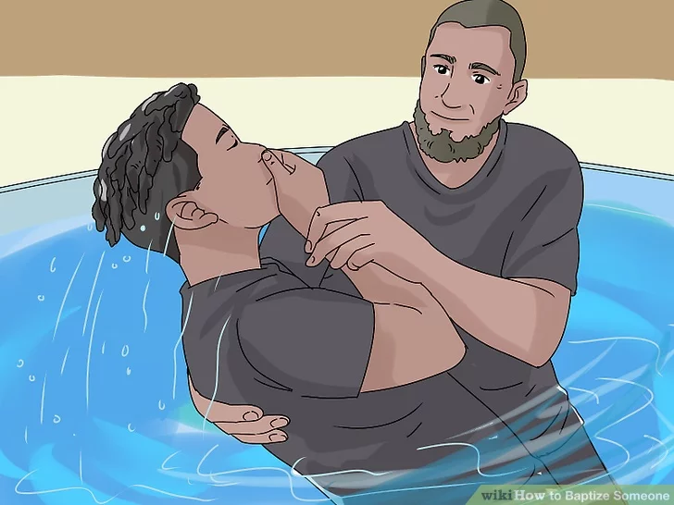
A Strong FOUNDATION and UNSINKABLE FAITH LEADS one to Evangelize EVERYONE Everyday!
MATTHEW 28:19 – TEACH AND BAPTIZE THE WORLD!
ACTS 22:16 – WHY WAIT?, SINS MUST BE WASHED AWAY!

Slide 18
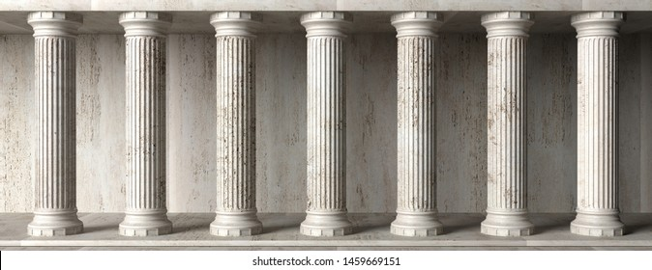
THE Gospel MESSAGE is STRONG and UNSINKABLE DIE to your Sin, BE Buried in WATER, ARISE Brand NEW!
B
E
LI
E
V
E
C
O
N
F
E
S
S
BE
FAITHFUL
R
E
P
E
N
T
HEAR
B
A
P
T
I
Z
E
D
S
HARE
GOD’S REDEMTIVE PLAN FOR ALL MANKIND YOUNG f OLD

