Slide 1
You Are Walking In A Circle
Promised Land This Way!
Why Do We Make It So Hard???
Bro Frank Johnson

Slide 2
You Are Walking In A Circle – Bible Texts
Jeremiah 8:5
Deuteronomy 7-9
Exodus 32

Slide 3
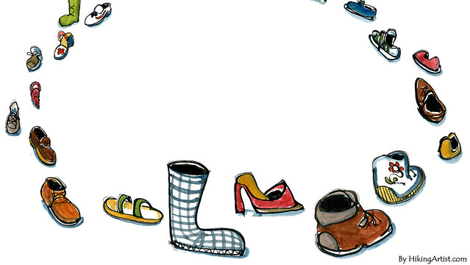
You Are Walking In A Circle
Being in Relationship to God
God’s Promises
Intercessor
Length of the Journey to God’s Promise
Warnings for the Journey
Solutions

Slide 4
Relationship With God
Old Testament Israel
Exodus 32:33-35
Deuteronomy 7:6-9, 12
The Promises of God
Love & Physical Blessings
Deuteronomy 7:13-15, 17-19, 8:4, 7-10, 9:1-3

Slide 5
The Journey to God’s Promise
Length of the Journey 317 miles – 11 Day Journey
Warnings:
DON’T DISOBEY THE LORD! (Deut 7:10-11; Deut. 8:1, 11-20)
DESTROY the 7 Pagan Nations (Deut. 7:2, 5, 16, 20-26)
NO COVENANTS with the 7 Pagan Nations (Deut. 7:2)
NO INTERMARRYING with the Foreigners (Deut. 7:3-4)
DON’T be Lustful & Prideful (Deut. 9:4-5)
RESIST EVIL influence (Ex. 32:21-24)

Slide 6
How Did Israel Treat God During the Journey?
Deuteronomy 9:6-16
Exodus 32:8-10
Jeremiah 8:5
Israel Needed An Intercessor
MOSES
Exodus 32:11-14, 30-32
Deuteronomy 9:16, 18-29
(40 Years) You Are Walking In A Circle

Slide 7
PART II: Relationship With God
Today
John 3:16 Romans 5:8 1 Peter 2:9-10
The Promises of God
Love, Spiritual, & Physical Blessings:
Acts 2:38 Romans 5:1, 8:1, 26-28, 33-35, 37-39;
1 John 1:7, 2:1, 17b Psalm 1:1-3 1 John 3:22
Eternal:
John 14:1-3 1 Thessalonians 4:15-17

Slide 8
The Journey to God’s Promise
Length of the Journey (Earth to Eternity) – Your Lifetime
Warnings for the Journey:
Romans 13:13
1 Corinthians 10:6-12
1 John 2:15-17a
1 Thessalonians 5:6, 8
Suffering:
1 Peter 2:21, 3:17, 5:8-9 James 1:2-3
Chastening:
Hebrews 12:5-11

Slide 9
How Do We Treat God During Our Journey?
1 John 2:4-6
1 Timothy 4:1
2 Timothy 4:3-4
Our Need For An Intercessor
JESUS
Romans 15:3 1 Corinthians. 15: 1-4 Hebrews 4:15-16
1 John 2:1

Slide 10
Are You Walking In A Circle?
Solutions:
Remember How God Sees You!
John 3:16 Romans 5:8 1 Peter 2:9-10
Remember You Have Work to Do!
Ephesians 2:10 Matthew 28:18-20 Mark 10:42-45 Galatians 6:9-10
Remember the Promises!
Are You Walking In A Circle…? STOP!

