Slide 1
Don’t Run From Your Purpose
Jonah Ch. 1-4
Matt. 13:47-50

Slide 2
What is Our Purpose?
We define our purpose in a few different ways.
We focus on our jobs/careers
We focus on our role as a spouse
We focus on our role as parents
We focus on the roles we play in our communities
Our struggle often comes when we have to articulate our Spiritual Purpose
Because of this, we sometimes find ourselves behaving in ways that directly work against our purpose.

Slide 3
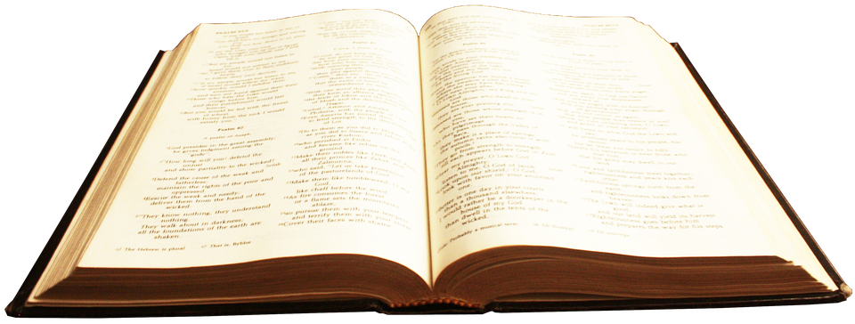
What is Our Purpose?
Simplified:
Our purpose is stated in the Great Commission.
Matt. 28:18-20 “And Jesus came and spake unto them saying, All power is given unto me in heaven and earth. ¹⁹ Go ye therefore, and teach all nations, baptizing them in the name of the Father, and of the Son, and of the Holy Ghost: ²⁰ teaching them to observe all things whatsoever I have commanded you: and lo I am with you alway; even unto the end of the world.

Slide 4
What Does Running Look Like?
Jonah 1-4
Jonah is instructed to go to Nineveh to preach to them
Jonah instead hops on a ship heading in the opposite direction
The brutal storm and the prospect of being responsible for the death of everyone aboard the ship causes Jonah to request to be thrown overboard
Jonah is swallowed by a great fish where he is able to collect himself and decides to fulfill the task God gave him
Jonah finally goes to Nineveh to preach to the people
Jonah gets mad when God decides to spare the lives of the people there

Slide 5
Why Do We Run?
The reasons can be numerous and varied, but if we are honest, there are 2 main reasons we do not work to fulfill our purpose.
#1: We don’t truly understand what our purpose is.
#2: Our heart is not right.

Slide 6
Understanding Our Purpose
Matt. 13:47-50
The problem that many of us face, as it pertains to fulfilling our purpose, is that we don’t know which part we are supposed to play in it. When we read these verses, many of us like to think of ourselves as the ones who will be separating the “wicked” from the “just”. Or maybe we see ourselves as the fishermen, bringing the catch to shore. That kind of thinking has left us believing that we are more than what we are.

Slide 7
Understanding Our Purpose
Matt. 13:47-50
The truth of the matter is that we are the NET.
The kingdom of heaven (in this instance) is not the location. It is the institution that Christ would eventually die for; THE CHURCH.
He explains this in a previous parable in the same chapter. Matt. 13:37-42

Slide 8
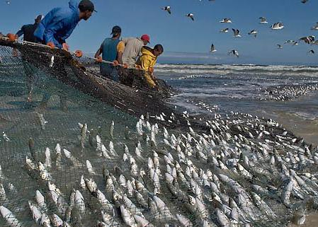
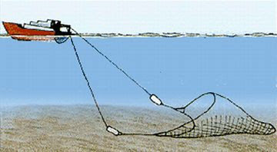
The Net

Slide 9
Why Gather Everything?
2 Peter 3:9
The Lord is not slack concerning his promise, as some men count slackness; but is longsuffering to us-ward, not willing that any should perish, but that all should come to repentance.
Our Purpose is to be the vehicle that brings EVERYONE in contact with the Gospel.
God wants everyone to be saved. He doesn’t play favorites. That’s what WE do.

Slide 10
Jonah’s Heart Problem
When our hearts are not right, we run from our purpose because we are not focused on the job, we are focused on ourselves.
Jonah’s focus should have been on the great opportunity he had to redeem the lost people of Nineveh, but instead he got mad that God decided not to utterly destroy them. (Jonah 4:1-3)
He didn’t think they were worth saving.
His heart was wrong.
Notes:
The brother from the Lost/Prodigal Son
We behave as if we’re going to lose something if someone else gets to experience the same benefits of having a relationship with God.

Slide 11
Our Heart Problem
We say “Shame on Jonah”, but what about us?
Don’t we have information that people need in order to be saved?
Will the people not perish (eternally) if we withhold this information?
Then SHAME ON US if we do the same thing! We are no better than Jonah when we run from our purpose of being that net; Of bringing in every kind.
We cannot pick and choose who can be used in the kingdom. That is NOT our job!
Notes:
Adam and Eve, Noah drunk, Judah and Tamar (gave us Pharez and Zerah) Pharez gave us Boaz who gave us Obed who gave us Jesse who is the father of David the king.
When David is young we respected him, nut when he got older he started acting up. If we knew someone like David, How many of us would share the gospel with them? Bring them to worship?

