Slide 1
John Jackson, Presenter
Saturday, June 5, 2021--Episode 14
Obedience of a Righteous Man
Job 1-22

Slide 3
Romans 6:23 For the wages of sin is death; but the gift of God is eternal life through Jesus Christ our Lord.

Slide 4
Romans 6:23 For the wages of sin is death; but the gift of God is eternal life through Jesus Christ our Lord
Job’s relationship with God is clearly based on Grace and not Merit

Slide 5
Romans 6:23 For the wages of sin is death; but the gift of God is eternal life through Jesus Christ our Lord
Job’s relationship with God is clearly based on Grace and not Merit
Ephesians 2:8-9 For by grace are ye saved through faith; and that not of yourselves: it is the gift of God: Not of works, lest any man should boast.

Slide 6
Jeremiah 12:1 Righteous art thou, O Lord, when I plead with thee: yet let me talk with thee of thy judgments: Wherefore doth the way of the wicked prosper? wherefore are all they happy that deal very treacherously?

Slide 7
Job 1:9-11 Then Satan (adversary) answered the Lord, and said, Doth Job fear God for nought? Hast not thou made an hedge about him, and about his house, and about all that he hath on every side? thou hast blessed the work of his hands, and his substance is increased in the land. But put forth thine hand now, and touch all that he hath, and he will curse thee to thy face.

Slide 8
Job 1:9-11 Then Satan (adversary) answered the Lord, and said, Doth Job fear God for nought? Hast not thou made an hedge about him, and about his house, and about all that he hath on every side? thou hast blessed the work of his hands, and his substance is increased in the land. But put forth thine hand now, and touch all that he hath, and he will curse thee to thy face. Job suffered tremendous loss! Verse 13-ff (finance and family) In all this, Job did not sin. (Let’s put ourselves in scripture)

Slide 9
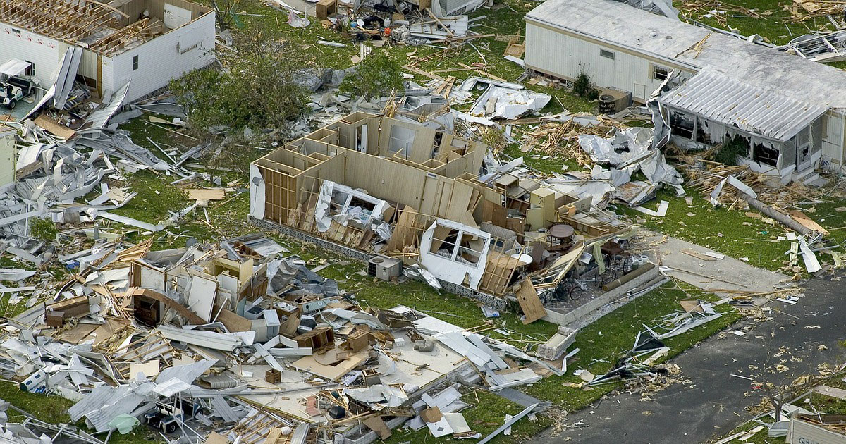

Slide 10
Job 2:7 So went Satan forth from the presence of the Lord, and smote Job with sore boils from the sole of his foot unto his crown. (health) Satan is absolutely motivated to do Job (and us) harm Luke 22:31 And the Lord said, Simon, Simon, behold, Satan hath desired (exaiteomai=to ask from, to demand) to have you, that he may sift you as wheat: same as Job 2:3

Slide 11
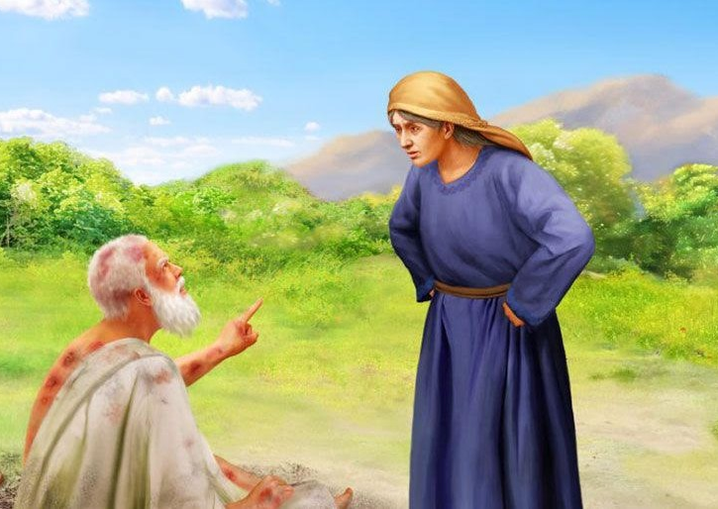
Job 2:9-10 Then said his wife unto him, Dost thou still retain thine integrity (innocence)? Curse (euphemism=bless) God, and die.
Would she have passed Satan’s test?
¹⁰ But he said unto her, Thou speakest as one of the foolish women speaketh. What? shall we receive good at the hand of God, and shall we not receive evil?
In all this Job did not sin with his lips.

Slide 12
Obedience of a Righteous Man
Job 1:21-22 And said, Naked came I out of my mother's womb, and naked shall I return thither: the Lord gave, and the Lord hath taken away; blessed be the name of the Lord. In all this Job sinned not, nor charged God foolishly.
Job worshipped through his trials.
Job 13:15 Though He slay me, I will hope in him;yet I will argue my ways to His face.
Job 19:25 For I know that my Redeemer lives, and at the last he will stand upon the earth.

Slide 13
God knew Job could bear this trial. Job became stronger. James 1:3 Knowing this, that the trying of your faith worketh patience. (tempered glass after going through fire is 4 times stronger.) All of Job’s suffering and affliction came on him because of his righteousness, not because of sin or a character flaw. Verse 8 And the LORD said unto Satan, Hast thou considered my servant Job, that there is none like him in the earth, a perfect and an upright man, one that feareth God, and escheweth evil?

Slide 14
Different Kinds of Suffering

Slide 15
Different Kinds of Suffering
Direct result of sin
Psalm 38:3-5 There is no soundness in my flesh because of thine anger; neither is there any rest in my bones because of my sin. For mine iniquities are gone over mine head: as an heavy burden they are too heavy for me. My wounds stink and are corrupt because of my foolishness.

Slide 16
Different Kinds of Suffering
Direct result of sin
Psalm 38:3-5 There is no soundness in my flesh because of thine anger; neither is there any rest in my bones because of my sin. For mine iniquities are gone over mine head: as an heavy burden they are too heavy for me. My wounds stink and are corrupt because of my foolishness.
God allows trials in order for us to mature as Christians

Slide 17
Different Kinds of Suffering
Direct result of sin
Psalm 38:3-5 There is no soundness in my flesh because of thine anger; neither is there any rest in my bones because of my sin. For mine iniquities are gone over mine head: as an heavy burden they are too heavy for me. My wounds stink and are corrupt because of my foolishness.
God allows trials in order for us to mature as Christians
Romans 5:3-5 And not only so, but we glory in tribulations also: knowing that tribulation worketh patience; And patience, experience; and experience, hope: And hope maketh not ashamed; because the love of God is shed abroad in our hearts by the Holy Ghost which is given unto us.

Slide 18
Friends and Worldly Advice
Friend: a person whom one knows and with whom one has a bond of mutual affection

Slide 19
Friends and Worldly Advice
Friend: a person whom one knows and with whom one has a bond of mutual affection
Job 2:11 Now when Job's three friends heard of all this evil that was come upon him, they came every one from his own place; Eliphaz the Temanite, and Bildad the Shuhite, and Zophar the Naamathite: for they had made an appointment together to come to mourn with him and to comfort him.

Slide 20
Friends and Worldly Advice
Friend: a person whom one knows and with whom one has a bond of mutual affection
Job 2:11 Now when Job's three friends heard of all this evil that was come upon him, they came every one from his own place; Eliphaz the Temanite, and Bildad the Shuhite, and Zophar the Naamathite: for they had made an appointment together to come to mourn with him and to comfort him.
Proverbs 27:17 Iron sharpeneth iron; so a man sharpeneth the countenance of his friend.

Slide 21
Friends and Worldly Advice
Friend: a person whom one knows and with whom one has a bond of mutual affection
Job 2:11 Now when Job's three friends heard of all this evil that was come upon him, they came every one from his own place; Eliphaz the Temanite, and Bildad the Shuhite, and Zophar the Naamathite: for they had made an appointment together to come to mourn with him and to comfort him.
Proverbs 27:17 Iron sharpeneth iron; so a man sharpeneth the countenance of his friend.
Job 16:1 Job called them miserable comforters.
They believed Job was reaping what he sewed. Job held fast to his integrity.

Slide 22
Obedience Is the Highest Form of Worship

Slide 23
Obedience Is the Highest Form of Worship
Job 1:20 Then Job arose, and rent his mantle, and shaved his head, and fell down upon the ground, and worshipped,

Slide 24
Obedience Is the Highest Form of Worship
Job 1:20 Then Job arose, and rent his mantle, and shaved his head, and fell down upon the ground, and worshipped,
Worship=shac-hah; A primitive root; to depress, that is, prostrate (especially reflexively in homage to royalty or God): - bow (self) down, crouch, fall down (flat), humbly beseech, do (make) obeisance, do reverence, make to stoop, worship.

Slide 25
Obedience Is the Highest Form of Worship
Job 1:20 Then Job arose, and rent his mantle, and shaved his head, and fell down upon the ground, and worshipped,
Worship=shac-hah; A primitive root; to depress, that is, prostrate (especially reflexively in homage to royalty or God): - bow (self) down, crouch, fall down (flat), humbly beseech, do (make) obeisance, do reverence, make to stoop, worship.
John 4:24 God is a Spirit: and they that worship (proskuneo=bow down) him must worship him in spirit (pneuma=rational soul, mind) and in truth.

Slide 26
Psalm 111:10 The fear of the Lord is the beginning of wisdom: a good understanding have all they that do his commandments: his praise endureth for ever.

Slide 27
Ecclesiastes 12:13
Let us hear the conclusion of the whole matter: Fear God, and keep his commandments: for this is the whole duty of man.

