Slide 1
OBEDIENCE IN CHRIST IS PARAMOUNT
:
OBEDIENCE THAT LEADS TO SALVATION
Murk Thomas, Presenter
Saturday, June 5, 2021
Episode 14

Slide 2
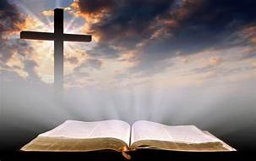
OBEDIENCE IN CHRIST IS PARAMOUNT

Slide 3
“Obedience that leads to Salvation – Cornelius Acts 10:1-48 & 11:1-18

Slide 4
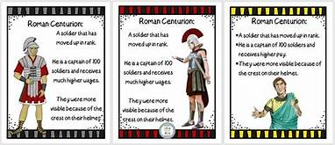
CORNELIUS--A ROMAN CENTURION

Slide 5
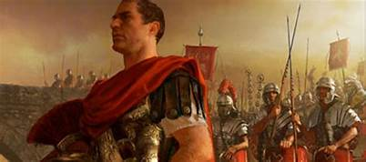
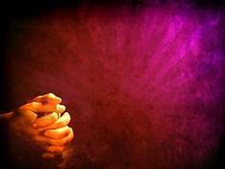
THE GOODNESS OF CORNELIUS
Centurion
Devout and Feared GOD
Household was devoted to GOD
Gave/Giving
Prayed to GOD
Just
Good Reputation

Slide 6
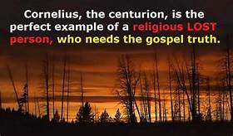
WHAT’S MISSING?

Slide 7
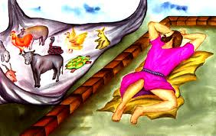
PETER’S VISION AT JOPPA verses 10-16
Mission to Judea & Samaria—Acts 10
Peter’s vision (10:9-16)
On the housetop, the 6th hour to pray
Saw a vision of something like a sheet full of unclean animals
Voice tells him to kill and eat
Peter replies that he has never eaten anything unclean
Voice replies that what God has cleansed no long consider unclean
This happened 3 times

Slide 8
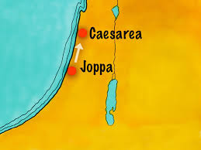
PETER GOES TO MEET CORNELIUS verses 21-23

Slide 9
ACTS 10
Peter visits Cornelius, the Gentile verses 24-33
Peter Corrects Cornelius verses 24-27
Peter Corrects Himself verses 28-29
Peter Preaches to Cornelius’ Household verses 34-48

Slide 10
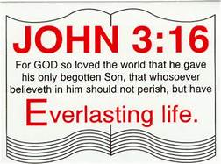
THE GOSPEL… Acts
Is equally for all people. verses 34-36
Is Possible through One Man’s Sacrifice. verses 37-38

Slide 11
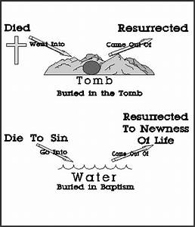
THE GOSPEL… Acts
Is Confirmed by One Spirit verses 44-46
Is Obeyed in One Baptism verses 47-48
“For we were all baptized by one spirit so as to form one body whether Jews or Gentiles, slave or free and we were all given the one spirit to drink.”
1 Corinthians 12:13

Slide 12
Acts 11:1-18 Peter recounts his experience with Cornelius

Slide 13
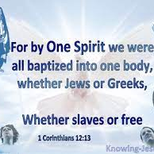
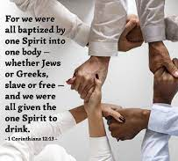
CORNELIUS
Peter is accused of visiting Gentiles verses 1-3
Peter explains his actions verses 4-17
The argument is settled

Slide 14
Something to Think About
Who decided Cornelius would be such a good man that God singled him out for special attention?
Who decided that Cornelius would obey the angel’s instruction and send for Peter?
Who decided that Cornelius would gather his friends and relatives to hear Peter’s word from God?
Did Cornelius in any way contribute, and without God’s contribution, could Cornelius have been saved, despite all his goodness?
We know certainly that God contributed and without God’s contribution Cornelius could not have been saved, despite all his goodness.
But did Cornelius contribute? If so, could he have been saved without that contribution?

Slide 15
1 John 2:5 But if anyone obeys his word, love for God is truly made complete in them. This is how we know we are in him:

