Slide 1
Stay in the Race at All Costs
Brian Alexander Saturday, March 6, 2021

Slide 2
Stay In The Race At All Costs
Stay In the Race at All Costs

Slide 3
Stay In (I Corinthians 9)
Paul encourages the church at Corinth
I Corinthians 9:24-27
Analysis
The phrase “stay in the race at all costs” implies that we are already in the race
Competing requires endurance, preparation, and discipline
Our prize is everlasting

Slide 4
Stay In The Race At All Costs
Stay In the Race at All Costs

Slide 5
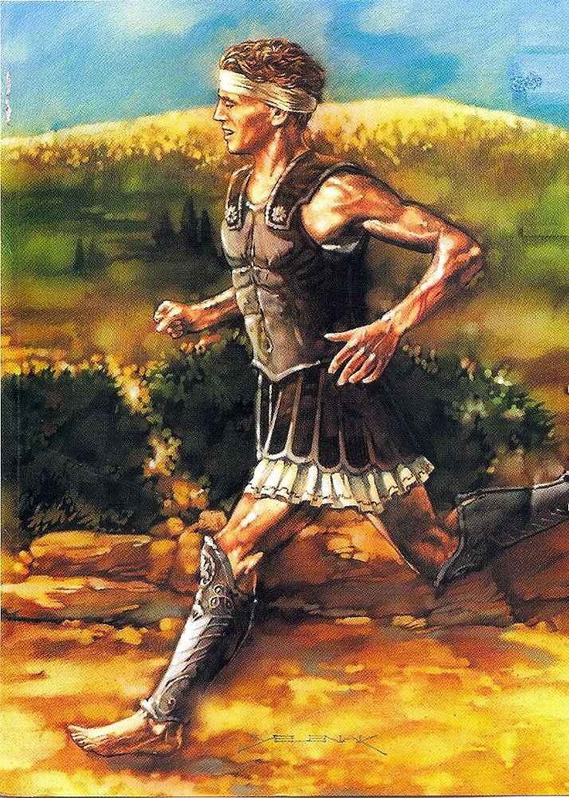
The Race
“Rejoice, We Conquer”
Notes:
While the massive Persian army landed, the Athenians sent a messenger named Philippides (his name was corrupted in later texts to Pheidippides) to Sparta to enlist the aid of the Spartans in the upcoming battle. He covered the distance of about 150 miles in less than two days, a remarkable accomplishment by any standard.
Back at Marathon, however, the decision was made not to wait for the Spartans. The Athenian army fell upon the vastly larger Persian forces while they were still preparing for battle. Against great odds, the Greeks prevailed. Though historians writing close to the time of the battle make no mention of the event, writers some 600 years later claim that a runner was dispatched to Athens to carry the news of the great victory. According to legend he reached the city, said, "Rejoice, we conquer," and fell to the ground dead.

Slide 6
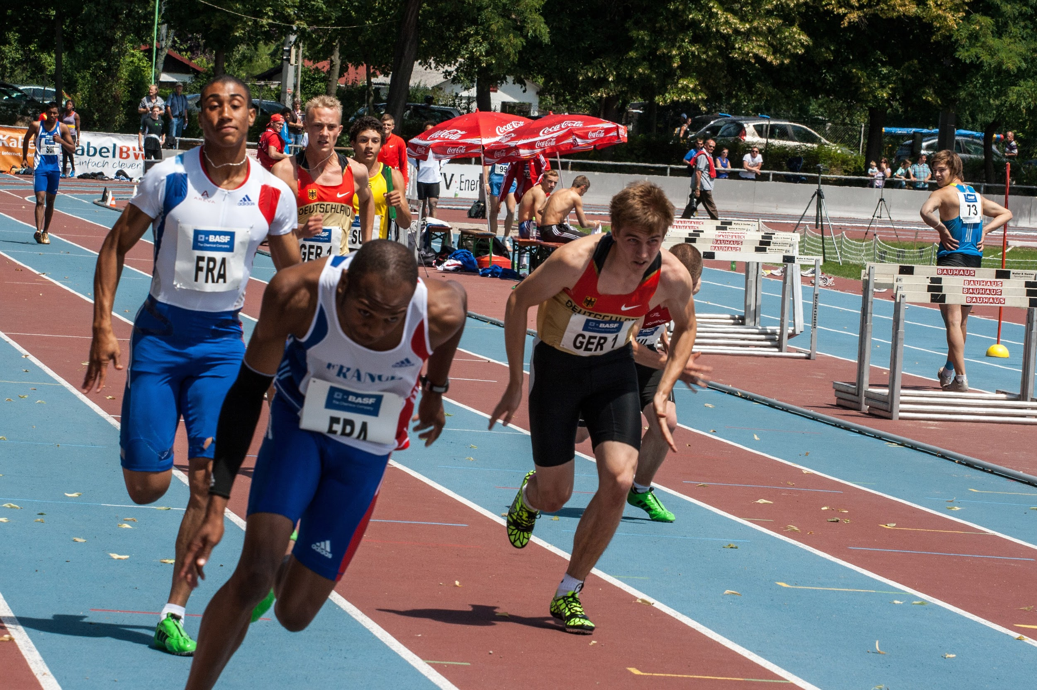
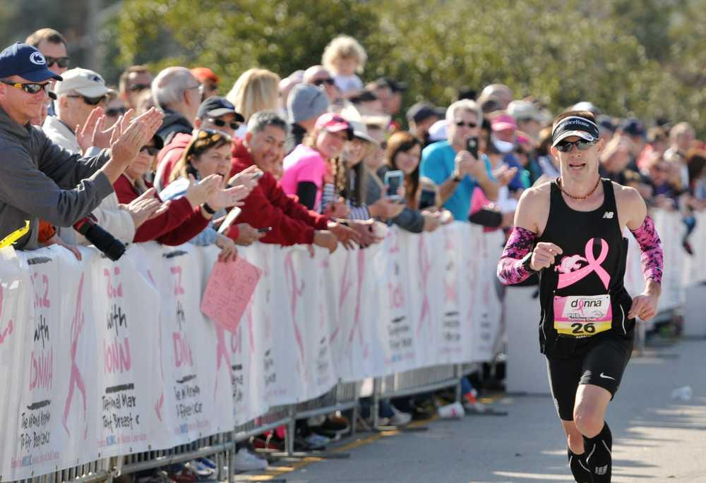
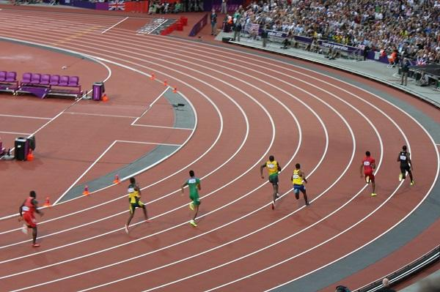
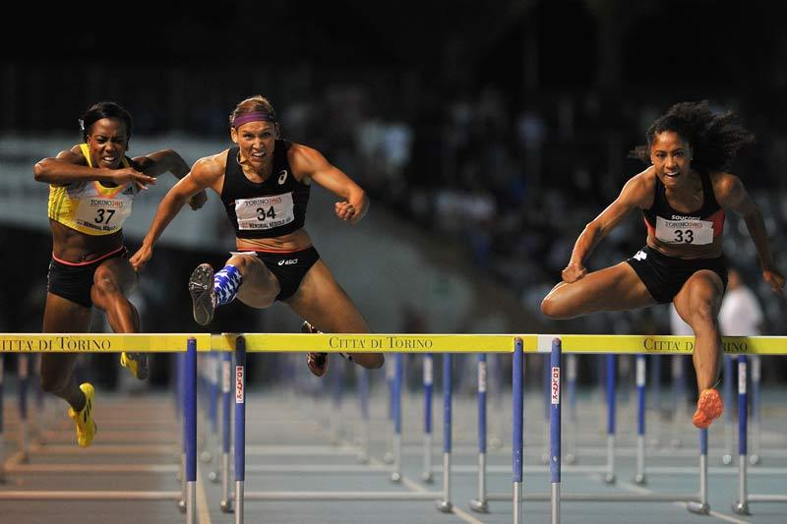

Slide 7
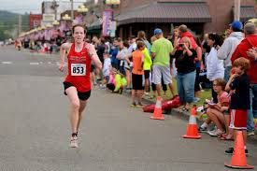
Which Type of Race Are You Running?!?

Slide 8
Hurdles
You Will Have Trouble—
Make the Next Right Move

Slide 9
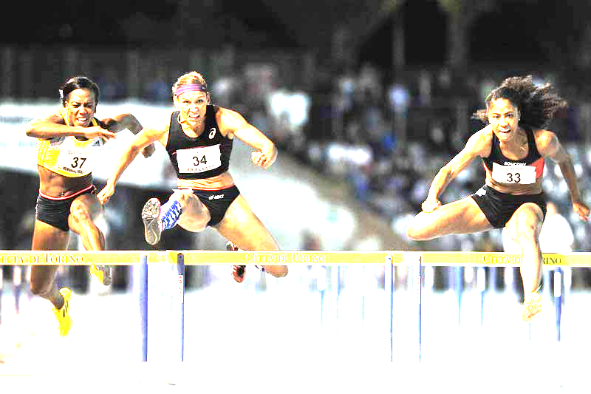
Hurdles: You Will Have Trouble (John 16)
Jesus warned us of persecution
John 16:1-3
Jesus left us with a Comforter
John 16:7; 13-15
Jesus assures us that trouble won’t last always
John 16:16-24
Jesus encourages us to get over our hurdles
John 16:32-35
Analysis:
We are able to get over our hurdles in life not because of OUR training but HIS provision
Expectation - Perspective = Frustration

Slide 10
Hurdles

Slide 11
Hurdles: Make the Next Right Move (II Samuel 11)
David makes a mistake
II Samuel 11: 2-4
David makes a bad decision because of his mistake
II Samuel 11:6-13
David makes another bad decision because of his bad decision
II Samuel 11:14-17
Analysis
We’re not going to clear every hurdle
Don’t miss the next hurdle
We have to regain our stride

Slide 12
Relay
Who Came Before Me?
What Is My Role Now?
Who Is Coming Behind Me?

Slide 13
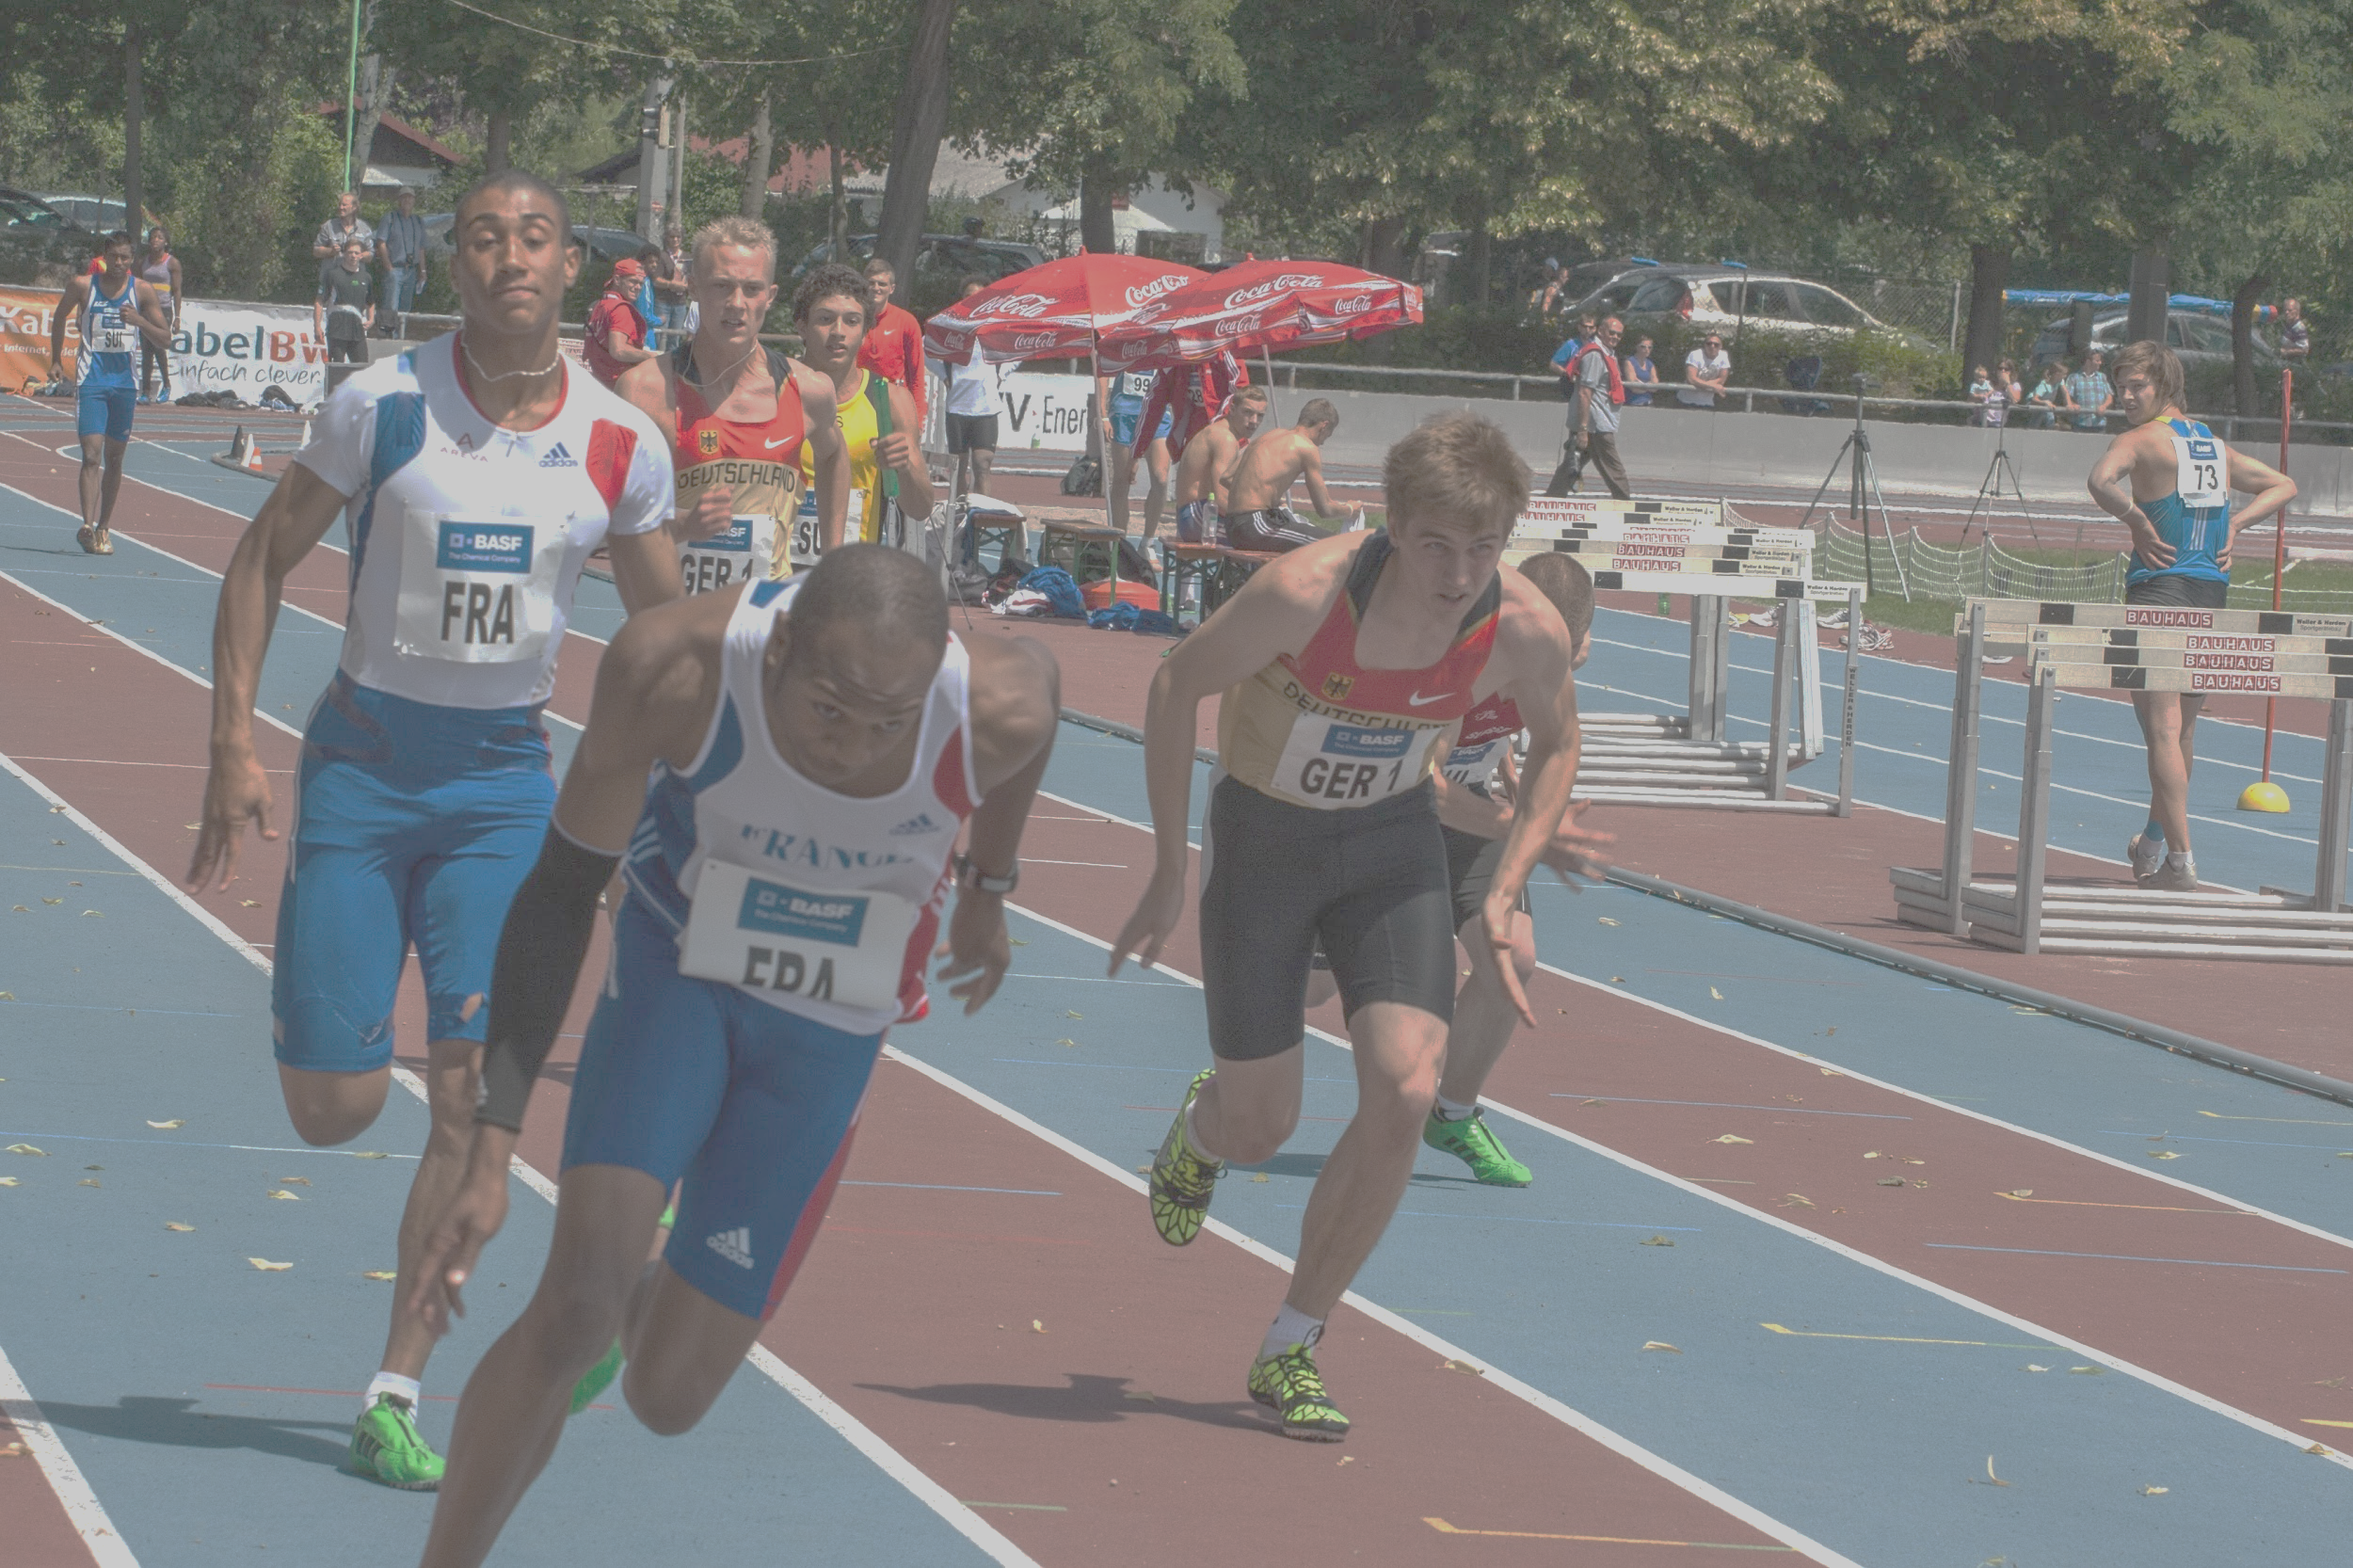
Relay: Who Came Before Me? (Exodus 3)
God makes Himself known to Moses by his predecessors
Exodus 3:13-15
Jesus makes Himself known to the Sadducees
Matthew 22:23-33
Peter references his predecessors when preaching Jesus
Acts 3:12-26
Analysis:
The promise of our predecessors is still OUR promise

Slide 14
Relay: What is My Role? (Exodus 3)
Moses was given a role
Exodus 3:9-10
Moses’ role was based on his past experiences
Exodus 2:11-12
Exodus 2:16-17
Moses served his purpose
Analysis
Our roles are based on our capacity
We are being prepared now for what God wants to do with us later

Slide 15
Relay: Who is Coming After Me?
Moses passes on
Deuteronomy 34:1-5
Joshua was prepared by Moses
Deuteronomy 34:9
God selects Joshua to complete Moses’ work
Joshua 1:1-9
Analysis
The most important part of the relay is passing the baton
Part of our role is to pass the goodness of God down to the next generation
Notes:
The hand-off has three components
Running Start
“Blind” reach back
Passing of the baton

Slide 16
Stay In The Race At All Costs
Stay In the Race at All Costs

Slide 17
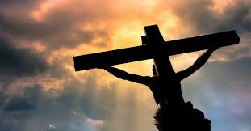
At All Costs
Cost and Value

Slide 18
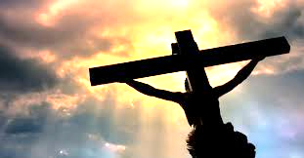
At All Costs: Cost and Value
Peter did not understand value
Matthew 17:21-23
Jesus communicates the value of a soul
Matthew 17:24-28
Jesus pays the cost to redeem our value
Matthew 27, 28
Paul shows us the cost of our discipleship
Romans 12:1-2
Analysis
Jesus incurred cost to show us our value
The cost of our discipleship is minimal yet significant
Notes:
The term “value” (in this context) refers to something intrinsically valuable or desirable.
The term “cost” can be defined as the amount or equivalent paid or charged for something

Slide 19
Stay In The Race At All Costs
Stay In the Race at All Costs

Slide 20
Stay In the Race at All Costs
“Our Charge”
Notes:
Phillippides

Slide 21
Our Charge
Paul charges Timothy to continue the fight
II Timothy 4:1-8
Analysis
There is hope in continuing in Christ.
Paul’s exhortation to Timothy applies to us

Slide 22
“Rejoice, we conquer…”

