Slide 1
The PRISON of the MIND
The SHARE Lectures
Saturday, December 12, 2020
Presenter: Rickie Sheffield

Slide 2
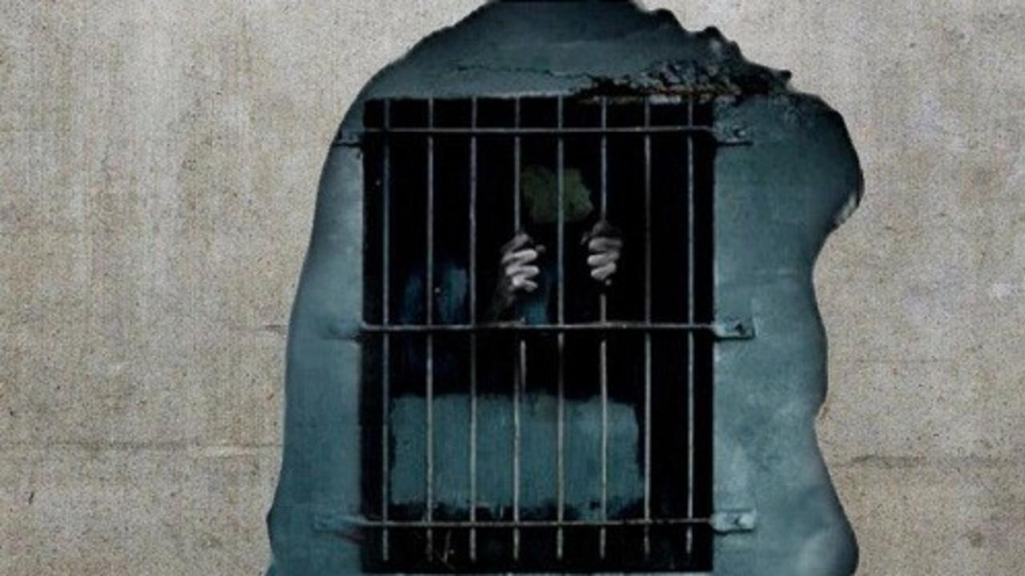
Releasing Ourselves from the Prisons of Our Minds

Slide 3
The SHARE| Ep 12 Theme: The Weight of Anxieties
Anx·i · e · ties (noun) pl: the result of uncertainty, feeling of worry, nervousness, or unease about an imminent event.
The Bible teaches that uncertainty is, essentially, distrust with the plan of God. It's not that anxiety is a sin, but anxiety is the act of experiencing fears and worries that one wouldn't experience if they truly follow and show commitment to God.

Slide 4
Understand that some individuals may struggle with chemical imbalances that contribute to severe anxieties.

Slide 5
Pris·on (noun): a state of confinement or captivity
Looking at both definitions, one thing is clear . . . I can become a prisoner of my thoughts through the weight of anxieties.

Slide 6
Proverbs 23:7--For as he thinketh in his heart so is he.
Our thoughts mold who we are.

Slide 7
We are trapped in a prison of our own making.
Our habits, beliefs, traditions, and perceptions are prison bars of slavery.
Our only hope is to trust in a set of habits, beliefs, traditions, and perceptions that are formed through Jesus Christ.

Slide 8
When we look at Romans 12, Paul warns against these very things . . .
¹I beseech you therefore, brethren, by the mercies of God, that ye present your bodies a living sacrifice, holy, acceptable unto God, which is your reasonable service.
² And be not conformed to this world but be ye transformed by the renewing of your mind, that ye may prove what is that good, and acceptable, and perfect, will of God.

Slide 9
Three things I see in verses 1 & 2
We’re being conformed daily.
Be careful what you allow into your mind.
Our help is only by the will of GOD.

Slide 10
We’re being CONFORMED daily . . .
Work stress or job change
Change in living arrangements
Pregnancy and giving birth
Family and relationship problems
Major emotional shock following a stressful or traumatic event
Verbal, sexual, physical or emotional abuse, or trauma
Death or loss of a loved one
School or education
We all can relate to many of these circumstances as they’re part of this side of life. When we’re consumed by these things, we become a prisoner to our emotions because of these events.

Slide 11
Philippians 4:6
Do not be anxious about anything, but in everything, by prayer and petition, with thanksgiving, present your requests to God.
Proverbs 12:25
An anxious heart weighs a man down, but a kind word cheers him up.
1 Peter 1:14
Peter warns us to not fashion ourselves after our former lusts.
Romans 12:2
And be not conformed to this world but be ye transformed by the renewing of your mind, that ye may prove what is that good, and acceptable, and perfect, will of God.

Slide 12
Be careful what you allow into your mind
There was a study that says the average person has about 6,200 thoughts every day (Newsweek: 071520)
Proverbs 4:23 (KJV)
Keep thy heart with all diligence, for out of it are the issues of life.
NIV
Above all else, guard your heart, for everything you do flows from it.
Proverbs 14:12 (The Message)
There’s a way of life that looks harmless enough, look again—it leads to hell. Sure, those people appear to be having a good time, but all that laughter will lead to heartbreak.

Slide 13
Matthew 15:11,17-20
¹¹ What goes into someone's mouth does not defile them, but what comes out of their mouth, that is what defiles them.
¹⁷ Do you not understand, that whatever entereth in at the mouth goeth into the belly, and is cast out into the draught?
¹⁸ But those things which proceed out of the mouth come forth from the heart, and they defile the man.
¹⁹ For out of the heart proceed evil thoughts, murders, adulteries, fornication, thefts, false witness, blasphemies.
Jesus uses this parable to help us understand that when we allow the things that are unhealthy to shape our thoughts they will produce in us opportunities to be controlled by evil.

Slide 14
Our help is only by the will of GOD
When we present our lives as a living sacrifice, then and only then will we have the help of GOD.
That means God wants us to live a life that brings glory to His Name.
1 Peter 2:5-10
You come to him as living stones, a spiritual house that is being built into a holy priesthood, so offer spiritual sacrifices that God accepts through Jesus Christ.
Vs 10
Once you were not God’s people, but now you are. Once you were not shown mercy, but now you have been shown mercy.
Vs 15
God wants you to silence people’s ignorance by doing what is right.

Slide 15
1 Corinthians 6:20
We were bought with a price: therefore glorify God in your body, and in your spirit, which are God’s.
Matthew 5:13-16
“Salt of the earth and light of the world”
Let me sum it up for everyone again
Based on God’s abundant mercies on our behalf, He is calling us to become a voluntary living service as a reasonable expression of our gratitude for all He has done for us and through us.
As I move to the second group of individuals struggling with the idea of swinging back and forth because of the weight of anxieties, let’s look at the church in Galatia
They struggled with two issues

Slide 16
It is for freedom that Christ has set us free. Stand firm, then, and do not let yourselves be burdened again by a yoke of slavery. Galatians 5:1
The church of Galatia imprisoned themselves on a pendulum of extremes. One side swung toward the cage of tradition, and the other side the prison of self-gratification. Paul wanted them to begin to understand that Jesus had freed them from their swinging prison and called to them to jump off the swing and live by faith expressed through love.
The only thing that counts is faith expressing itself through love. Galatians 5:6

Slide 17
THE PENDULUM The Cage of Traditional Belonging (5:7-12)
On one side of the pendulum, some of the church of Galatia was comforted by their tradition. It was familiar, predictable, and very well established. Their traditions served to guide their actions. As comforting as their traditions were, it didn’t change the facts.
Jesus had established a better way that focused on a heart that beats for Him (new covenant / uncircumcised), more than simply controlling the actions of the flesh (old covenant / circumcised).

Slide 18
What is familiar, predictable, and well established in your life that could simply be tradition? How could you allow God to better focus you to be motivated by a heart that beats for Him?
The Prison of Self-Gratification (5:13-21) On the other side of the pendulum, some of the church of Galatia wanted to indulge in every selfish action that their traditions opposed. They took their new found freedom in Christ as a “Get Out of Jail Free” card. They assumed it allowed them to experience the life they were previously not allowed. Without realizing it, they chose to walk away from one prison, controlled by a set of rules, and enter an equally damning one, controlled by self-gratification.

Slide 19
Jesus came to free us from the prison of our own personal desires, too. His freedom offers us the chance to find purpose through sacrificial love rather than gratifying our selfish desires.
What self-gratifying tendencies do you express?
How could you allow God to better focus you to be motivated by a heart that beats for Him?

Slide 20
OUR STORY (5:22-26)
Our Story is no different than the story of the church of Galatia. We struggle with swinging back and forth from a life that is caged in familiar, predictable, and established traditions; and a prison of self-gratification. It’s time that we jump off the swing and embrace the life that we were designed to live.
But the fruit of the Spirit is love, joy, peace, forbearance, kindness, goodness, faithfulness, 23 gentleness and self-control. Against such things there is no law. Galatians 5:22-23
What may God be asking you to let go of so you can live more freely in the fruit of the Spirit?

Slide 21
Thank You for Your Attendance Today!
Continue to Pray for Our Church Family

