Slide 2
The SHARE Lectures
Transform Your Mind Romans 12:1-2
Presenter: Tyrone Jones
Saturday, September 26, 2020

Slide 3
The Beginning of Time/Creation
Genesis 1:1―In the beginning God created the heavens and the earth. ² Now the earth was formless and empty, darkness was over the surface of the deep, and the Spirit of God was hovering over the waters.
The earth was without form
The earth was empty
Darkness was over the surface of the deep
The Spirit of God was hovering over the waters.

Slide 4
Transformation Is Eminent at This Time in History
The creation begins
In six days God transforms the earth
The 7th day God rested
The Heavens and the Earth were created for the reason He created them for. The Transformation of all time is taking place
Genesis 1:26― And God said, Let us make man in our image, after our likeness: and let them have dominion over the fish of the sea, and over the fowl of the air, and over the cattle, and over all the earth, and over every creeping thing that creepeth upon the earth.

Slide 5
Historical Periods ― Transformation over Time
The Patriarchal Dispensation Period known as the family religion. Genesis 1-Exodus 20
The Mosaic Dispensation Period known as the national religion. Exodus 20-Acts 1
The Christian Dispensation Period known as the universal religion. Acts 2-Revelation

Slide 6
Transformation through a Metamorphosis
The Life Cycle of a Frog
After a frog lays eggs, it goes through a series of changes and development in the process of metamorphosis.
There are five stages in the life cycle
Breeding (not a stage in the life cycle)
Before we get into the steps of the metamorphosis, the male and female frogs have to breed first. It is one romantic sight!

Slide 7
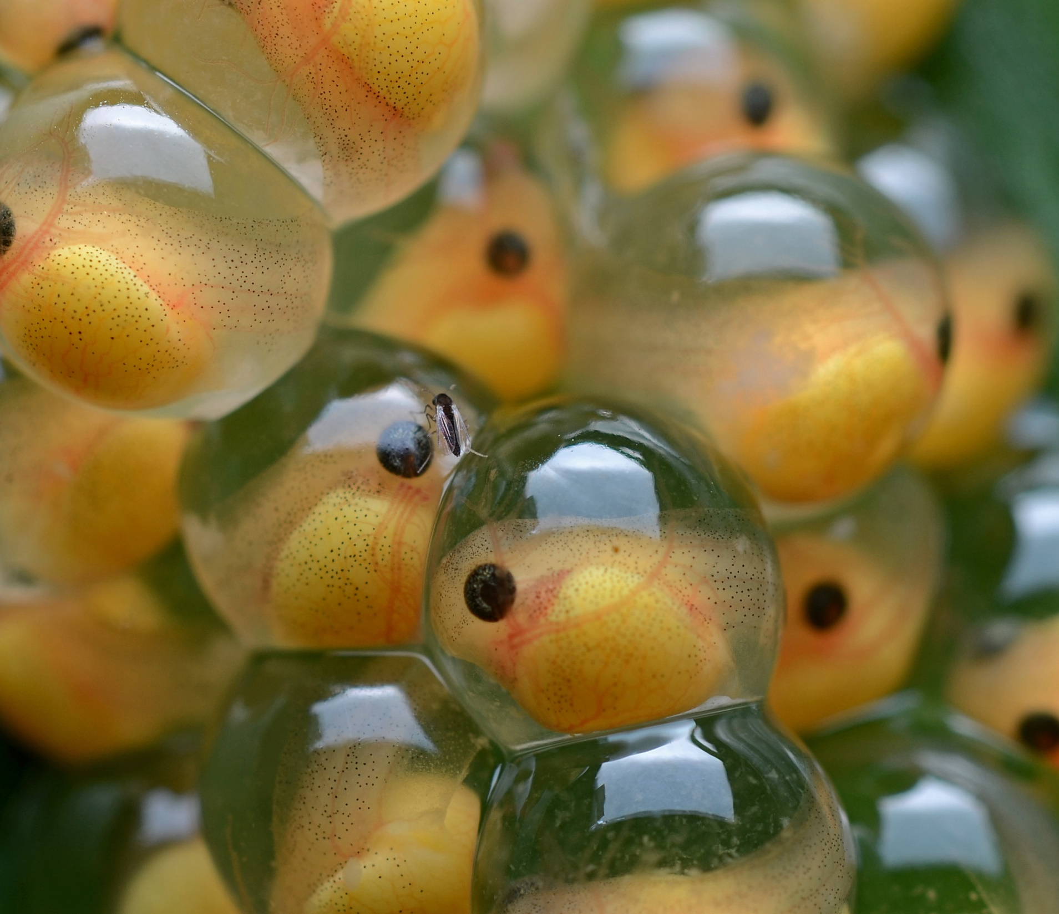
A Transformation Cycle
Egg Stage
Just before breeding, the females lay their fertilized eggs into the still water. The male fertilizes the eggs as the female releases them. There are a lot of eggs!
This Photo by Unknown Author is licensed under CC BY-SA

Slide 8
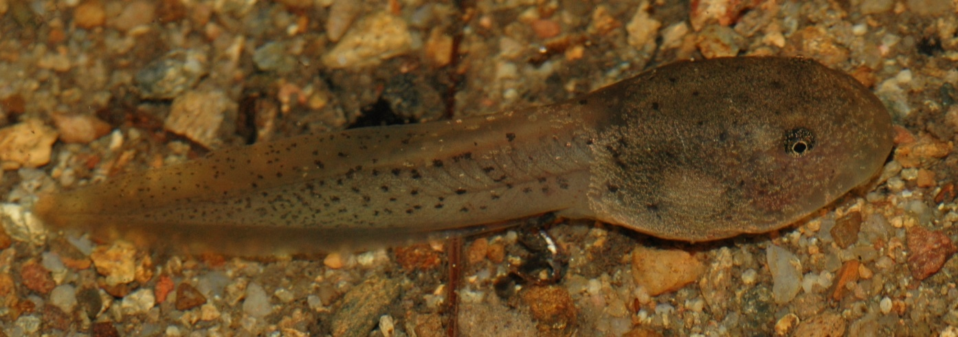
A Transformation Cycle
Tadpole Stage
Tadpoles resemble small fish. They are tiny and have a head, a tail, and gills for breathing. Until now, they had the luxury of getting their nutrients in the eggs.
This Photo by Unknown Author is licensed under CC BY-SA

Slide 9
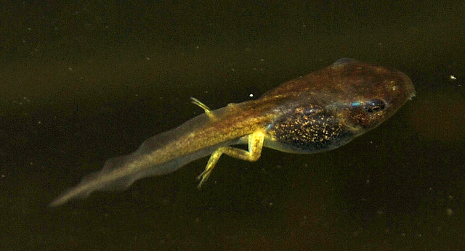
A Transformation Cycle
Tadpole with Limbs Stage
As the tadpoles continue to eat, they grow in size. Also, they start to develop their fore and hind limbs. As the legs grow, the tail begins to diminish, and the tadpole turns into a froglet.

Slide 10
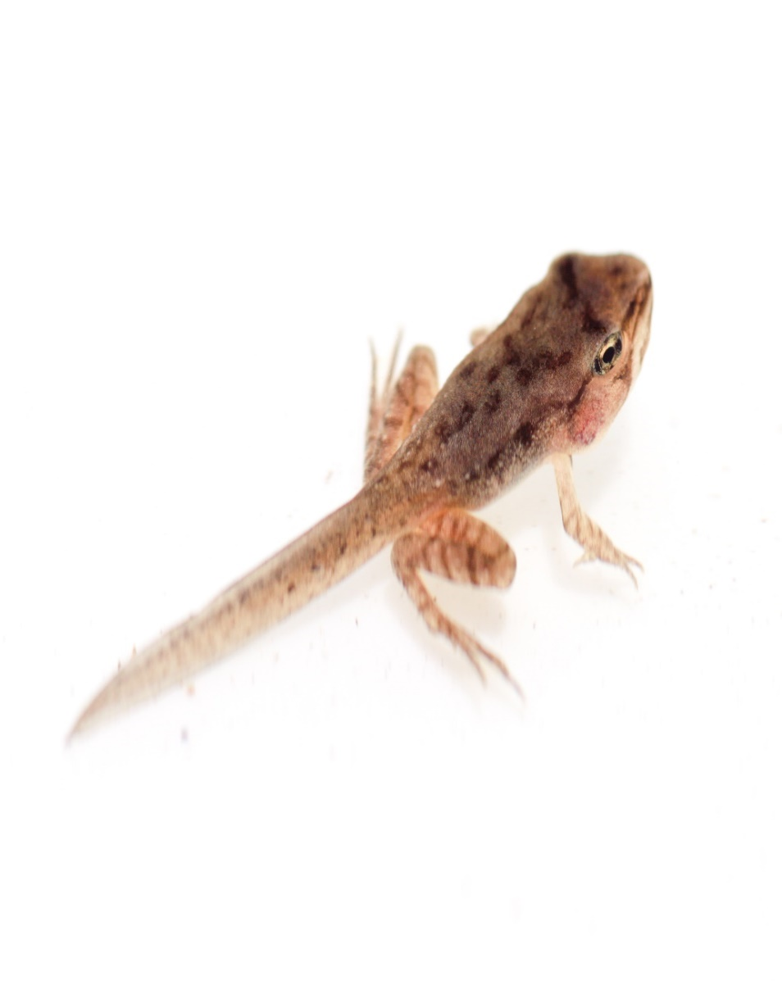
A Transformation Cycle
Froglet Stage
At this stage, it has been 9 to 12 weeks. The tadpole now has a very little tail and more significant limbs. It is now a froglet, a young frog.

Slide 11
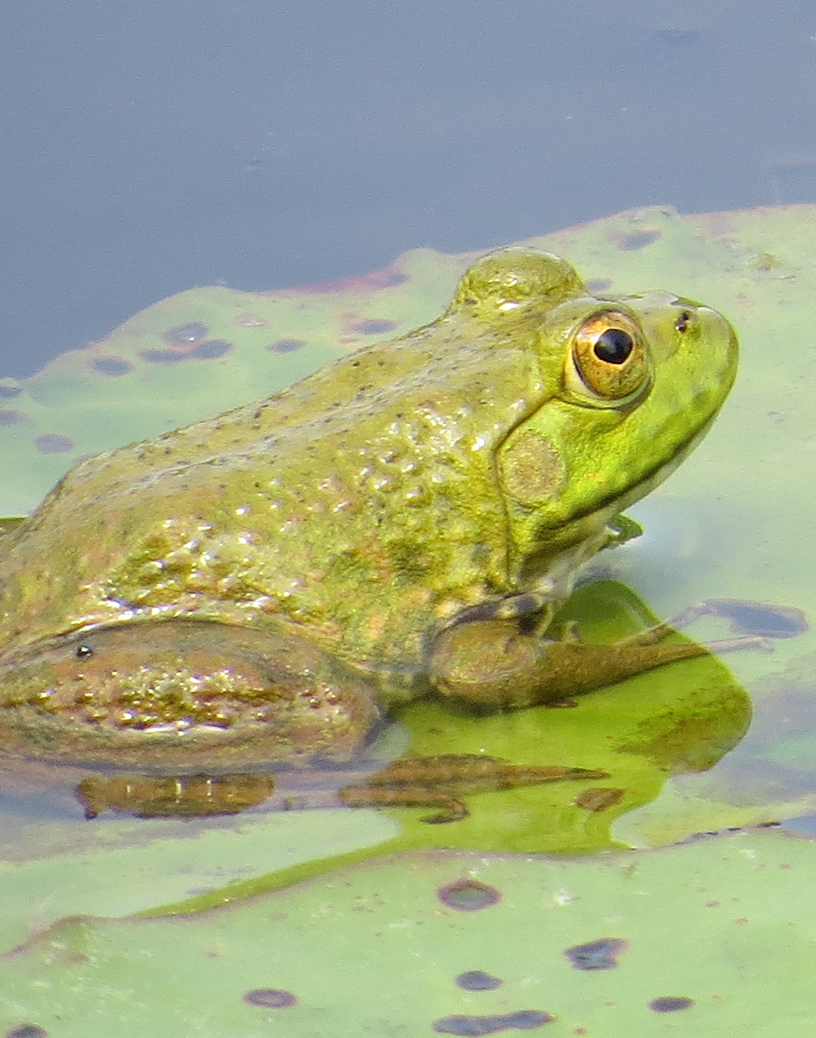
A Transformation Cycle
Adult Frog Stage
We are at the ultimate stage! Here, the tail is now invisible, and the frog has proper fore and hind limbs. Also, the adult completely absorbs the gills.
The adult frog is now ready to breed, and the cycle can start all over again.
This Photo by Unknown Author is licensed under CC BY-NC-ND

Slide 12
Transform Your Mind
Just as the life cycle of a frog starts over, the Christian is engaged in a perpetual transforming of the mind on a daily basis. This is how you do it.
Keep Falling in Love with Christ Over and Over Again

Slide 13
God’s Love for His chosen nation, Israel, in the midst of their rejection of Him Romans 10:21
Romans 10:21-But to Israel he saith, All day long I have stretched forth my hands unto a disobedient and gainsaying people.
The Apostle Paul makes it very clear by quoting Isaiah 65:2. God is pictured in His
Long-suffering
His loving kindness for Israel
His stretched-out Hands beckoning them to come to Him
FACT- They rejected Him with disobedience and contradictory speech. Just as the Gentles were without excuse in Romans 1, the Jews were without excuse here

Slide 14
Mindset of Rejection
The Gospel had been preached to them
They heard it
They understood it
FACT-They rejected it
FACT-When they disobeyed Christ, they disobeyed God
FACT-In speaking against Christ, they spoke against God
FACT-The Scriptures pointed the way to Christ, but they rejected Him

Slide 15
Mindset of Rejection-Romans 11:1
I say then, Hath God cast away his people? God forbid. For I also am an Israelite, of the seed of Abraham, of the tribe of Benjamin.
What are you saying Paul? The Jews were responsible for their state, they had refused to believe in Jesus and obey God’s Will. Because of this, God rejected them.
FACT-Let’s be clear here-This doesn’t mean that he had cast them off and will have nothing to do with them.
FACT-Paul answers by saying that he does not save them en masse, which is as a group, but each Israelite can have the right relationship with God if he believes in Jesus and obeys the Gospel.

Slide 16
Mindset of Rejection― Romans 11:8
(According as it is written, God hath given them the spirit of slumber, eyes that they should not see, and ears that they should not hear;) unto this day.
The Latin word Callus describes their minds as hardened. When a part of a bone is fractured, the callus causes the part to lose its feeling.
Their minds were insensitive to touch
They could no longer hear and feel the appeal of God
This can happen to any man
Show me a person who lives his own way towards God and I will show you a person who will become insensitive towards God
If a man goes on to sin, he will become insensitive to the horror of sin.

Slide 17
Mindset of Rejection-Romans 11:8
FACT-They heard the Gospel and rejected it
FACT- They refused to believe and obey it, so they became hardened
FACT-Isaiah 6:9, Paul talks about how the consequences of refusing to believe the message of the Gospel resulted in their being unable to see things rightly
What does God do in this situation, since they will not use their eyes to see? I will let them go blind.
Romans 11:9, David said, let their table be made a snare and a trap, a stumbling block, and a recompense unto them. This is referenced from Psalms 69:22-23. This was spoken towards David’s enemies

Slide 18
Transform Your Minds Romans 12:1-2
Now that you are a Christian:
This is not a command Paul says to the Gentiles
Who are you, Now that you’ve heard and received the Gospel and choose to do your will
Who are you, Now that you understand the Gospel
Who are you-To turn away from the teaching of the Gospel
Who are you-To disobey Christ, and disobey God now that you are a Christian
Who are you-To speak against Christ, and speak against God

Slide 19
Transform Your Minds Romans 12:1-2
Who are you-You are a nobody that was at odds with the nation of Israel and through God’s love, mercy, and grace took away the enmity that was between you and the nation of Israel that there might be peace, and that the world might be saved
Now that you are a Christian:

Slide 20
Transform Your Minds Romans 12:1-2
Now that you are a Christian:
(According as it is written, God hath given them the spirit of slumber, eyes that they should not see, and ears that they should not hear;) unto this day.
I beseech you that your minds will not become harden as the Israelites. There is a word called Callus, it means that their minds were harden.
I beseech you that your minds will not become insensitive to God
I beseech you that you will hear and feel the appeal of God
I beseech you that you won’t live your own way towards God
If a man goes on to sin, he will become insensitive to the horror of sin.
What happened to Israel can happen to you

Slide 21
Transform Your Minds―Romans 12:1 Now that you are a Christian . . .
I beseech is not a command
I beseech is not a command . . .
It is a loving entreaty Paul says
God has provided salvation/blessings as we live the Christian walk
Present your bodies as a living sacrifice
Your physical body
Keep it presented
It is to be a living sacrifice, not a dead sacrifice
It is to be oneself and not someone else
Your body should be holy and free from sin
Acceptable to God
To do His Will willingly and obediently
A living sacrifice to the service of God reasonably
A spiritual response to the Grace of God and what He has done for man

Slide 22
Transform Your Minds―Romans 12:1 Now that you are a Christian . . .
Christian Living
Christians are not to be like the temporal world, if so you will become carnal
Christians are to change their minds to follow God instead of the things of the world
Your heart must be pure and sincere and desire to know God’s Will and do it
Understanding these principles will allow the Christian to do what is right and good in every situation
FACT-God’s Word is the standard for living.
It contains principles and precepts
FACT-You must have a good and honest heart in all circumstances to do what is pleasing and right in God’s sight

Slide 23
Romans 11:36-For of him, and through him, and unto him, are all things. To him be the glory forever, Amen
All things are created by God. All things are sustained by God. And all things are for His glory and honor. When man realizes this, he is on his way to understanding how great God is. God is to be worshiped and served

Slide 24
Transform Your Mind A Perpetual Renewing of the Mind
New babe in Christ
Change of mind
Change of attitude
Change of habits
Righteous counsel
Understanding wisdom
Take off the disguise or camouflage
Infirmities that might be holding you back
Loving not the world
Finally, your body must be presented as a living sacrifice

Slide 25
Thank You for Your Attendance Today!
Continue to Pray for our Church Family

