Slide 1
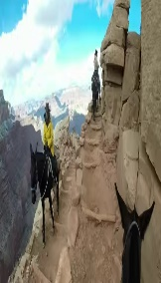
130 60 71
138 72 81
132 121 63

Slide 2
“The World Is Not a Safe Guide for Your Life” Matthew 7
Presenter: François Ransom
Saturday, September 26, 2020

Slide 3
INTRODUCTION
There has always been a lot of criticism and judgement in the world
However, this has increased exponentially because of the pandemic, job loss, death, business closings, racial unrest, and the pandemonium going on in Washington DC
Matthew 7:1-5 / 1 John 4:1a and verses 5-6
We are constantly “chewing” on each other and, as humans, tend to judge each other

Slide 4
INTRODUCTION
This behavior is not a safe guide for our lives because of the following:
1) We don’t have all the facts
2) Because we don’t know the heart (mind) we cannot legislate the heart/mind
3) It’s hard for us to be impartial

Slide 6
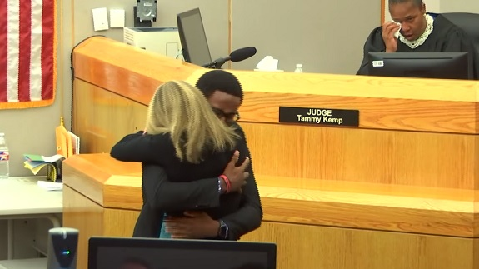
THE WORLD DOES NOT FOLLOW THE “GOLDEN RULE”
THE WORLD SAYS “Do unto others before they do unto you”
But what does Jesus teach? Matthew 7:12

Slide 7
THE WORLD DOES NOT FOLLOW THE “GOLDEN RULE”
Luke 6:31-35 (New Living Translation)
³¹ Do to others as you would like them to do to you.
³² “If you love only those who love you, why should you get credit for that? Even sinners love those who love them! ³³ And if you do good only to those who do good to you, why should you get credit? Even sinners do that much! ³⁴ And if you lend money only to those who can repay you, why should you get credit? Even sinners will lend to other sinners for a full return.
³⁵ “Love your enemies! Do good to them. Lend to them without expecting to be repaid. Then your reward from heaven will be very great, and you will truly be acting as children of the Most High, for He is kind to those who are unthankful and wicked.

Slide 8
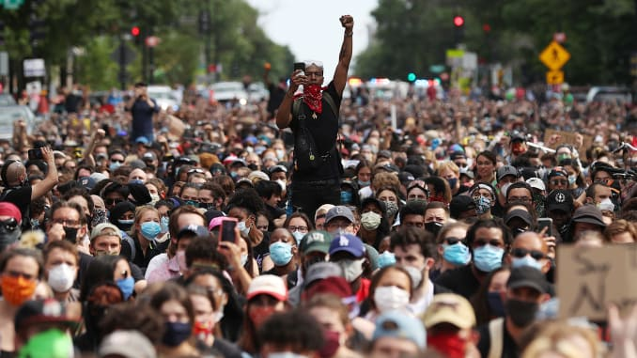
FOLLOWING THE MAJORITY IS NOT A SAFE GUIDE FOR OUR LIVES
Nowadays the world says the wrong thing to do is the right thing to do, and that the right thing to do is the wrong thing to do

Slide 9
FOLLOWING THE MAJORITY IS NOT A SAFE GUIDE FOR OUR LIVES
Isaiah 5:20 (New Living Translation)
“What sorrow for those who say that evil is good and good is evil, that dark is light and light is dark, that bitter is sweet, and sweet is bitter”.
²¹ “what sorrow for those who are wise in their own eyes and think themselves so clever”.
Jesus said people like this cannot see . . .
Matthew 15:14 (New Living Translation)
“So ignore them. They are blind guides leading the blind, and if one blind person guides another, they will both fall into a ditch”.

Slide 10
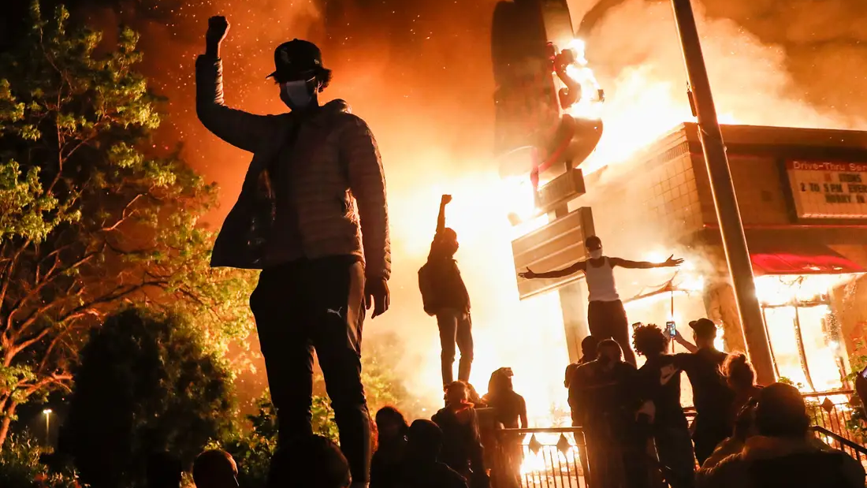
IF NOT CAREFUL IN THIS AREA, WE CAN FALL VICTIM TO A “HERD MENTALITY”
A herd mentality defined, is the phenomenon of individuals deciding to follow others and imitating group behaviors, rather than deciding independently on the basis of their own private information
Romans 8:6 (New Living Translation)
“So letting your sinful nature control your mind leads to death. But letting the spirit control your mind leads to life and peace”.
A psychological theory by Dr. Wendy James called “The Contagion Theory”, proposed that crowds exert a hypnotic influence on their members that result in irrational and emotionally-charged behavior often referred to as a crowd frenzy.
Paul dealt with this in Ephesus in Acts 19:24-32 (New Living Translation)

Slide 11
STUDIES WORK “IN CONCERT” WITH WHAT THE BIBLE TEACHES US ABOUT FOLLOWING THE MAJORITY
Sociologists at Leeds University, a public research university in West Yorkshire, England, performed a group experiment where volunteers were told to randomly walk around a large hall without talking to each other
A select few were then given more detailed instructions on where to walk
The scientists discovered that people end up blindly following one or two instructed people who appear to know where they’re going
The results of these experiments showed that it only takes 5% of confident looking and instructed people to influence the direction of the 95% of people in the crowd, and the 200 volunteers did this without even realizing it!

Slide 12
THE WORLD DOES NOT FOLLOW THE PROFOUND TEACHINGS OF JESUS
Jesus was a carpenter. He wasn’t a theologian or doctor of the law . . . but was the law itself and the creator of it
2 Timothy 3:16 (The Message Bible) “every part of scripture is God-breathed and useful one way or another – showing us truth, exposing our rebellion, correcting our mistakes . . . training us to live God’s way.
Matthew 7:28-29 (KJV) “and it came to pass, when Jesus had ended these sayings, the people were astonished at his doctrine: for he taught them as one having authority, and not as the scribes”.

Slide 13
WE LOOK TO GOD FOR GUIDANCE, NOT TO THE WORLD
We’ve often heard the phrase that the BIBLE is “(B)asic (I)nstruction (B)efore (L)ife (E)nds”
This phrase is true for the Christian and for those who are seeking the truth
Proverbs 1:5 (ESV)
“Let the wise hear and increase in learning, and the one who understands obtain guidance . . .
Psalms 32:8 (ESV)
“The Lord says, I will guide you along the best pathway for your life. I will advise you and watch over you”
Psalms 16:7 (ESV) “I will bless the Lord who guides me; even at night my heart instructs me”.

Slide 14
CONCLUSION
In closing, we’ve learned that a) judging and being critical of others before taking introspection of ourselves, b) not treating people the way we want to be treated, c) following the majority, and d) not following the principles of the Scriptures, is a “recipe for disaster”.
I believe it’s painfully obvious that the safest guide for our lives is following the profound teachings of our Lord and Savior Jesus Christ.
THANK YOU FOR YOUR ATTENTION

