Slide 1
The Wrong Perception of the pathway to life
Mathew 7:21-24
Notes:
Perception-a way of regarding, understanding, or interpreting something; a mental impression.
If there appears to be a conflict between two statements in the scriptures, we must realize that it is our understanding that is the problem.

Slide 2
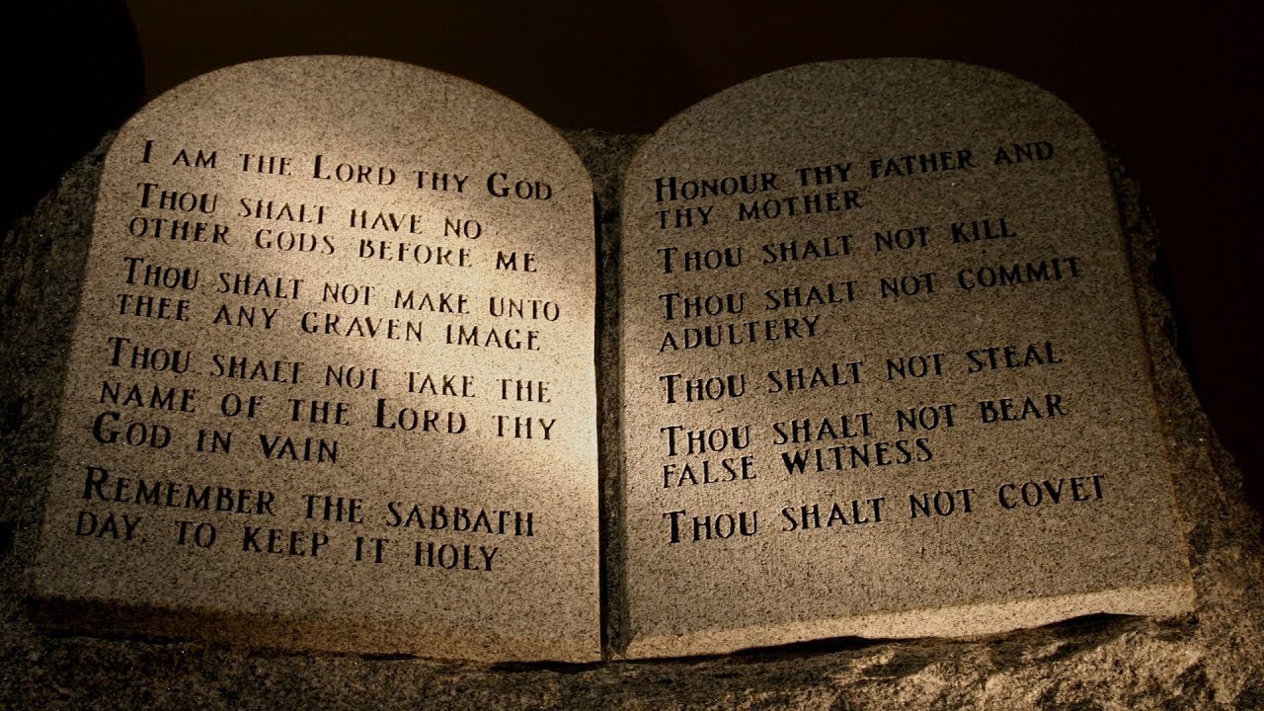
“We are saved by the Law of Moses”

Slide 3
Common Misconceptions
We are still under law, because Christ said that he did not come to destroy the law.
Matthew5:17
"Do not think that I came to destroy the Law or the Prophets. I did not come to destroy but to fulfill"
James 2:8-12 verifies that the Law of Moses is still in effect.
8 If ye fulfil the royal law according to the scripture, Thou shalt love thy neighbour as thyself, ye do well:
9 But if ye have respect to persons, ye commit sin, and are convinced of the law as transgressors.
10 For whosoever shall keep the whole law, and yet offend in one point, he is guilty of all.
11 For he that said, Do not commit adultery, said also, Do not kill. Now if thou commit no adultery, yet if thou kill, thou art become a transgressor of the law.
12 So speak ye, and so do, as they that shall be judged by the law of liberty.

Slide 4
What does the Bible teach?
Gal.3:24-25
Wherefore the law was our schoolmaster to bring us unto Christ, that we might be justified by faith. But after that faith is come, we are no longer under a schoolmaster.
Rom 10:4
For Christ is the end of the law for righteousness to everyone who believes.
Col 2:14
Blotting out the handwriting of ordinances that was against us, which was contrary to us, and took it out of the way, nailing it to his cross;
Gal. 2:21
“I do not nullify the grace of God, for if righteousness comes through the Law, then Christ died needlessly.”
Notes:
Jesus explained what he meant by "fulfilled" when he emphasized that the Law would not end until all was fulfilled. This "fulfilled" comes from a different Greek word, ginotai. It means, "to be, to come into being, to be made, be done, become, or to be celebrated." In other words Jesus is saying that the world would have a better chance of ending before God accomplished His purpose for the Law.
Another verse that speaks to this same topic is Romans 10:4, "For Christ is the end of the law for righteousness to everyone who believes." The word translated "end" is from the Greek word "telos," which means "end, termination, conclusion, aim, result, goal, outcome." In other words the purpose of the Law was culminated in Christ Jesus. Jesus was its goal. With His death, he brought the law to its conclusion.
Jeremiah 31:31
“The days are coming,” declares the Lord, “when I will make a new covenant with the people of Israel and with the people of Judah.”
Romans9:4
Who are Israelites; to whom pertaineth the adoption, and the glory, and the covenants, and the giving of the law, and the service of God, and the promises;
In that he saith, A new covenant, he hath made the first old. Now that which decayeth and waxeth old is ready to vanish away.
But a closer look shows us that it would remain in force till all things be accomplished. Jesus has just said, I came not to destroy, but to fulfil the law and the prophets (Matt. 5:17). The fact is, the Law of Moses was a transitory time for God to prepare man for the coming of Christ, so that the law has become our tutor to bring us unto Christ (Gal. 3:24). All that the law and the prophets taught finds fulfillment in Christ and His death, burial, resurrection and the establishment of His kingdom, the church.

Slide 5
“You can join the church of your choice.”

Slide 6
Common Misconceptions
It doesn’t matter were you go to church as long as you are worshiping the Lord.
God is not concern with how with worship him as long as we are worshiping him.
Notes:
In our world today, there are many different churches claiming to be Jesus’ Church.

Slide 7
What does the Bible teach?
Matt16:18
upon this rock I will build my church
Matt17:5
“This is my beloved Son,1 with whom I am well pleased; listen to him.”
1 Cor1:12
One of you says, “I follow Paul”; another, “I follow Apollos”; another, “I follow Cephas”; still another, “I follow Christ.”
Eph1:22-23
And hath put all things under his feet, and gave him to be the head over all things to the church, Which is his body, the fulness of him that filleth all in all.
Eph 4:4-6
There is one body and one Spirit, just as you were called to one hope when you were called; one Lord, one faith, one baptism; one God and Father of all, who is over all and through all and in all.
Notes:
Acts 4:12
Salvation is found in no one else, for there is no other name under heaven given to mankind by which we must be saved.”
Mat12:25- kingdom divided

Slide 8
What does the Bible teach?
Leadership
Elders-Act 20:17
Deacons- 1 Tim 3:8-13
Evangelist-Rom 10:14-15
Worship
Preaching and teaching- 1 Cor1:18
Lords Supper -1 Cor11:23-26
Prayer -1 Cor14:15
Singing- 1 Cor14:15
Giving- 1 Cor16:2
Names for the church
Romans16:16
1 Cor 1:2
Acts 20:28

Slide 9
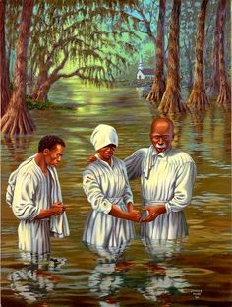
“Baptism is not essential to salvation.”

Slide 10
Common Misconceptions
All you have to do Is call on the name of the lord.
Acts2:21
And it shall come to pass that whoever calls on the name of the Lord shall be saved
Romans10:13
"For whosoever shall call upon the name of the Lord shall be saved.“
Paul said that Christ didn’t send him to baptize therefore, baptism is not essential to salvation
1 Cor 1:17
For Christ did not send me to baptize, but to preach the gospel, not with wisdom of words, lest the cross of Christ should be made of no effect.

Slide 11
What does the Bible teach?
Acts 2:21
Acts 22:16
Notes:
The Bible doesn't teach that salvation is exclusively by faith.
The Bible has always taught that salvation occurs when faith is joined by obedient action to the commands of God
Acts: 10:24-33
Cornelius had faith.
It is not faith alone, but faith working in harmony with working obedience.

Slide 12
What does the Bible teach?
1 Peter 3:21
There is also an antitype which now saves us—baptism (not the removal of the filth of the flesh, but the answer of a good conscience toward God), through the resurrection of Jesus Christ,
Mark16:16
He that believeth and is baptized shall be saved; but he that believeth not shall be damned.
Acts2:38
Peter replied, “Repent and be baptized, every one of you, in the name of Jesus Christ for the forgiveness of your sins. And you will receive the gift of the Holy Spirit.
Acts 8:26-40
Philip and the Eunuch
Acts 16:30-33
Jailor
Act 10: 44-48
Cornelius

Slide 13
“Once saved, always saved.”
I’m done

Slide 14
Common Misconceptions
Scriptures used in defense of “Once saved, always saved.”
John 10:28
And I give them eternal life, and they shall never perish; neither shall anyone snatch them out of my hand.
1 John 3:9
Whoever has been born of God does not sin, for His seed remains in him; and he cannot sin, because he has been born of God.
2 Peter 1:10
Therefore, brethren, be even more diligent to make your call and election sure, for if you do these things you will never stumble,
Notes:
If we claim to be without sin, we deceive ourselves and the truth is not in us. If we confess our sins, he is faithful and just and will forgive us our sins and purify us from all unrighteousness. If we claim we have not sinned, we make him out to be a liar and his word is not in us. (1 John 1:8-10; NIV)
So, obviously we need to understand what John means by his comment in 1 John 3:9.

Slide 15
What does the Bible teach?
Calvin is not the originator of this doctrine. It was first taught by Satan thousands of years before in the Garden of Eden.
Genesis 3:1-4
1Peter 5:8
Be alert and of sober mind. Your enemy the devil prowls around like a roaring lion looking for someone to devour.

Slide 16
What does the Bible teach?
1Cor 10:12
Wherefore let him that thinketh he standeth take heed lest he fall.
1 Tim 1:19-20
Holding faith, and a good conscience; which some having put away concerning faith have made shipwreck: 20 Of whom is Hymenaeus and Alexander; whom I have delivered unto Satan, that they may learn not to blaspheme.
2Tim4:10
For Demas hath forsaken me, having loved this present world, and is departed unto Thessalonica; Crescens to Galatia, Titus unto Dalmatia.
Gal 5:4
4 You have become estranged from Christ, you who attempt to be justified by law; you have fallen from grace.
Notes:
Heb 3:12 Beware, brethren, lest there be in any of you an evil heart of unbelief in departing from the living God;

Slide 17
What does the Bible teach?
Phi 2:12
Therefore, my dear friends, as you have always obeyed—not only in my presence, but now much more in my absence—continue to work out your salvation with fear and trembling,
James 1:12
Blessed is the one who perseveres under trial because, having stood the test, that person will receive the crown of life that the Lord has promised to those who love him.
The Scriptures put as much emphasis on finishing the race strong as they do starting the race.
Notes:
There are countless Scriptures calling God’s people to remain faithful until the very end of their life.

