Slide 1
The Promise of the abundant Life

Slide 2
Question
What does it mean to receive the abundant Life?
Webster's Dictionary:
Defines - Abundant
Adjective :
1.) Present in great quantity
2.) more than adequate or over sufficient
3.) well supplied with something
4.) to be filled

Slide 3
Abundant defined
What does it mean to receive the abundant Life?
Webster Dictionary:
Defines - Abundant
Verb :
1.) To occur or exist in great quantities or numbers
2.) To be rich or well supplied
Synonyms : Flourish, thrive , swam, infest or overflow, plentiful
Antonym: Sparse or Scarce

Slide 4
Life defined
What does it mean to receive the abundant Life?
Webster's Dictionary:
Defines – Life
1.) The condition that distinguishes organisms from inorganic and dead organisms, being manifest by growth through metabolism , reproduction and the power of adaptation to environment through changes originating internally.
2.) The animate existence or period of animate existence of an individual.
3.) A corresponding state, existence, or principle of existence conceived of as belonging to the soul or eternal Life.

Slide 5
Life defined continued……..
4.) for or lasting a life time, life long
Example: a life membership or a club, life sentence or life subscription.
Life Defined : Noun
1.) The state or quality that distinguishes living beings or organisms from dead ones & from inorganic matter , characterized chiefly by metabolism, growth, and the ability to reproduce and respond stimuli.

Slide 6
Life defined continued
Life defined continued
Example:
1.) The period between birth and life
2.)a living person or being , to save a life
3.)the time between birth and present time
4.)The remainder or extent of one’s life

Slide 7
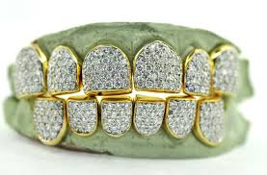
Abundant defined

Slide 8
Abundant defined

Slide 9
Abundant Life Scripture
John 10:10 – The thief does not come except to steal, and to kill, and to destroy. I have come that they may have life, and that they may have life more abundantly.

Slide 10
The Promise
3 factors of God’s Promise
God will always do what he promises
We must understand that keeping promises is important.
Explore the difference between good and bad promises

Slide 11
God will always do what he promises
Why? Because he loves us(1John 4:19)
Each promise is important to God
(2 Corinthians 1:20 )
We can count on God to do what he says(Acts 2:39)
God’s Promises are never broken.(Deuteronomy 31:6)- God will never leave us nor forsake us.
God keeps his promise because he is good and He never lies. (Psalms 100:5) For the Lord is good; His mercy is everlasting, and his truth endures over all generations

Slide 12
God will always do what he promises
Genesis Chapter 7, 8, 9 : 8-17 – Noah and the Ark
Genesis 9:8-17 New International Version (NIV)
⁸ Then God said to Noah and to his sons with him: ⁹ “I now establish my covenant with you and with your descendants after you ¹⁰ and with every living creature that was with you—the birds, the livestock and all the wild animals, all those that came out of the ark with you—every living creature on earth. ¹¹ I establish my covenant with you: Never again will all life be destroyed by the waters of a flood; never again will there be a flood to destroy the earth.”
God Keeps HIS Promise.

Slide 13
God will always do what he promises
¹² And God said, “This is the sign of the covenant I am making between me and you and every living creature with you, a covenant for all generations to come: ¹³ I have set my rainbow in the clouds, and it will be the sign of the covenant between me and the earth. ¹⁴ Whenever I bring clouds over the earth and the rainbow appears in the clouds, ¹⁵ I will remember my covenant between me and you and all living creatures of every kind. Never again will the waters become a flood to destroy all life. ¹⁶ Whenever the rainbow appears in the clouds, I will see it and remember the everlasting covenant between God and all living creatures of every kind on the earth.”
¹⁷ So God said to Noah, “This is the sign of the covenant I have established between me and all life on the earth.”
God Keeps HIS Promise.

Slide 14
Explore the difference between good and bad promises
A good promise helps others!
Ex: Prayer
God’s promise to answer my prayer
(1 John 3:22)
Ex: Be there for others in time of trouble
God promise to help when we are in trouble
(Psalm 50:15)
Ex: When we make mistakes
God promises to Love me
(Romans 5:5)

Slide 15
Explore the difference between good and bad promises
A bad promise will get you in trouble
Ex: Kids, family members, appointments, work, etc.
If you make a bad promise and keep it, it will only make things worse.
Ecclesiastes 5:5
It is better not to make a vow than to make one and not fulfill it.

Slide 16
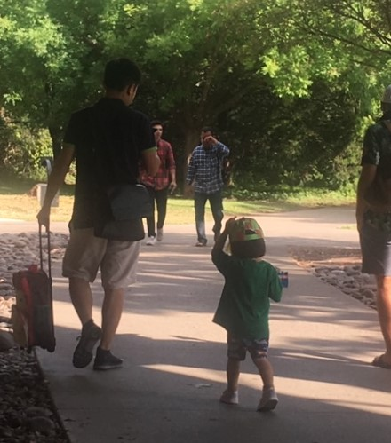

Slide 17
The Promise of an abundant Life!
The greatest promise God has made to us is the promise of eternal life through Christ Jesus. If we believe in Jesus and obedient to HIS WILL , put our trust and faith in him, God promises that we can live with him forever in Heaven someday.
John5:24 and Ephesians 2:8-9, Rev 2:10
What a wonderful Promise!

