Slide 1
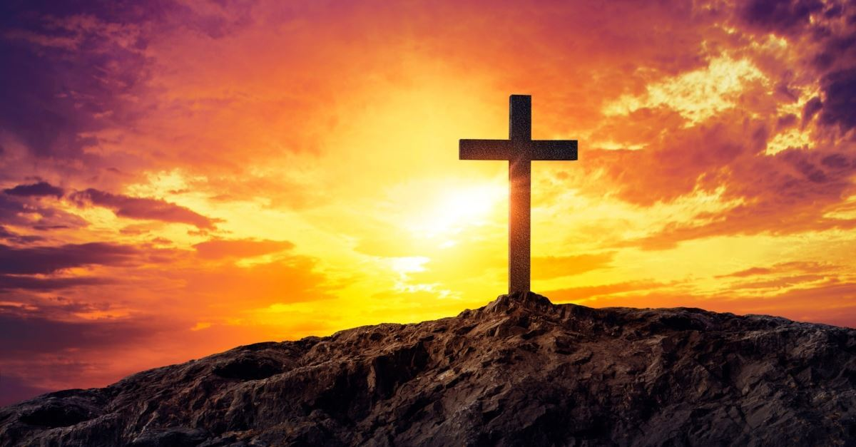
The Full Armor of God
Presenter: David Wynn II
The SHARE
Saturday, December 14, 2019

Slide 2
The Full Armor of God
Objective:
Read Ephesian 6: 10 - 17
The reasons why you need to put on the full armor of God
Football Equipment
Read 1st Thessalonians 5:1-28

Slide 3
The Full Armor of God
¹⁰ Finally, be strong in the Lord and in his mighty power. ¹¹ Put on the full armor of God, so that you can take your stand against the devil’s schemes. ¹² For our struggle is not against flesh and blood, but against the rulers, against the authorities, against the powers of this dark world and against the spiritual forces of evil in the heavenly realms. ¹³ Therefore put on the full armor of God, so that when the day of evil comes, you may be able to stand your ground, and after you have done everything, to stand. ¹⁴ Stand firm then, with the belt of truth buckled around your waist, with the breastplate of righteousness in place, ¹⁵ and with your feet fitted with the readiness that comes from the gospel of peace. ¹⁶ In addition to all this, take up the shield of faith, with which you can extinguish all the flaming arrows of the evil one. ¹⁷ Take the helmet of salvation and the sword of the Spirit, which is the word of God.

Slide 4
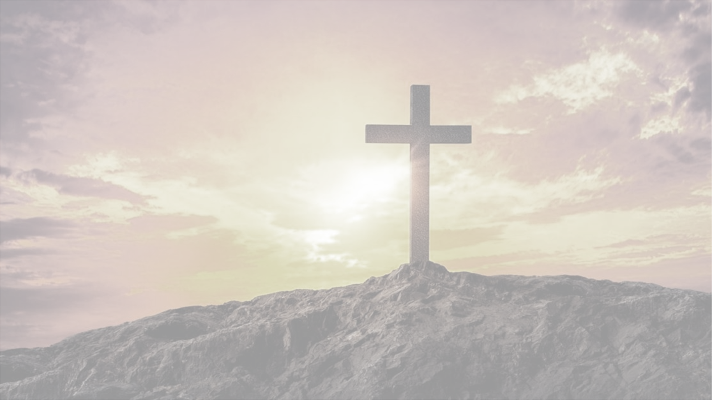
The Full Armor of God
The reasons why you need to put on the full armor of God
So you don’t end up like Elmo

Slide 5
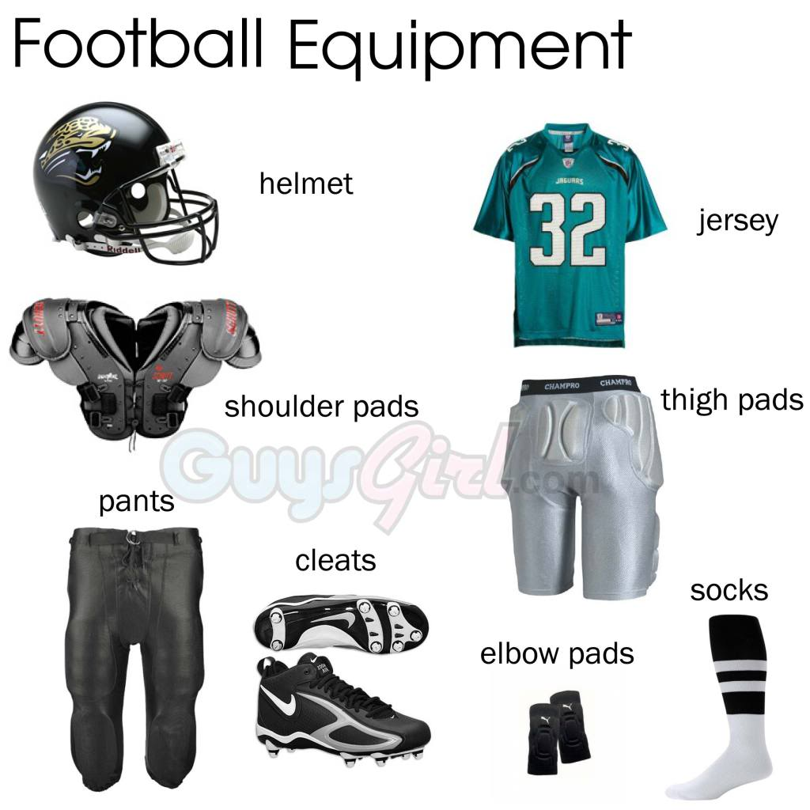
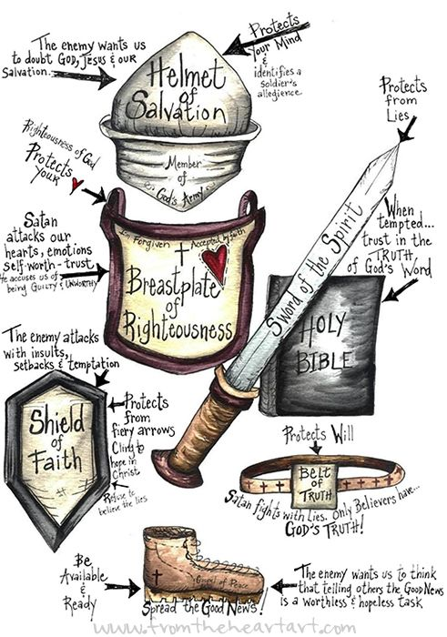
The Full Armor of God
Football Equipment Is like the full armor of God but there are some similarities like Breastplate to the Shoulder pads, Shoes to Cleats, the Helmet, and most importantly they protect you from the opposing team.

Slide 6
The Full Armor of God List
Belt of truth
Breastplate of righteousness
Shoes of the gospel
Shield of faith
Helmet of salvation
Sword of the spirit

Slide 7
1. Belt of Truth (Ephesians 6:14)
“Stand therefore, having girded your waist with truth,” Paul says. Truth is the belt that holds all the other pieces of the armor in place.

Slide 8
2. Breastplate of Righteousness (Ephesians 6:14)
The breastplate covers the heart and shields it and the other vital organs. The Bible says, “Keep your heart with all diligence, for out of it spring the issues of life” (Proverbs 4:23).

Slide 9
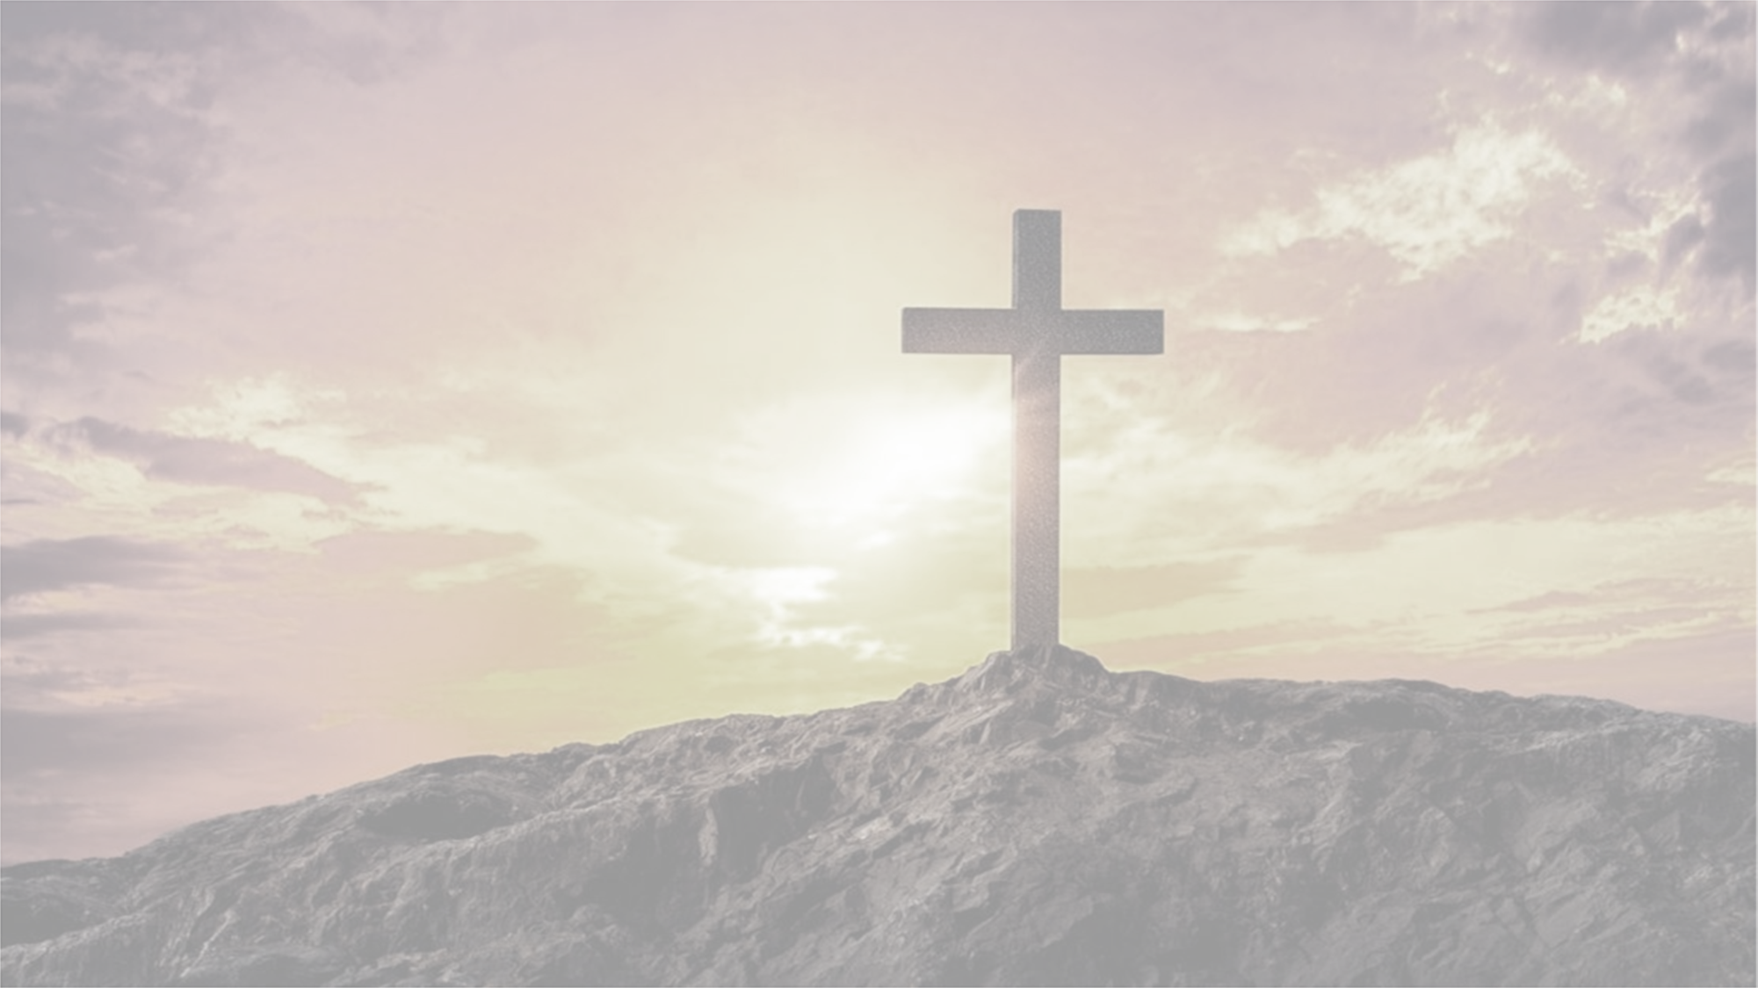
3. Shoes of the Gospel (Ephesians 6:15)
Soldiers marching into battle must have comfortable shoes. As soldiers of Christ, we must put on “gospel shoes” that will allow us to march wherever our Lord leads. The apostle John says, “He who says he abides in Him [Jesus] ought himself also to walk just as He [Jesus] walked” (1 John 2:6).

Slide 10
4. Shield of Faith (Ephesians 6:16)
Paul says, “Above all, . . . [take] the shield of faith with which you will be able to quench all the fiery darts of the wicked one” (Ephesians 6:16). When Satan attacks with doubts, the shield of faith turns aside the blow.

Slide 11
Helmet of Salvation (Ephesians 6:17)
The helmet protects the head—perhaps the most vital part of the body since it is the seat of thought and the mind. When we have a sure knowledge of our salvation, we will not be moved by Satan’s deceptions. When we are certain that we are in Christ with our sins forgiven, we will have a peace that nothing can disturb.

Slide 12
Sword of the Spirit (Ephesians 6:17)
The sword of the spirit is the only weapon of offense listed in the armor of God. All the other parts are defensive in nature. God’s Word—the Bible—is described as “living and powerful, and sharper than any two-edged sword” (Hebrews 4:12).

Slide 13
The Full Armor of God—1 Thessalonians 5:1-28
Now, brothers and sisters, about times and dates we do not need to write to you, ² for you know very well that the day of the Lord will come like a thief in the night. ³ While people are saying, “Peace and safety,” destruction will come on them suddenly, as labor pains on a pregnant woman, and they will not escape.
⁴ But you, brothers and sisters, are not in darkness so that this day should surprise you like a thief. ⁵ You are all children of the light and children of the day. We do not belong to the night or to the darkness. ⁶ So then, let us not be like others, who are asleep, but let us be awake and sober. ⁷ For those who sleep, sleep at night, and those who get drunk, get drunk at night. ⁸ But since we belong to the day, let us be sober, putting on faith and love as a breastplate, and the hope of salvation as a helmet.

Slide 14
The Full Armor of God—1 Thessalonians 9-13
⁹ For God did not appoint us to suffer wrath but to receive salvation through our Lord Jesus Christ. ¹⁰ He died for us so that, whether we are awake or asleep, we may live together with him. ¹¹ Therefore encourage one another and build each other up, just as in fact you are doing. ¹² Now we ask you, brothers and sisters, to acknowledge those who work hard among you, who care for you in the Lord and who admonish you. ¹³ Hold them in the highest regard in love because of their work. Live in peace with each other.

Slide 15
The Full Armor of God—1 Thessalonians 14-28
¹⁴ And we urge you, brothers and sisters, warn those who are idle and disruptive, encourage the disheartened, help the weak, be patient with everyone. ¹⁵ Make sure that nobody pays back wrong for wrong, but always strive to do what is good for each other and for everyone else.
¹⁶ Rejoice always, ¹⁷ pray continually, ¹⁸ give thanks in all circumstances; for this is God’s will for you in Christ Jesus.
¹⁹ Do not quench the Spirit. ²⁰ Do not treat prophecies with contempt ²¹ but test them all; hold on to what is good, ²² reject every kind of evil.

Slide 16
The Full Armor of God—1 Thessalonians 14-28
²³ May God himself, the God of peace, sanctify you through and through. May your whole spirit, soul and body be kept blameless at the coming of our Lord Jesus Christ. ²⁴ The one who calls you is faithful, and he will do it.
²⁵ Brothers and sisters, pray for us. ²⁶ Greet all God’s people with a holy kiss. ²⁷ I charge you before the Lord to have this letter read to all the brothers and sisters.
²⁸ The grace of our Lord Jesus Christ be with you.

Slide 17
The Full Armor of God

