Slide 1
Directions: Circle the correct answer only after reading each scripture
Have the student read the scripture out loud
If the student can not read, read the scripture out loud for the student
Once the student has read the scripture, ask them the question in the lesson

Slide 2
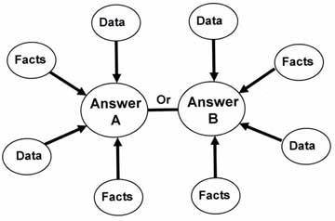
II Peter 1:3
Question 1
YES----NO Has God given us everything we need for life and godliness
YES----NO Since “all” has been provided, do you need additional information other than the Bible?
What are some possibilities and questions that can be raised?
How would you respond?

Slide 3
Ephesians 2:15 ; Colossians 2:14 Have the student read the scriptures out loud
Question 2
YES---NO Has God Abolished the law with its commandments and regulations?
YES---NO Were the hand written ordinances (Ten Commandments) taken out of the way at the time Jesus died on the cross?
Question behind the question. How do you respond?
Do you mean I don’t have to follow the ten commandments
Dispensation moment

Slide 4
Hebrews 8:6-7
Question 3
YES----NO Does God contrast the two covenants: the law of Moses and the New Testament of Christ?
YES----NO If nothing had been wrong with the law of Moses, would God have replaced it with the law of Christ?
Analogy- In society laws are constantly changing, rules are always broken, which brings about change or reform.
Dispensation moment.

Slide 5
Romans 7:6-7
Question 4
Purpose : Is to show that we have been delivered from the Old Law to serve the new way of the spirit
Methodology:
Have we been released from anything? – Yes
How do we serve now? – New way of the spirit
Answer question on the OBS lesson

Slide 6
Further Explanation
Read Matthew 5:21-22
Which one of the 10 commandments is in verse 21?
What does Jesus say in verse 22?
Read Matthew. 5:27-28
Which one of the 10 commandments is in verse 27?
What does Jesus say in verse 28?
Moses Old Law Jesus New Law
Do not kill Do not be angry
Do not Commit Adultery Do not lust
g. Which is the superior law?
h. Some of the principles in the old law are also in Jesus’ teaching

Slide 7
Study And Complete this Chart. Mark Through The Laws Not In Effect Today
Question 5
Purpose: Show analogy between present-day civil and spiritual laws
Methodology:
Find United States-want to discover which law is binding on us today as citizens
Law of Indians?- No, cross out
Laws of England?-No, cross out
Constitution?-Yes
Spiritual Application- which law is binding on us today?
Does God deal with us like he did with Moses, Abraham and other patriarchs in the Old Testament? – No, cross out
Law of Moses? –N0, cross out
New Testament? - Yes

Slide 8
II Timothy 3:16-17
Question 6
YES-NO Since Scriptures make known the will of God to thoroughly equip(furnish) you to every good work, do you need other revelations to make you complete spiritually?
YES-NO Is it your understanding that the New Testament is the law now spiritually binding?

Slide 9
John 12:48 ; John 10:10
Question 7
YES-NO Will the words of Jesus judge you in the last day, rather than the words or commandments of Moses or others?
Question 8
YES-NO Did Jesus come so that you could have a full and abundant life now, as well as eternity?
Explain the abundant life

Slide 10
John 14:6
Question 9
YES-NO Since Jesus said He came to give a full abundant life, should you go to Jesus’s words (teachings) to learn of His way to have that life?
YES-NO Could the words of these people give you the abundant life: mothers, fathers, husbands, wives, friends or neighbors?
YES-NO Could the words of these people give you the abundant life: Joseph Smith, John Calvin, Martin Luther, Wesley brothers, John Knox or the Pope?

Slide 11
Founders of Denominational Churches
Joseph Smith-Mormons in New York 1820’s
John Calvin-Presbyterian Church 1541 in Europe
Martin Luther-Lutheran Church 1526 in Germany
Wesley Brothers-Methodist Church 1739 in England
John Knox-Baptist Church 1609 Amsterdam
The Pope-First Pope: Boniface in 606, Rome Italy

Slide 12
Matthew 7:13-14
Question 10
YES-NO Will the majority enter heaven?
YES-NO Is the majority a safe guide for your spiritual life?
YES-NO Do you want to go to heaven?

Slide 13
Matthew 7:21-23 (see OBS Worksheet-Ladder)
Question 11
YES-NO Since Jesus said he came to give a full and abundant life should you go to Jesus to learn of His way to have that life?
YES-NO Did Jesus say you could enter heaven by doing the will of men?
YES-NO Could Jesus say, “Depart from me” even if you are sincere and say, “Lord, Lord” and do many good works?

Slide 14
OBS Worksheet Ladder
Ask the students to read I Corinthians 3:11, and then fill in the blank. Ask the student to read Romans 10:17 and Hebrews 11:6
Then say, “Christ is the foundation and upon this foundation faith is built”
“ If a ladder has only one side will it work?” (Allow time for an answer.)
(Note the left side of the ladder,) “ If man desires to enter heaven without endeavoring to “Do all the will of God (Matthew 7:21-23; 28:20) will he succeed?”(allow time for an answer).
(Note the right side of the ladder.) “If man desires to enter heaven without the Grace of God will he succeed?”

Slide 15
OBS Worksheet Ladder Continued
6. May one enter heaven by refusing to walk up the ladder in faith and obedience, or by skipping steps?
7. Man must do his part and God will do His part.
At Question 13, after the student answers the questions, go to the worksheet ladder
8. “From this passage (John 3:16) we learn that one must believe. Therefore, as you continue to study please place on each step of the ladder what God commands or wants you to do…”
9. Have the student to place his/her name on the front of the worksheet.
10. Ask the student to highlight on his/her lesson all the places within the lesson that refer you to the worksheet ladder.

Slide 16
John 8:24
Question 14- See Looking Back section on worksheet ladder
Yes-No Is it possible to enter heaven if you do not believe in Jesus Christ?
Ask the student to complete the 6 questions under “Looking back” without comment.

Slide 17
Looking Back Section
Purpose is to help the student reflect on any prior commitment they made to Christ
Have the student answer the questions honestly as they apply to them. Let them know you will come back and talk about it later in the study. Remember the student should answer the question without comment.

Slide 18
Review
Foundation has been built
Who is the foundation? Christ
Romans 10:17- Faith comes through hearing the word of God
Hebrews 11:6- Without faith it is impossible to please God
Matthew 7:21-23-Man must do all the will of God
Ephesians 2:8- It is through the grace of God that man is saved

Slide 19
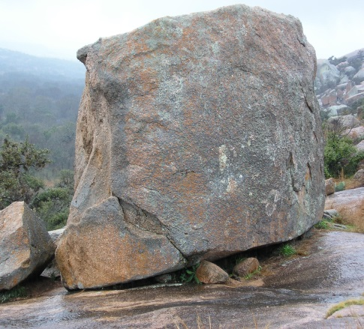
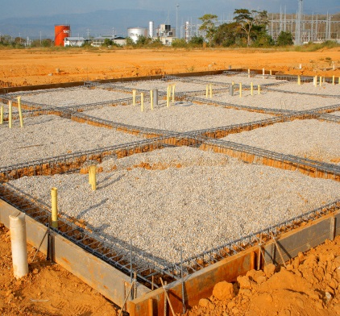
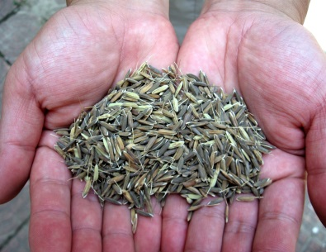
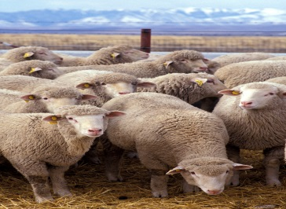
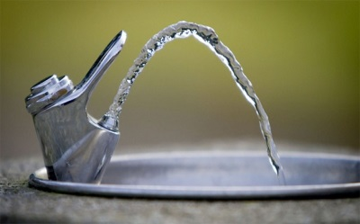
Metaphor/Analogy Moment Share at this time

Slide 20
Analogy
Seed is the word of __________
Breath of __________________
The broad road _____________
The narrow road_____________
Godly sorrow________________
Worldly sorrow_______________

Slide 21
John 14:15;Matthew 22:37-38 See Worksheet Ladder
Question 15
Purpose: Show that loving and obeying Christ is necessary for salvation.
Methodology:
If we love Christ, what will we do? –OBEY HIM
Yes- No Is it God’s will that you believe in Christ And Love Him?
Yes- No If you do not obey Christ do you love Him?

Slide 22
Romans 6:17
Question 16
Purpose: To show sincerity of heart as well as obedience to the right teaching is what pleases God.
What condition were the people formally in? Slaves to sin
Yes- No When you obey God can you obey only from an outward expression and not from the heart?
Yes- No When you obey God, must you obey God’s form of teaching?

Slide 23
Luke 13:3 See Worksheet Ladder
Question 17
Purpose: Show repentance necessary for salvation
Methodology: What did Jesus say will happen if they do not repent? All will perish.
Yes-No In addition to belief and love, is it God’s will that you repent?
Yes-No Will you receive the full and abundant life if you do not repent?

Slide 24
Acts 3:19; II Corinthians 7:10 See OBS Worksheet Ladder-Cross
Question 18
Purpose: To Show that repentance leads to forgiveness of sins.
Methodology: Does repentance involve a change in habits, speech? –Yes
Yes-No Does repentance mean to stop sinning and turn to God instead of sorrow alone?

Slide 25
II Corinthians 7:10
Question 18 continued…….
Purpose: To show two types of sorrow, difference in each and eternal
result of each.
Godly sorrow - Repentance - Salvation - No regret
Worldly sorrow - Death

Slide 26
Worksheet Cross
Purpose: Is to help the student see themselves as they really are – sinners before God, deserving of punishment.
Ask the student to think seriously about his/her life and then write down on the dotted lines 1 or 2 things in their life that they believe that are sins that separate them from God.
Then ask if they feel these things could separate them from God eternally unless repented of.

Slide 27
Matthew 10:32-33; Romans 9:10 See OBS Worksheet Ladder
Question 19
Yes- No In addition to belief, love And repentance, is it God’s will that you should confess/acknowledge Christ before men?
Question 20
Yes- No Will you be saved if you do not confess Jesus with your mouth before men?

