Slide 1
The Historical Dispensations of the Bible
3:27
9:00
A Study of the Patriarchal Period
The SHARE, Episode 8 “A Careful Comparison of the Dispensations:
Presenter: Shelton T. W. Gibbs III

Slide 2
Hebrews 1:1-2 (GW)
¹ In the past God spoke to our ancestors at many different times and in many different ways through the prophets. ² In these last days He has spoken to us through His Son. God made His Son responsible for everything. His Son is the one through whom God made the universe.

Slide 3
God Has Revealed Himself in Many Different Ways . . .

Slide 4
Through Nature
What might be called a revelation of His Supreme deity and power. A person can look at nature and clearly see God's deity and power

Slide 5
Through Conscience
What might be called an inner witness or sense of duty to God

Slide 6
Through Law
What might be called a revelation of Supreme justice

Slide 7
Through Religion
What might be called a revelation of how to worship and become acceptable to God

Slide 8
Through Prophets and Priests
What might be called the revelation of God through human spokesmen and mediators

Slide 9
To Know God, One Uses the Method Used to Know Anyone
Man can know about a person, know all the facts about a person's life; but until he personally meets the person and associates and fellowships with him, he does not personally know him.

Slide 10
Therefore, if man was to ever know God, God had to reveal Himself in the most supreme way possible: He had to come to earth and show Himself to man, revealing exactly who He is and what He is like.

Slide 11
The Supreme revelation of God is Jesus Christ, God's very own Son. God has revealed Himself in the most glorious way possible: He has sent His very own Son into the world.

Slide 12
Basic Descriptions of the Three Historical Periods

Slide 13
The Patriarchal (Father-Rule)
Began at Creation and lasted until the giving of the law on Mt. Sinai. Its history is recorded in Genesis 1 through Exodus 20.

Slide 14
The Mosaic or Jewish (National)
Began at Mt. Sinai and lasted until the crucifixion of Christ. Its history is found from Exodus 20 to Acts 2. This law was to last for a definite time (Galatians 3:19-29). It was nailed to the cross (Colossians 2:14-18). It was done away with (2 Corinthians 3). We are no longer bound by it.

Slide 15
The Christian (International)
Began at Jerusalem on the first Pentecost after the resurrection of Christ and will last until the end of time. Its record is found from Acts 2 through Revelation. We currently live under this dispensation. (Hebrews 1:1-2; 10:8-10).

Slide 16
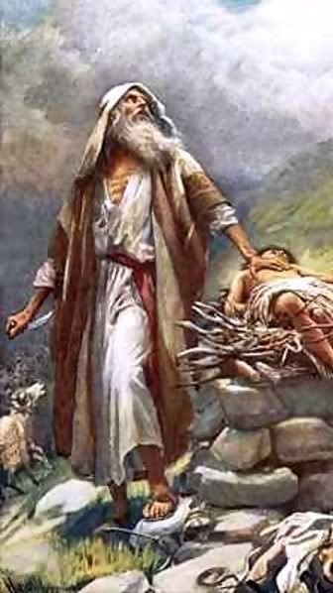
The Patriarchal Period

Slide 17
The first dispensation of Bible history is commonly called the “Patriarchal Period.” An understanding of this age is important, for it tells of man’s earliest relationship with God and answers many questions basic to understanding the rest of the Bible.

Slide 18
Significant Facts of the Patriarchal Period

Slide 19
A. Name
1. The word “patriarch” means “father, leader, chief, ruler”; therefore this period is literally called the age of “Father-Rule.”
2. God revealed His will directly to the heads of the families who in turn taught their children (Hebrews 1:1-2). There is no evidence of any written law during this age.

Slide 20
Hebrews 1:1-2 (KJV)
¹ God, who at sundry times and in divers manners spake in time past unto the fathers by the prophets,
² Hath in these last days spoken unto us by His Son, whom He hath appointed Heir of all things, by whom also He made the worlds;

Slide 21
B. Man’s Relationship to God
1. As God spoke to the fathers by dreams, angels, or visions, they would instruct their children, thus this is sometimes called an age of family religion (Genesis 18:19).

Slide 22
Genesis 18:16-19 (KJV)
¹⁶ And the men rose up from thence, and looked toward Sodom: and Abraham went with them to bring them on the way. ¹⁷ And the LORD said, Shall I hide from Abraham that thing which I do; ¹⁸ Seeing that Abraham shall surely become a great and mighty nation, and all the nations of the earth shall be blessed in him? ¹⁹ For I know him, that he will command his children and his household after him, and they shall keep the way of the LORD, to do justice and judgment; that the LORD may bring upon Abraham that which He hath spoken of him.

Slide 23
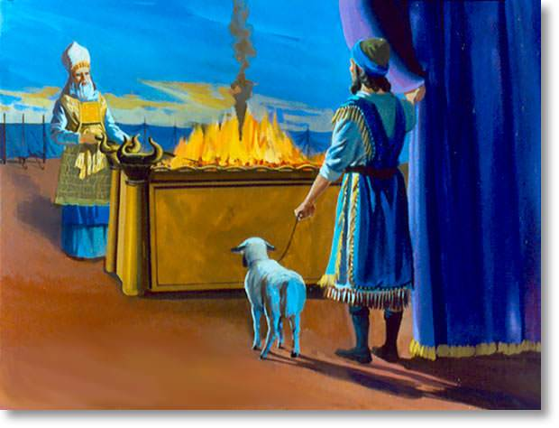
Worship consisted of animal sacrifices offered upon altars (Genesis 8:20; 12:7-8).

Slide 24
Genesis 8:20-22 (KJV)
²⁰ And Noah builded an altar unto the LORD; and took of every clean beast, and of every clean fowl, and offered burnt offerings on the altar. ²¹ And the LORD smelled a sweet savour; and the LORD said in his heart, I will not again curse the ground any more for man's sake; for the imagination of man's heart is evil from his youth; neither will I again smite any more every thing living, as I have done^{. 22} While the earth remaineth, seedtime and harvest, and cold and heat, and summer and winter, and day and night shall not cease.

Slide 25
Genesis 12:6-8 (KJV)
⁶ And Abram passed through the land unto the place of Sichem, unto the plain of Moreh. And the Canaanite was then in the land. ⁷ And the LORD appeared unto Abram, and said, Unto thy seed will I give this land: and there builded he an altar unto the LORD, who appeared unto him. ⁸ And he removed from thence unto a mountain on the east of Bethel, and pitched his tent, having Bethel on the west, and Hai on the east: and there he builded an altar unto the LORD, and called upon the name of the LORD.

Slide 26
C. Duration
1. We will relieve the Bible of many pressures if we keep in mind that it was written for religious ends rather than scientific or chronological purposes.
We are not given an exact date for creation nor can we be certain that every generation from Adam is specifically mentioned. On the basis of what is revealed, this period lasted at least 2500 years, perhaps longer.

Slide 27
C. Duration , cont’d
2. This period begins with Creation, recorded in Genesis 1, and continues until the giving of the Ten Commandments recorded in Exodus 20.

Slide 28
D. Importance of the Patriarchal Period
The Bible record of the Patriarchal Period does not go into detail about every event or person; however, what is told answers some important questions giving us a deeper understanding of the rest of the Bible.

Slide 29
Let us consider . . .
Questions Answered by the Significant Events of the Patriarchal Period

Slide 30
Q: How Did All Things Begin?
A: The Creation
1. All things started with a miracle of God, Genesis 1:1-2:3.
2. The atheist must start somewhere—all things came from nothing? FANTASTIC! WHO CAN BELIEVE IT?

Slide 31
Q: What Makes Man Superior to Animals?
A: The Creation of Man in God’s Image
1. Man was created in God’s image—spirit, intelligence, dominion, Genesis 1:26-28; 2:7-8.
2. Institution of marriage—woman, an help suitable (meet) for man, Genesis 2:18-24.

Slide 32
Q: Why Do We Need God, Salvation, or the Bible?
A: The Fall of Man
1. Man’s first relationship with God was ideal. God placed man in the Garden of Eden and provided every necessary thing, Genesis 2:8-17.
2. Man is in God’s image, thus God did not force Adam to serve Him. The devil tempted; man fell by his own choice; his return will be by choice, Genesis 3:1-13; Romans 6:16-18.

Slide 33
Q: Will God Really Destroy That Which He Had Created?
A: The Flood
1. Man’s wickedness increased; God purposed to destroy the world, Genesis 6:5-7.
2. Through the righteousness of Noah, eight souls were spared, Genesis 6:8-10:32.
3. God has promised to destroy the world again, 2 Peter 3:1-14.

Slide 34
Q: How Did Man Become Separated Into Different Nations?
A: The Division of Man
1. The Tower of Babel—confusing of tongues, Genesis 11:1-9.
2. The descendants of Shem, Ham, and Japheth, Genesis 10, 11.

Slide 35
Q: Who Are the Jews, and Why Were They God’s Chosen People?
A: The Call of Abraham
1. The Land promise (Canaan, Palestine), Genesis 12:1.
2. The Nation promise (Israel, Hebrews, Jews), Genesis 12:2.
3. The Spiritual promise (Christ), Genesis 12:3, “bless all families . . .” Galatians 3:26-29.

Slide 36
An Overview of the Patriarchal Period of Israel’s History

Slide 37
The easiest way to survey this period of Old Testament History is according to the four dominant individuals, the patriarchs themselves.
To be certain, there is some overlap between the narratives of these four successive generations, but we will briefly survey the period according to the four great personages of that time—Abraham, Isaac, Jacob, and Joseph.

Slide 38
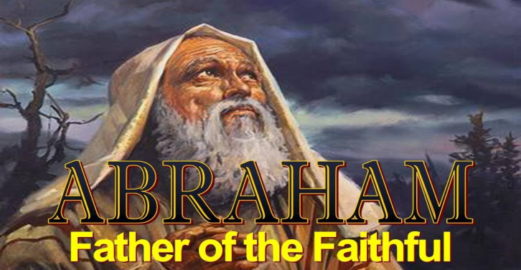
ABRAHAM
Abraham was a man of faith. We see him going forth trusting in God’s guidance, believing God’s promises, inheriting God’s blessing, and undergoing difficult testing.
Despite his occasional failures, Abraham was accounted as righteous. The following is a brief sketch of Abraham’s life as recorded in Genesis

Slide 39
ABRAHAM 2166 BC TO 1991 BC
2091 BC
1. The Birth of Abram Genesis 11:26
2. Departure from Ur of the Chaldees Genesis 11:31-32
3. The Sojourn in Haran Genesis 11:31-32
4. Abram’s arrival in Canaan Genesis 12:1-9 2091 BC
5. Abram’s Flight to Egypt Genesis 12:10-20
6. The Separation of Abram from Lot Genesis 13
7. Abram’s Rescue of Lot Genesis 14
8. The Formal Covenant/Promise of a Son Genesis 15
9. The Birth of Ismael to Abram & Hagar Genesis 16 2086 BC
10. Abram Awaits the Promised Child Genesis 16-18
11. Abram’s Experience with the Philistines Genesis 20
12. The Birth of Isaac/Sacrifice of Isaac Genesis 21-22 2066 BC
13. The Death of Sarah & Encounter with the Hittites Genesis 23 2029 BC
14. A Bride is Found for Isaac Genesis 24
15. Abraham’s Marriage to Keturah Genesis 25
16. The Death of Abraham Genesis 25:7 1991 BC
Leaves Ur Genesis11:31-32
Abram, Lot Separate Genesis 13
Covenant/ Son Promised Genesis 15
Arrives in Canaan Genesis 12:1-9
2166
2091
Abram’s Birth Genesis11:26
Sojourn @ Haran Genesis11:31-32
Flight to Egypt Genesis 12:10-20
Abram Rescues Lot Genesis 14
Isaac Birth/Sacrifice Genesis 21-22
Bride for Isaac Genesis 24
Abraham’s Death Genesis 25:7
Awaits Promised Child Genesis 16-18
2086
2029
2066
1991
Ismael’s (Haggar) Birth Genesis 16
Episode w/ Philistines Genesis 20
Sarah’s Death/ Hittites Encounter Genesis 23
Abraham Marries Keturah Genesis 25

Slide 40
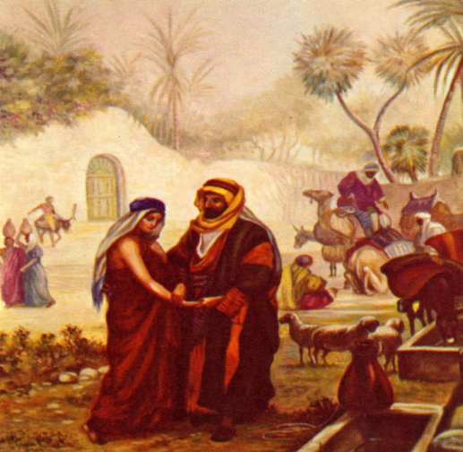
ISAAC
Isaac was the son of promise. He was the one through whom the Abrahamic covenant would be fulfilled (Genesis 26:24-25).
He was the link between Abraham and the patriarchs who followed. It is interesting that his birth is mentioned in Genesis 21:2-3 and his death in Genesis 35:29, but he is the main character only in the short section from Genesis 25:19 to 26:35.
The following is a brief sketch of Isaac’s life.

Slide 41
ISAAC 2066 BC TO 1886 BC
Isaac Fooled, Jacob Blessed Genesis 25:21-34
1. Birth of Isaac Genesis 21 2066 BC
2. Experience on Mt. Moriah Genesis 22
3. Isaac’s Marriage to Rebekah Genesis 24
4. The Birth of Jacob & Esau Genesis 25:21-34 2006 BC
5. Isaac’s Lie to Abimelech concerning Rebekah Genesis 26
6. Isaac is Deceived; Jacob gets the Blessing Genesis 27 1929 BC
7. Isaac’s Death Genesis 35:28-29 1886 BC
Mt Moriah Experience Genesis 22
Esau & Jacob Born Genesis 25:21-34
2066
1886
2006
1929
Isaac's Birth Genesis 21
Isaac Marries Rebekah Genesis 24
Isaac Lies to Abimelech Genesis 26
Isaac’s Death Genesis 35:28-29

Slide 42
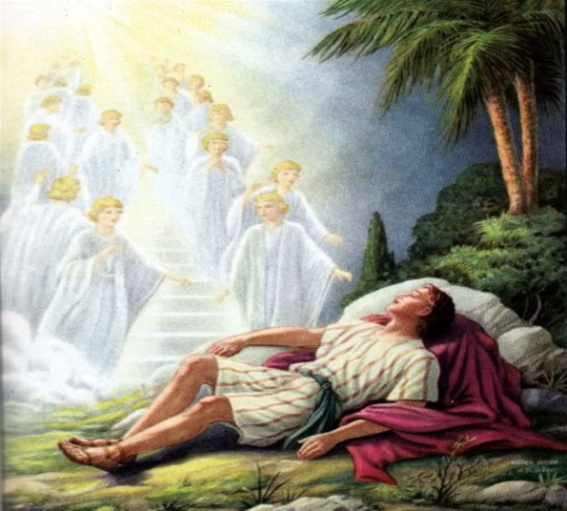
JACOB
Jacob is known as the Father of the Nation of Israel. In fact his name was changed to Israel in Genesis 32:28.
He had 12 sons who would become the 12 tribes of Israel.
The covenant promise was renewed through Jacob as it had been with Abraham and Isaac (Genesis 28: 13-15; 35:10-12). The following is a brief sketch of his life.

Slide 43
JACOB 2006 BC TO 1859 BC
Flight to Haran Genesis -28:1-29-13
Jacob’s Return to Canaan Genesis 31:21-33:20
Jacob Goes to Egypt Genesis 46:1-47:26
2006
1859
1876
Jacob’s Birth Genesis 25
20 Yr Sojourn in Haran Genesis 29:14-31:20
Jacob’s Final Yrs in Canaan Genesis 34-36
Jacob’s Blessing & Death Genesis 35:28-29

Slide 44
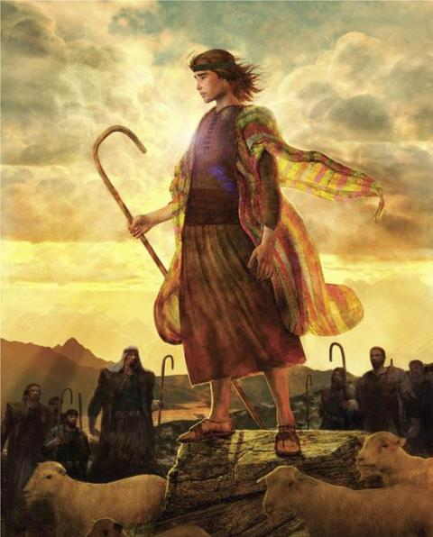
JOSEPH
Although Joseph, one of Jacob’s 12 sons, was not part of the Messianic line, God sovereignly used him to protect the Messianic line.
Joseph is the one responsible for the relocation of God’s chosen people to Egypt. Joseph serves as a link between the patriarchal period and the period of the Exodus.
Joseph was a righteous and faithful man despite times of suffering and glory. The following is a brief sketch of his life.

Slide 45
JOSEPH 1915 BC TO 1805 BC
Joseph Sold into Slavery Genesis 37
Honored in Egypt Genesis 41
Family Reunion b/c of Famine Genesis 46:1-47:26
1915
1805
JOSEPH 1915 BC TO 1805 BC
1. The Birth of Joseph Genesis 30:24 1915 BC
2. Joseph is Sold into Slavery Genesis 37
3. Joseph Suffered in Egypt Genesis 39-40
4. Joseph Eventually Honored in Egypt Genesis 41
5. Joseph is Reunited with his Brothers Genesis 42-45
6. Joseph’s Family Joins him in Egypt due to Famine Genesis 46:1-47:26 1876 BC
7. The Death of Joseph Genesis 50:22-26 1805 BC thgxcz
1876
Joseph’s Birth Genesis 30:24
Suffered in Egypt Genesis 39-40
Reunited with Brothers Genesis 42-45
Joseph’s Death Genesis 50:22-26

