Slide 1
Mosaic Dispensation
The SHARE, Episode Eight:
“A Careful Comparison of the Dispensations”
Greenville Avenue Church of Christ
Presenter: Ben Myers, D. Min., LPC, M.A., B.S.
Saturday, September 28, 2019

Slide 2
Mosaic Dispensation
The word “dispensation” means “a system of order, government, or organization of a nation, community, etc., especially as existing at a particular time.” It is a word used to understand the theological system of organizing and understanding God's work. The “Mosaic Dispensation” is that which is relating to Moses or the writings, laws, and principles attributed to him.

Slide 3
Mosaic Dispensation
God’s “Scheme of Redemption”:
Isaiah 28:10,13, Hebrews 1:1
“Here a little, there a little”, “many times and in various ways”
Roman 4:3, 6
Faith saves Abraham in Patriarchal Dispensation
Faith saves David during Mosaic Dispensation
I Peter 1:10
Prophets enquired and searched
Angels desired to look into it
Hebrews 11:6
“But without faith it is impossible to please him”!
Faith=Trust & Obedience!

Slide 4
Mosaic Dispensation
The Mosaic Dispensation grew out of the promise made to Abraham 430 years later!. God gave Israel a government, the Law of Moses, which guided them religiously and politically so the promise might be kept! (Genesis 12:2-3, Galatians. 3:16-17)
Under the Mosaic dispensation, the Jews had their own written law. Abraham’s descendants, in their exodus from Egypt, were led to the foot of Mt. Sinai, and God gave to them the ten commandments written upon two tables of stone. He also gave them other laws for their good which Moses wrote by inspiration. (Exodus 19,20)
One purpose of the Mosaic dispensation was to make and keep Abraham’s descendants a separate and distinct race until Christ, the promised seed, should come. The law of Moses served as a middle wall of partition for it separated the Jews from other nations. (Ephesians 2:14)

Slide 5
Mosaic Dispensation
The weakness of the Law of Moses was that there was no forgiveness of sins. It was only a “shadow” of things to come! (Hebrews 10:1-4)
God always intended for the Mosaic dispensation to be temporary. (Galatians 3:19)
The Law, Mosaic Dispensation, Old Testament was to be abolished/fulfilled at the coming of Christ. This dispensation was to last until the fulfillment of the Abrahamic promise in Christ! (Galatians 3:16)
The Mosaic Dispensation is the bondmaid that is sent out once the freewoman comes! (Galatians 4:21-31)

Slide 6
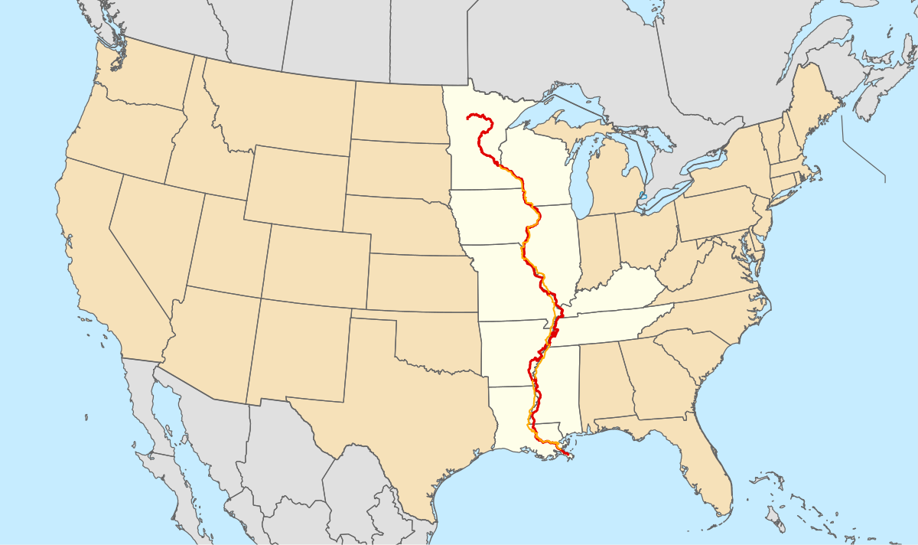
Mosaic Dispensation
Patriarchal
Mosaic
Christian
Illustration: Mississippi River Start and Finish

Slide 7
Mosaic Dispensation
Patriarchal
Dispensation
Mosaic
Dispensation
Christian
Dispensation
From Pentecost to His Return
A.D. 33 -
From Adam to Mount Sinai
2500 Years
From Sinai to the Cross
1500 Years

Slide 8
Mosaic Dispensation
A. The Law Was Given to the Jews—Not for All Nations.
B. The Law Was to Serve as a Schoolmaster.
C. The Law Did not Provide Remission of Sins.
D. The Law Came to an End With the Death of Christ.
E. To Serve the Law Makes the Cross of None Effect.

Slide 9
Mosaic Dispensation
Old Covenant/Mosaic Dispensation:
Old (Hebrews 8:13)
Decayeth (Hebrews 8:13)
Vanishing Away (Hebrews 8:13)
God changed the Law (Hebrews 7:12)
Old, Disannulled (Hebrews 7:18)
Weak (Hebrews 7:18)
Unprofitable (Hebrews 7:18)
Shadow of good things to come (Hebrews 10:1)
Taken away (Hebrews 10:9)
Blotted out (Colossians 2:14)
Not under it (Galatians 3:25)

Slide 10
Mosaic Dispensation
Chronological Events of the Mosaic Dispensation
A. Forty Years in Wilderness Because of Unbelief (Num.13;14)
B. Conquest of Canaan
C. Period of the Judges
D. The United Kingdom
E. The Divided Kingdom
F. The Age of the Prophets (Fall of nation & prophecies of Christ)
G. Return from Captivity

Slide 11
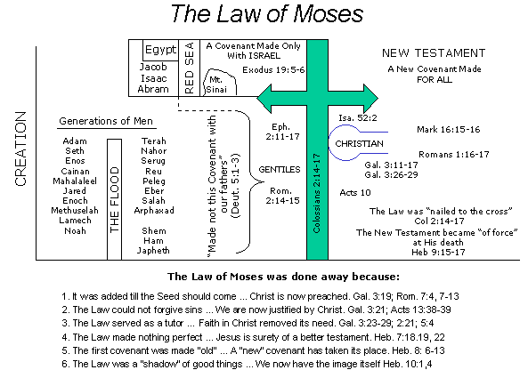
Mosaic Dispensation

Slide 12
Mosaic Dispensation
Reason we study the Old Testament:
To gain wisdom and equipment for every good work (2 Tim.3:14-17)
To provide background for the New Testament (Acts 3:20-24)
It is the only reliable history of that period of time (only O.T. mention of Hittites)
To gain examples, both good and bad (James 5, 1 Cor.10)
To learn patience, comfort, and hope (Rom. 15:4)
To gain light for a dark day (2 Pet. 1:19-21)
To understand the nature of God (Husband, Shepherd, etc.,)
It points to Christ the Savior (John 5:39, Acts 8:35)

Slide 13
Mosaic Dispensation
Goal of Mosaic Dispensation is True Worship!
Must have a Mediator (Mediation)
O.T. Moses / N.T. Jesus
Must have an Acceptable Sacrifice (Sanctification)
O.T. Aaron / N.T. Melchizedec
Must have a Place (Location)
O.T. Earthly Jerusalem / N.T. Heavenly Zion
*Must have the “Real” and not the “Shadow”!!!!!

