Slide 1
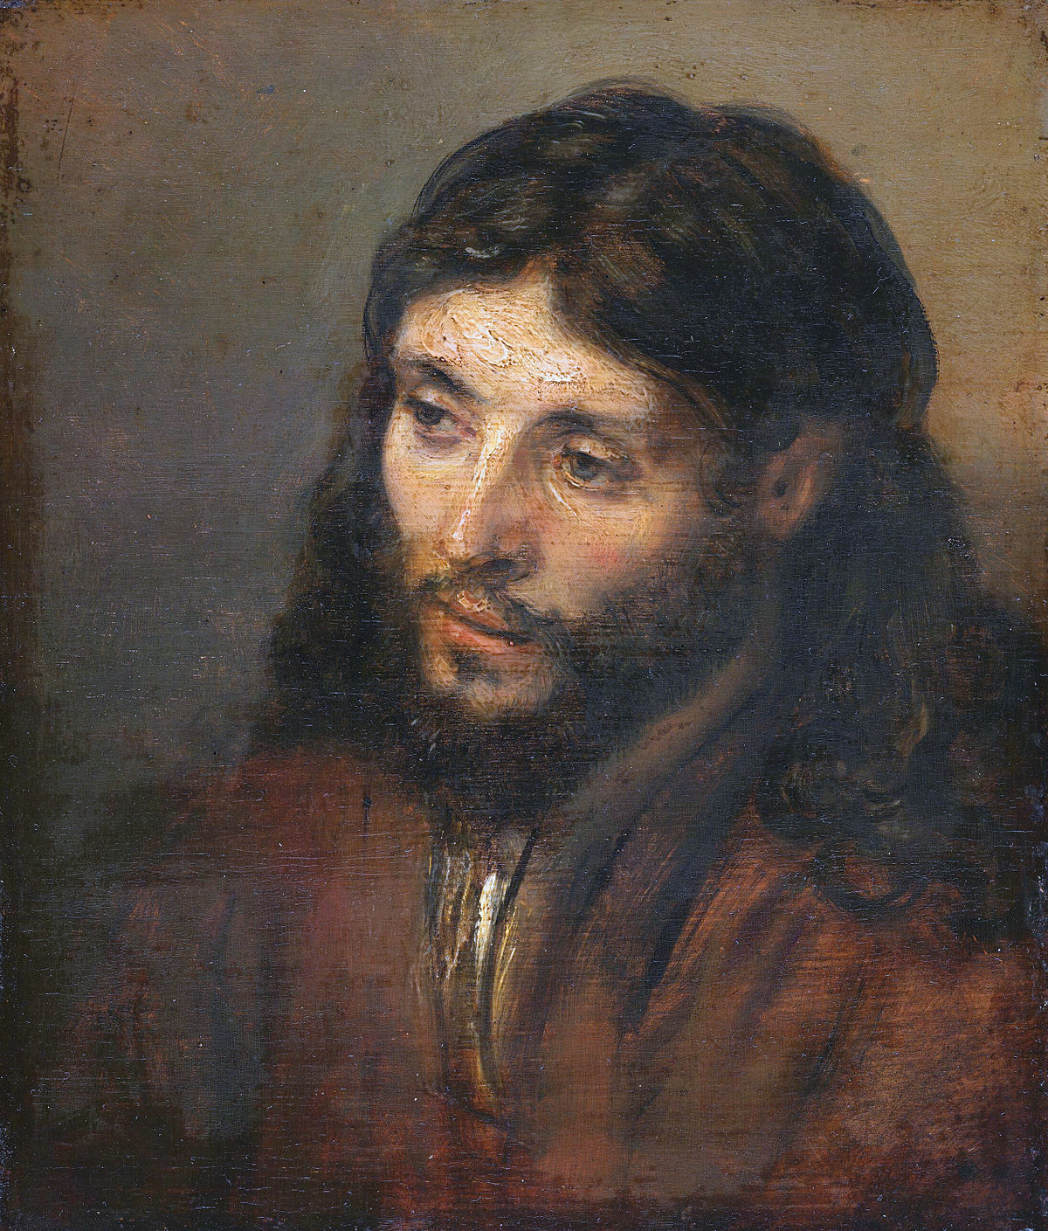
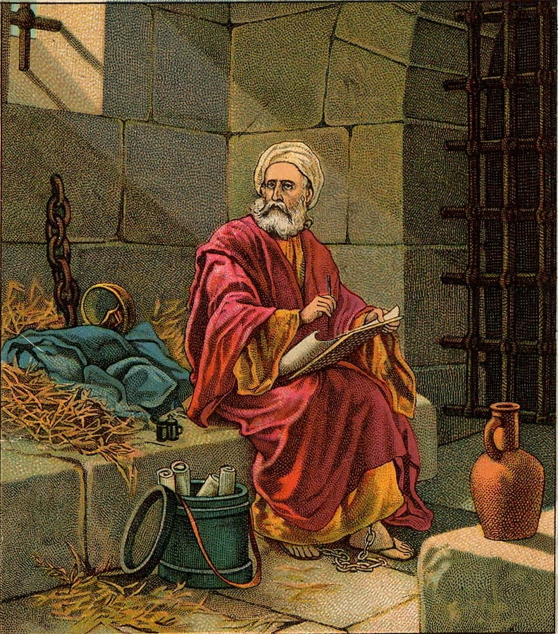
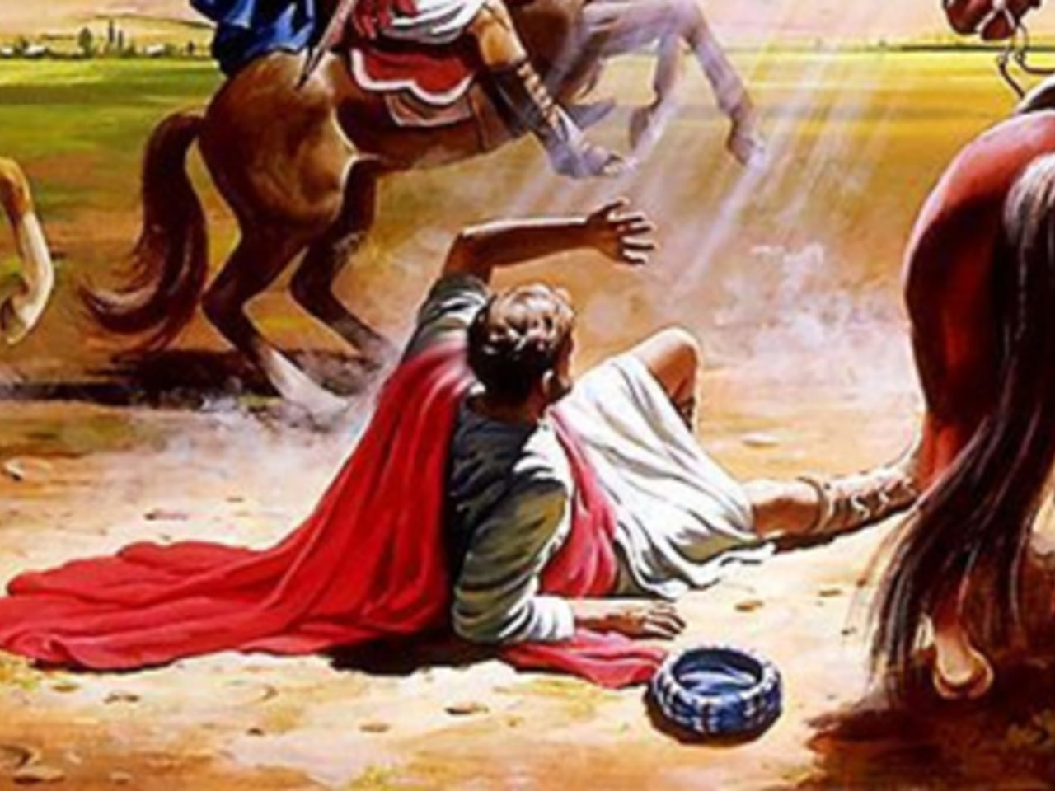
How do I know I have been transformed by the renewing of my mind?
DAMASCUS
PAUL
THE OLD MAN THE NEW MAN
GUIDE-POST OR EXAMPLE?
SOLOMON 2 PETER 1:3 (OBS LESSON 1) PAUL
s
E
S
E
PAUL
Notes:
Good Afternoon, I am Brother Bernard Aikens and I have been an active member of GACC since June of 2003.
My topic for the Share is, “How Do I know I have been Transformed by the renewing of my mind?”
Let’s first look at the scene above my topic. We have Saul on the road to Damascus, this is man’s plan. Then we have an intervention occurring that disrupts man’s plan and changes his course for life. Saul, the persecutor of the Church was on his way to continue his attack on God’s people. Our Lord intervened in a Prolific way that caused Saul to fall to the ground and ask what do you of me Lord? The Bible says every knee shall bow and all shall be brought low before our Lord. Saul at this point new he was not in charge and he submitted to God’s plan.
Look at the next scene and we see two terms, the Old Man and the New man. Col 3:1-4 says set your affection on things above, and not on things on this earth. So we see Solomon when he became king asked God to give him a wise and discerning heart, 1 Kgs 3:9. Solomon started on fire with passion for leading, living and caring for God’s people iaw the word, (Up arrow) but in latter years of his life changed as his appetite for the flesh, foreign women, (down arrow) caused him to sin greatly. Unlike David who turned from sin, Solomon had 700 wives and 300 concubines that turned him away from the Lord. It was the allure of the world that led to his downfall.
Solomon’s Guide post was the Lord, but he decided that his only master would be his worldly desires. Three key Points: 1) We can never underestimate our desires of the flesh 2) God’s commands are always for his glory… and our best 3) God never permits polygamy.

Slide 2
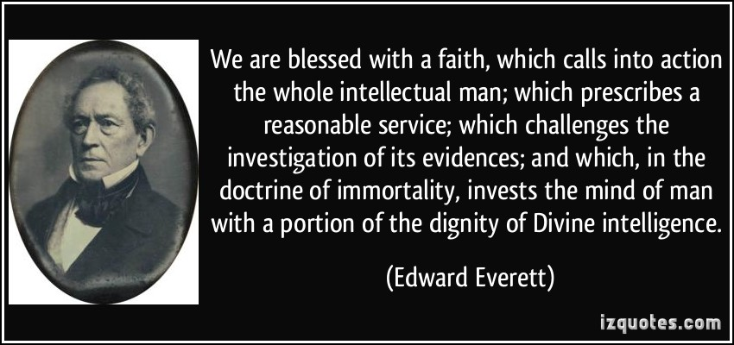
How do I know I have been transformed by the renewing of my mind?
What does it mean to be transformed by the renewing of my mind?
Mind Renewal Versus Growth of Knowledge.
Does knowledge Alone Provide the path to Transformation?
Some will become Double-minded.
Renewed through the Spirit of my Mind
What does a Transformed Mind Look Like ?
Notes:
These are the key questions that will be answered during my presentation.

Slide 3
I. What DOES IT MEAN TO BE TRANSFORMED BY THE RENEWING OF MY MIND?
ROM 12:2 “AND BE NOT CONFORMED TO THIS WORLD: BUT BE YE TRANSFORMED BY THE RENEWING OF YOUR MIND, THAT YE MAY PROVE WHAT IS THAT GOOD, AND ACCEPTABLE, AND PERFECT WILL OF GOD.”
Paul begins to exhort us to godly living in Chapters 12-16 (Serve one another/submit to authority/Support the weak/Salute the Saints)
The practical section of Romans begins with a great “Therefore.” seeing all that God did on our behalf, therefore
Live like this.
The first of Paul’s great exhortations is to be renewed in our minds:
“I appeal to you therefore, brothers, by the mercies of God, to present your bodies as a living sacrifice, holy and
Acceptable to God, which is your spiritual worship.
Notes:
This scripture is saying that we must show love toward all mankind as our Lord so loved the world that he gave his only son for remission of our sins.
Agape love in this since is pleasing to God.

Slide 4
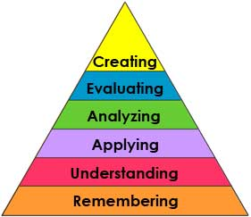
II. God’s Plan is based on mind renewal, but man pursues accumulation of knowledge - Ed and Joshua Smith
Some assume renewing of mind means growing in knowledge of scriptures through study and memorization
If this were true, then any unbeliever could expect the same if they applied themselves to intellectually know the truth
However, transformation is the key term we must understand, it is the sole evidence that mind renewal has occurred.
Mind renewal is more than gaining bible knowledge, it is the engine that brings about transformation
The Epicurean Materialist: Man’s duty is to seek carnal enjoyment and the pleasures of life Eccl 2: 24-26)
The Heb. Koheleth (Preacher) said in Eccl 12:13, “Fear God and Keep his commandments; for this is the whole duty of man.”

Slide 5
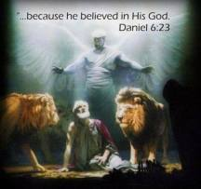
iii. Does knowledge alone provide the path to transformation?
Jer 17:9 Depravity of the human heart, who can know it?
Jer 29:12-13 Prayer heard. Seek God. Apply all your heart. Answers promised.
Dan 1: 3-17 King Nebuchadnezzar directs Ashpenaz, Master of the Eunuchs to bring certain children of the kings seed and Princes with no blemish, but well favored and skilled in wisdom, knowledge, sciences and ability to stand before the King. Among these were the children of Judah: Daniel (Belshazzar), Hananiah (Shadrach), Mishael (Meshach), and Azariah (Abednego). V8: But Daniel purposed in his heart to not defile himself with the portion of the King’s meat nor his wine. God brought Daniel into favor with the prince of the eunuchs, so Daniel asked for 10 days eating pulse and drinking water. After 10 days, their countenances appeared fairer and fatter in flesh than all the children that did eat of the portion of the king’s meat. Thus Melzar took away the portion of meat and wine and feed them pulse and water.
As for the 4 children, God gave them knowledge and skill in all learning and wisdom: Daniel understand all visions and dreams.

Slide 6
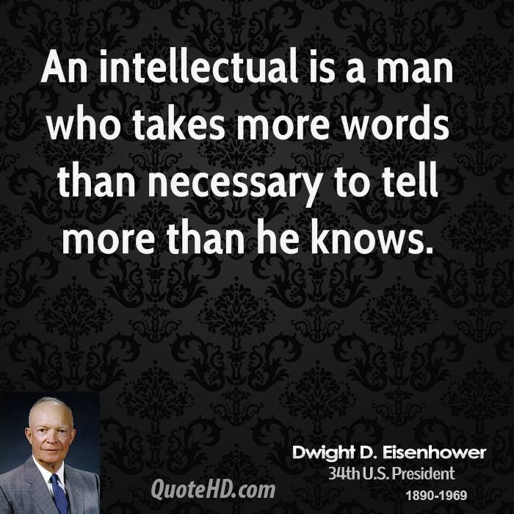
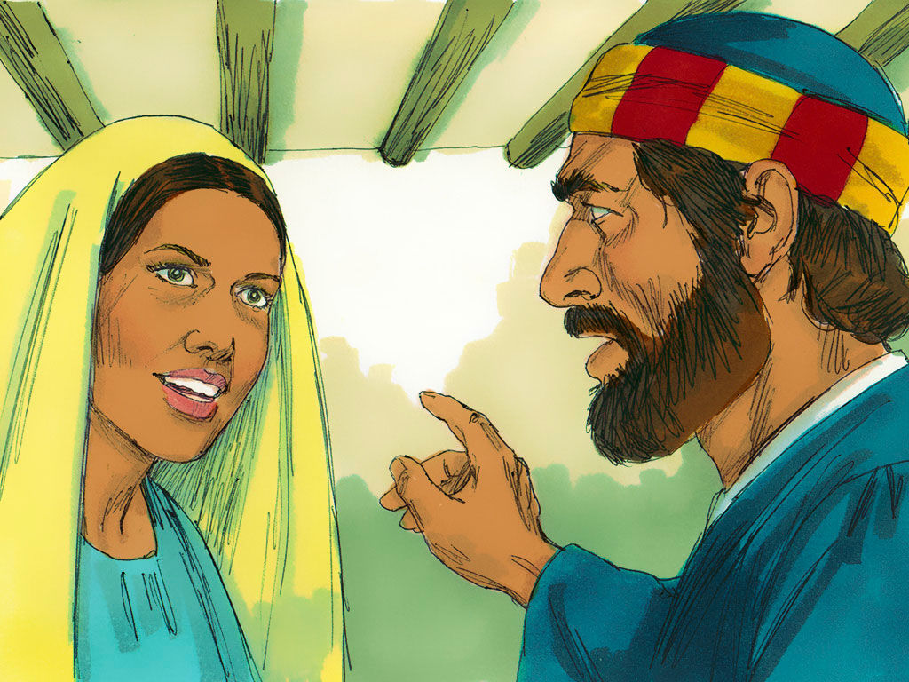
iv. How does one become double-minded BELIEVER? Dan Delzell, Christian post contributor
ANANAIS & SAPPHIRA - ACTS 5: 1-11
To never mature to become goal-oriented. Goals motivate us to work hard, to persevere in the face of difficulty, to persist when others might quit.
Tendency to set short-term goals focused on now and not long-term goal of seeking eternal salvation with our Lord.
Accepting of the easy wrong over the hard right
To constantly live in a state of compromise, half for Christ and half for bad habits – Hence, you are “double-minded”

Slide 7
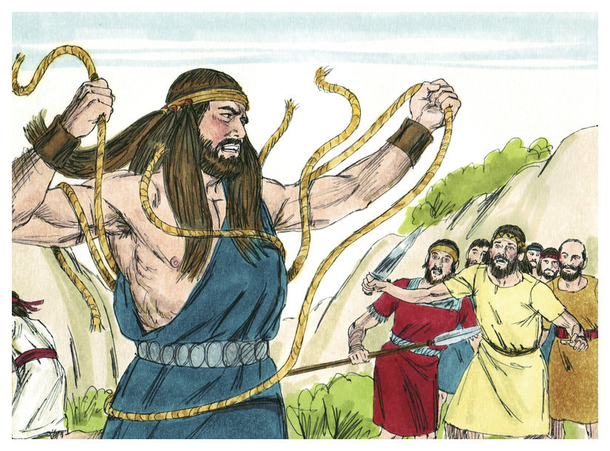
iv. How does one become double-minded BELIEVER? Dan Delzell, Christian post contributor (cont.)
SAMSON – JUDGES 13-16
CHARACTERISTICS OF A DOUBLE-MINDED BELIEVER
Two major influences that fuel your thought life (always torn in two directions)
You have history with both major influences (those who fail to understand their past stand the chance of repeating same errors/sins..)
You compromise your thought life in one primary area (focus on me, myself, and I) . I want it NOW!
Led by the Holy Spirit, except when the other issue is driving your thinking – desires of the flesh
Experience real peace only when your mind is under God’s control
Act on old habits easily (familiar, comfortable, desired)
Desire to be only drawn to the things of God --- Constant inner battle between man’s spiritual and fleshly desires (Ro 7:14-25)

Slide 8
v. Renewal through the spirit of my mind.
Brother W.F. Washington stated, "Satan's desire is to be master of the minds of men and then he can control the world”
We live in a country where 30-38% of Black males between the ages of 18 – 35 are or have been incarcerated
Given these statistics, we can all agree, a transformation is needed that infuses our young men with a spiritual renewal of the mind/heart. (Eph 4:23).
Psalm 51:10 David said, “Create in me a clean heart, O God, and renew a steadfast spirit within me.” (Desire - Attitude – Action – Results in Due Time)

Slide 9
v. Renewal through the spirit of my mind. (Cont.)
Brother W.F. Washington stated, "Satan's desire is to be master of the minds of men (Unlimited Desires) and then he can control the world”
Isa 40:31 “Yet those who wait for the LORD will gain new strength; They will mount up with wings like eagles, They will run and not get tired, They will walk and not become weary.”
2 Cor 4:16 “Therefore we do not lose heart , but though our outer man is decaying, yet our inner man is being renewed day by day.” The one who renews us is familiar with the trials and tribulations of this life, and so we have Christ, the sacrificial lamb, who possesses all power in heaven and on earth as our Mediator (win-win).
Titus 3:5 “He saved us, not on the basis of deeds which we have done in righteousness, but according to His mercy , by the washing of regeneration and renewing by the Holy Spirit.”

Slide 10
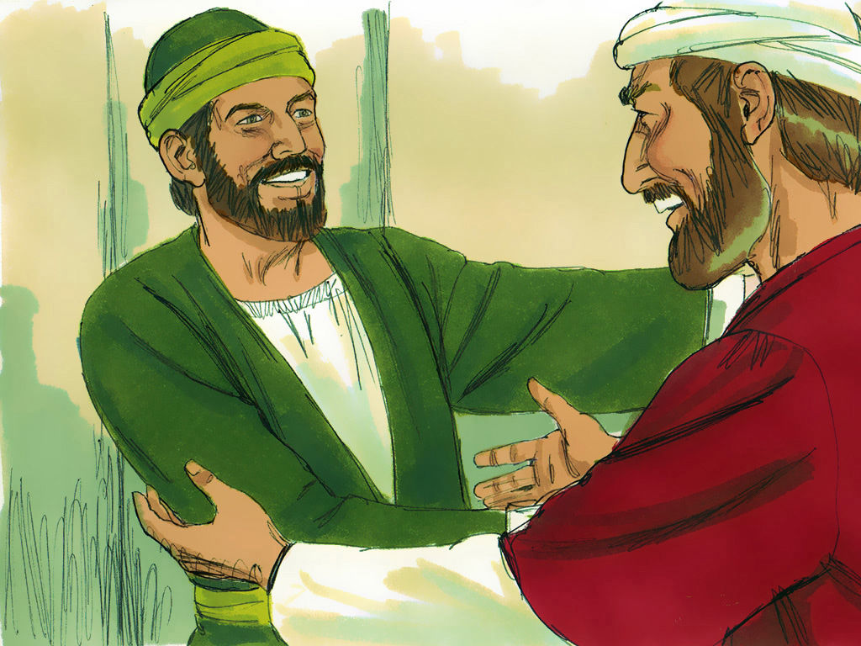
vi. What does a transformed mind of A Believer look like?
Rom 12:2 This is accomplished by the renewing of our minds, an inward spiritual transformation that will manifest itself in outward actions. (Worldly centered to Godly centered)
Col 10:10 In the transformed life in Christ, this is demonstrated through our “bearing fruit in every work and growing in the knowledge of God”
Transformation involves those who were once far from God being “drawn near” to Him through the blood of Christ. (Eph 2:13)
Transformation within us is seen in the way we increasingly reflect the likeness and glory of Christ . (2 Cor 3:18)
Rom 8:9 The Apostle Paul said, “You, however, are controlled not by the sinful nature but by the Spirit, if the Spirit of God lives in you
You got a new Attitude: Paul said, “ I have been crucified with Christ and I no longer live, but Christ lives in me . The life I live in the body, I live by faith in the son of God, who loved me and gave himself for me.” (Gal 2:20)

Slide 11
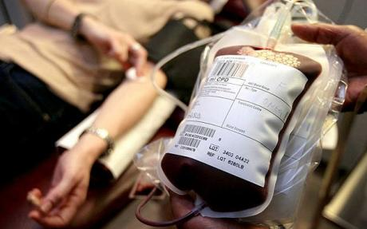
vi. What does a transformed mind of A Believer look like?
You live in hope ….. knowing no matter the problem, all will work out .
The improbable appear reasonable. If God said it, I believe it, and have confidence it will happen.
You live in peace with yourself and others and you don’t worry; your speculations are positive (2 Cor 10:5)
I’m Okay! I accept my weaknesses knowing that when and where I am weak Christ is strong (2 Cor 12:9-10)
You are quick to forgive and freely give others grace and mercy. (Quiet on offenses and confront in love)
You are confident and thankful. (Phil 4:13)
You believe in others and give them the benefit of the doubt. (I am my brothers keeper) Gen 4:9 & Gal 6:2

Slide 12
What does a transformed mind look like?
8. 2 Tim 3:16-17 The man of God is prepared for every good work. (OBS lesson 1)
9. John 10:10 “The thief comes to steal and kill and destroy; I have come that you may have life, and have it to the fullest” (OBS lesson 1)
10. Math 7:13-14 I may have to go through the gate alone. The bible says, small is the gate and narrow the road that leads to life and only a few find it” (OBS lesson 1)
11. Math 22:37-38 “Love thy God with all thy heart, soul, and with all thy mind, for this is the first and great commandment”

Slide 13
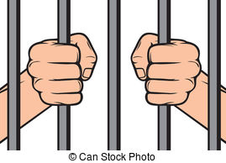
BIBLICAL EXAMPLES OF Those transformed by the renewing of THEIR mind?
John 8: 31-32
2 Tim 2:15
TRUTH
STUDY
1. All twelve Apostles: All went from ordinary men from a variety of backgrounds to team of the leaders used by God to guide the beginning of the church in the power of the Holy Spirit. Each to the Gospel to faraway places.
2. The Woman at the Well in Samaria --- John 4:1-42
3. The Woman caught in Adultery ---- John 8: 1-11
4. The man possessed by demons living in the graveyard of Gerasene--- Mark 5:1-20
5. Nicodemus------- John 3:1-21; 7:50; 19:38-39
6. Saul of Tarsus------ Acts 9:1-31

