Slide 1
The Share – Episode 7 – June 22, 2019 Theme – “Beware of False Doctrine and Teachers”
Sub-topic 1
Part A - Who and what is a false teacher?
Part B- What is false doctrine?

Slide 2
Part A – Who and what is a False teacher?
Let’s begin with word definitions for Part A - Webster’s dictionary:
False – 1- Contrary to facts or truth, [who establishes the facts or truth? Will be discussed in other slides] , 2 – Insincere or [hypocritical], ie, not trustworthy
Teacher – 1 – one who teaches a subject or topic, 2 – “SME- subject matter expert”
False teacher – 1- one who teaches contrary to the facts or truth, 2- one who’s teaching is insincere or hypocritical
Messiah – [1] Judaism – A king who will be sent by God to save the Jews, [2] Christianity – a person who is expected to save people from a very bad situation
Prophet – [1] one who foretells future events, [2] one who utters divinely inspired revelations
Law – a rule made by the governing body, ie, government of a town, state, countryFor this presentation, we agree that Facts, Truth, Standards and Law are derived from the Bible
Showing results from NIV cell phone Bible Apps in OT & NT
Facts - 38 ; Truth – 137; Standard[s]–– 29; Law - 662
For our study or presentation, I selected the word Truth from the Bible to direct our presentation regarding False teacher.
Truth will be expounded upon later in this presentation

Slide 3
A1 – Who and what is a false teacher?
What were some responses toward False[72X][hood] in the Old Testament?:
Exo 23:1 – Moses said, “Do not spread false reports
Lev 19:12 – Lord said, “Do not swear falsely by my name and so profane the name of your God. I am the Lord”
Duet 5:20 – Lord said, “You shall not give false testimony against your neighbor”
Psalms 119:163 – King David said, “I hate and detest falsehood, but I love your law”
Prov 12:17 – Solomon said, “An honest witness does not deceive, but a false witness pours out lies.
Isa 41:29 – See, they are all false! Their deeds amount to nothing…
Jere 23:32 – “Indeed, I am against those who prophesy false dreams, declares the Lord
Dan 6:24 – At the king’s command, the men who had falsely accused David were brought in and thrown into the lion’s den, along with their wives and children
Malachi 2:6 – True instruction was in his [God] mouth and nothing false was found on his lips…

Slide 4
A2 – Who and what is a false teacher?
What are some responses toward False[37X][hood] in the New Testament?:
Matt 7:15 – Jesus said, “Watch out for false prophets. They come to you in sheep’s clothing, but inwardly they are ferocious wolves…”
Matt 24:11 – “and many false prophets will appear and deceive many people”.
Matt 24:24 – Jesus said, “For false messiahs and false prophets will appear and perform great signs and wonders to deceive, if possible, even the elect.”
Lk 18:20 – “You know the commandments: You shall not commit adultery, you shall not murder, you shall not steal, you shall not give false testimony, honor your father and mother”
Acts 6:13 – They produced false witnesses, who testified, “This fellow never stops speaking against this holy place and against the law
Acts 13:6 – They traveled through the whole island until they came to Paphos. There they met a Jewish sorcerer and false prophet named Bar-Jesus.
2Cor 11:13 – For such people are false apostles, deceitful workers, masquerading as apostles of Christ

Slide 5
A3 – Who and what is a false teacher?
Cont’d - What are some responses toward False[37X][hood] in the New Testament?:
Gal 2:4 – This matter arose because some false believers had infiltrated our ranks to spy on the freedom we have in Christ Jesus and to make us slaves. [believers who have fallen from truth?]
Eph 4:25 - Therefore, each of you must put off falsehood and speak truthfully to your neighbor, for we are all members of one body.
1Tim 6:20 – Timothy, guard what has been entrusted to your care. Turn away from godless chatter and the opposing ideas of what is falsely called knowledge.
2Pet 2:1 – But there were also false prophets among the people, just as there will be false teachers among you. They will secretly introduce heresies…
1John 4:1 – Dear friends, do not believe every spirit, but test the spirits to see whether they are from God, because many false prophets have gone out into the world.
1John 4:6 – We are from God, and whoever knows God listens to us; but whoever is not from God does not listen to us. This is how we recognize the Spirit of truth and the spirit of falsehood

Slide 6
Part B – What is False Doctrine? Who started it [them]?
Brief review & add Truth and Standard word definitions - Webster’s dictionary:
False – 1- Contrary to facts or truth, [who establishes the facts or truth? Will be discussed in other slides] , 2 – Insincere or [hypocritical], ie, not trustworthy
Doctrine – a set of ideas or beliefs that are taught or believed to be true
False doctrine – a set of ideas or belief that are contrary to facts or truth that are taught
Truth as indicated on brief slide, Truth stated 137 in Bible, OT = 35X; NT = 102X, Why dT?
Truth – [1] a judgement or statement or idea that is true or accepted as true, [2] fidelity to an original or to a standard
Biblical Truth is defined by its author – Jesus – with scriptural proof on following slides
Next, let’s review examples of Falsehood and how they relate to Standards – a model to be followed or imitated, established by customs and/or organizations with consent or approval, ie ISO- [International Standards Organization, ie, est stds for cars, applicances, Engineering, etc]
For parallel, how about reviewing Standards for American Professional Football & Basketball?

Slide 7
B1 – An Example of a Standard Change? Who started it [them]?
Physics is a funny thing. Despite dictating the behaviors and states of everything from atoms to stars, our interpretation of its effects are rooted in very human constructs. Meters, amperes and seconds were all defined using arbitrary terms and methods.
For years, the kilogram and meter weren't just terms, they were physical objects held in a Paris vault that some Victorian-era committee just decided would be the standard. But now, for the first time since the international system of units (SI) was launched in 1960, the International Bureau of Weights and Measures (BIPM) is redefining four basic units of measurement, not by any human metric but by the immutable forces of the universe. A committee from the BIPM met in Paris this week and voted on Friday to recommend redefining the kilogram, mole, ampere and Kelvin.
Andrew Tarantola, @terrortola
10.24.17 in Services

Slide 8
B2 – An Example of a Standard? Change? Who started it [them]?
Written by: Connor Morris | 06/18/2018 - Co-Founder, CMO, Apex Sports
Who started it? Walter Camp
What year started? Nov 12, 1892
Have there been rule changes?

Slide 9
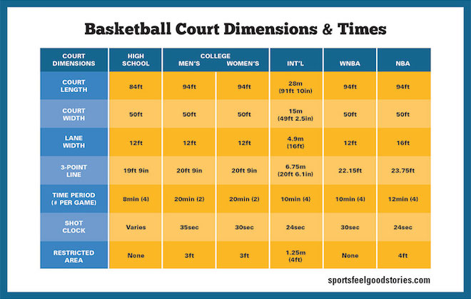
B3 – An Example of a Standard? Change? Who started it [them]?
Who started it? James Naismith
What year started? Dec 1891
Have there been rule changes?

Slide 10
B4 – Jesus’s Doctrine and Biblical Truth Defined
Matt 28:20 – “and teaching them to obey everything I have commanded you. And surely I am with you always to the very end of the age.
Luke 20:21 – So the spies questioned him “Teacher, we know that you speak and teach what is right, and that you do not show partiality, but teach the way of God in accordance with the truth”
John 1:14 – The Word became flesh and made his dwelling among us. We have seen his glory, the glory of the one and only Son, who came from the Father, full of grace and truth
John 1:17 – For the law was given through Moses, grace and truth came through Jesus Christ
John 4:23 – Yet, a time is coming and has now come when the true worshipers will worship the Father in Spirit and in truth, for they are the kind of worshipers the Father seeks.
John 14:6 – Jesus answered, I am the way and the truth and the life. No one come to the Father, except through me.
John 15:26 – “When the Advocate comes, whom I will send to you from the Father – the Spirit of truth who goes out from the Father – he will testify about me”.
John 17:17 - Sanctify them by the truth, your word is truth
John 18:38 – “What is truth?” retorted Pilate. With this he went out again to the Jews gathered there and said, “I find no basis for a charge against him
Acts 2:42 – They [1st century – A.D. 33- 100] devoted themselves to the apostles teachings and to the fellowship, to the breaking of bread and to prayer.
Sports and man-made rules will change…. Heb 12:27- 28 - God kingdom [Church], [rules] can NEVER be shaken…change

Slide 11
Part B5 – Jesus’s Doctrine and Biblical Truth Defined
Matt 16:13 – 19 - … 15 – “who do you say I am? 16 – Simon Peter answered, “You are the Messiah, the Son of the living God.” 17 – Jesus replied, “Blessed are you, Simon son of Jonah, for this was not revealed to you by flesh and blood, but by my Father in heaven, 18 – And I tell you that you are Peter, and on this rock I will build my church, and the gates of Hades will not overcome it. 19 – I will give you the keys of the kingdom of heaven, whatever you bind on earth will be bound in heaven, and whatever you loose on earth will be loosed in heaven”
Mark 12:13-14 – the Pharisees said, “Teacher.. we know that you are a man of integrity and that you teach the way of God in accordance with the truth…
Acts 2:37 - 38 – On the day of Pentecost, during Peter 1st preached sermon, the people asked Peter & the apostles, “Brothers, what shall we do? 38 – Peter replied, “repent and be baptized every one of you, in the name of Jesus Christ for the forgiveness of your sins, And you will receive the gift of the Holy Spirit”.
Rom 16:16 - … all the churches of Christ send greetings.
1Cor 15:1-4 – Now, brothers and sisters, I want to remind you of the gospel I preached to you, which you received and on which you have taken your stand, 2- By this gospel you are saved, if you hold firmly to the word I preached to you. Otherwise, you have believed in vain. 3- For what I received, I passed on to you as of first importance, that Christ died for our sins according to the Scriptures, 4 – that he was buried, that he was raised on the third day according to the Scriptures
Rom 2:8 – But for those who are self-seeking and who reject the truth and follow evil, there will be wrath and anger
2Tim 2:15 – Do your best to present yourself to God as one approved, a worker who does not need to be ashamed and who correctly handles the word of truth.

Slide 12
B6 – Jesus’s Doctrine and Biblical Truth Defined
17. OBS lesson 1, Q3 - Heb 8:6-7 – Does God contrast the two covenants, law of Moses and New Testament of Christ? Y. If nothing had been wrong with the law of Moses, would God have replaced it with the law of Christ? N
18. OBS lesson 1, Q4 – Rom 7:6-7 – Are you delivered [discharged/released] from the law? - Yes
19. OBS lesson 3, Q11 – Gal 1:8 – If anyone preaches a gospel that cannot be read in the NT, will he be eternally condemned? - Yes
 | Governing Laws that Changed - Why?
No. | Country | Earlier Rule | Earlier Rule | Present Law
1 | Argentina | Indians | Spain | Republic of Argentina
2 | Australia | Aborigines | England | Constitution
3 | Canada | Indians | England | Constitution
4 | Germany | German Crown | Third Reich [Hitler] | Republic of Germany
5 | India | France | England | Republic of India
6 | Japan | Shogunates | Japanese Crown | Constitution Monarch
7 | Scotland | Clans | Scottish Crown | British
8 | Spain | Spanish Crowns | Republic | Fascist Dicator
9 | United States | Indians | England | Constitution
10 | SPIRITUAL
11 | Bible | Patriarchal [Family] - OT | Law of Moses - [Ten Commandments] - OT | Christian - [Jesus Christ]- NT

Slide 13
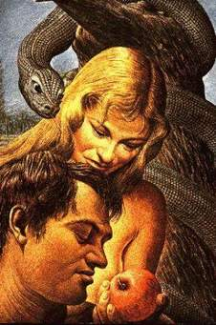
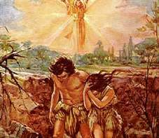
B7 – 1st Seed of Man’s Disobedience - Planted, by Who?
1. Adam & Eve in the Garden with Satan [serpent] – Gen 3:1ff
3:2, – the woman said to the serpent, we may eat fruit from the trees in the garden, 3 – but God did say, “You must NOT eat fruit from the tree that is in the middle of the garden, and you must not touch it, or you will die”.
3:21. 24 – “The Lord God made garments of skin for Adam and his wife and clothed them. 23 – And the Lord God said, “the man has now become like one of us, knowing good and evil… 23 – So the Lord God banished him from the Garden of Eden… 24- and placed a cherubim and a flaming sword flashing back and forth to guard the way to the tree of life”.

Slide 14
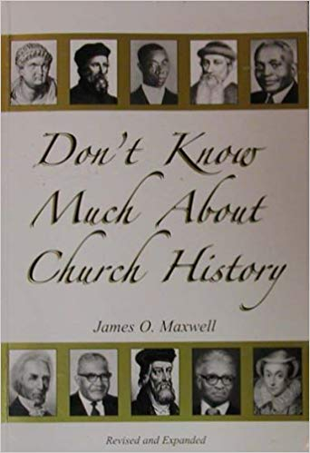
B8 –2rd Seed of Disobedience [False Doctrine] Planted, by Who?
Bro James Maxwell book
“Apostasy Began Within the Church Through Its Elders”
“5 Fold Formula” of Apostasy –Man made Denominations – Acts 20:28-31 - written A.D. 63 or 70
Stage 1 - “After Paul’s departing grievous wolves would enter in among the flock
Stage 2 – the flock would not be spared
Stage 3 – from within men would arise
Stage 4 – these men would speak perverse things
Stage 5 – disciples will be drawn away from the flock by these men who have risen in the church”
Vs 31 – “So be on your guard”!
“Toward the close of the first century, elders began to be called “fathers” by those who were affectionately and theologically influenced by them” [Vos. P. 9] . pg 33 Maxwell
Matt 23:9 – Jesus said, “And do not call anyone on earth “father”, for you have one Father, and he is in heaven”.
Jere10:23- “I know, O Lord, that a man’s life is not his own, it is not for man to direct their steps”.

Slide 15
B9 – Results of False Doctrine Seeds Planted by Who? When?
19 of 100’s of False Teachers & Doctrines developed after 1st Century [after A.D. 100]?:
No | Time,A.D | Church | Place | Founder | Church
0 | 33 | Church of Christ | Jerusalem | Jesus Christ | The Lord, Mt 16:18,Rom 16:16
1 | 606 | Roman Catholic | Rome | Boniface III | Roman Catholic
2 | 622 | Islam | Mecca | Muhammad | Islam
3 | 1054 | Greek Catholic | Greece | Photius | Greek Catholic
4 | 1520 | Lutheran | Germany | Martin Luther | Lutheran
5 | 1534 | Episcopalian | England | Henry VIII | Episcopalian
6 | 1536 | Presbyterian | Switzerland | John Calvin/Knox | Presbyterian
7 | 1550 | Congregational | England | Robert Browne | Congregational
8 | 1607 | Baptist | Holland | John Smthye | Baptist
9 | 1647 | Quaker | England | Fox | Quaker
10 | 1739 | Methodist | England | John Wesley | Methodist
11 | 1767 | United Brethren | USA | Otterbern | United Brethren
12 | 1816 | Evangelical | USA | Albright | Evangelical
13 | 1830 | Mormons | USA | Joseph Smith | Latter Day Saints (Mormons)
14 | 1830 | 7th Day Adventists | USA | William Miller/White | 7th Day Adventists
15 | 1866 | Christian Scientist | USA | Mary Baker Eddy | Christian Scientist
16 | 1872 | Jehovah's Witnesses | USA | Charles T Russell | Jehovah's Witnesses
17 | 1895 | Nazarene | USA | Bresee | Nazarene
18 | 1917 | Four Square Gospel | USA | McPherson | Four Square Gospel
19 | 1920 | Christian (UCMS) | USA | Burham | Christian (UCMS)
Source: Ivy Conner, 1995,CR
We will review only 3 of 100’s on the following slides

Slide 16
B10- 33 A.D.- Church of Christ – New Testament doctrines
Jesus Christ established his Church with written regulations
Jesus established his New Testament doctrines written in the book of Matthew through Revelation to govern his Church and his people
“We would like to encourage you to make a careful comparison of this church with the one described in detail in your Bible. We believe that you will find this church is desirous in every way to be the church of the New Testament”. Source: GACOC weekly bullentin-back pg

Slide 17
B11 –What happen after John’s death? After A.D.100
Classification of Church Fathers:
Apostolic Fathers [95-150 A.D.]
Ignatius, Polycarp, Clement of Rome, Barnabas.
Apologists [140-200 A.D.]
a. Justin Martyr, Tertullian, Tatian
Polemicists [180-225 A.D] – polemic means “ a strong written or spoken attack against someone else’s opinions, belief, practices. Study…
Scientific Theologians [225-460 A.D]
a. 3 schools of thought developed based on where you lived in the Roman Empire [1] Alexandrian; [2] Western; [3] Eastern, Study…
Pg 34- Maxwell
False doctrine Seeds Planted by Church Fathers:
Ignatius and Clement of Rome in 110 A.D. stressed that bishops were superior to elders & should be over elders, deacons & members of local congregation
The Council of Nicea, convened by Constantine in 325 A.D. stressed that Metropolitan [city] Bishops [Archbishops], because of their location in population center, should have ascendancy [domination] over Country Bishops”
Irenaeus and Tertullian in the late 2rd century, taught that a bishop should oversee a plurality of congregation in a geographical area. This led to the Diocesan Bishop [Catholic teaching?]
Pg 35- Maxwell

Slide 18
B12 – Church History between 100 - 606 A.D.
Year Established, A.D. | The Church and Denominations
33 | Church of Christ
100 - 606 | More than 500 years – Persecution of Christians… Internal Heresies… What other events occurred?? Why?? Any other reliable [eyewitness] historical records?
606 | Roman Catholic
622 | Islam
1607 | Baptist
Source: Maxwell, pg30 & Ivy Conner, pg 1

Slide 19
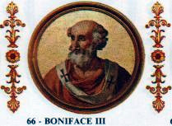
B13 - 606 A.D.- Roman Catholic - False doctrine & their Teachers
Boniface III was appointed as the supreme head [universal bishop or Pope of the church by Rome’s Emperor Phocus [606-607 A.D.] ]
Man-made; False doctrines [no NT scriptural support -Heb 8:6]:
Infant baptism – began in third century [300 A.D.]
Holy water – began in 120 A.D.
Celibacy urged for Priests – in 385 A.D.
Images Introduced – in 405 A.D.
Worship of Virgin Mary – in 431 A.D.
Purgatory – in 593 A.D. by Gregory the Great
Prayers directed to Mary, dead saints and angels – 600 A.D.
Instrumental music – in 670 A.D. by Pope Vitalian, threaten division, therefore, discontinued for 150 yrs; began in 800
Confession of Sins to Priests – in 1215 A.D., by Pope Innocent III
16 others listed in the book
Pg 35-37 in the book
254 Popes [Yr 606 – 2013] = 1407 yrs
Pope Francis – 1st Pope born outside Europe; in Argentinian [South America]

Slide 20
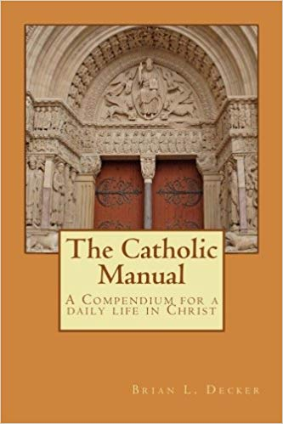
B14 - 606 A.D.- Roman Catholic - False doctrine & their Teachers
The Catholic Manual – a single volume compendium providing a summary of the required beliefs to be held by members of the Catholic faith,
the primary prayers of the Church,
daily mediations and guides for common devotional acts,
including how to pray the Rosary and the Stations of the Cross.
The Manual is intended to provide a reference for the edification and inspiration of those who are members of the Catholic Church
or those who feel themselves called to a better understanding of a daily life in Christ.
Copyright by Brian Decker
Timeline of Catholic/Orthodox Church relations: https://www.catholicbridge.com/catholic/timeline-of-catholic-church.php
AD Event [Timeline years AD 1-500]
20s *c. 29 AD Our Lord's Resurrection. The First Pentecost. St. Peter preaches in Jerusalem and converts three thousand people, creating the first Christian community.
30s *c. 35 Saul of Tarsus has an apparition of Jesus Christ and is converted to Christianity.
*c. 39 St. Peter baptizes Cornelius. This event marks the beginning of the missionizing to the Gentiles.
40s *42 The first persecution of Christians in Jerusalem under Herod Agrippa. Many Christians escape to Antioch, establishing its first community.
*44 Martyrdom of St. James the Great, brother of the Apostle John. He is the first apostle to die for the faith. He was sentenced by Herod Agrippa in 44 AD. Today he is honored at the shrine of Santiago Compostela.

Slide 21
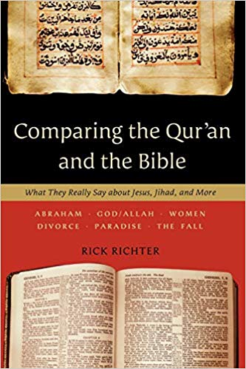
B15 - 622 A.D.- Islam- History, False doctrine & their Teachers
“Prophet Mohammed was the founder of the Islam religious.
At age 40, he had a vision in which the angel Gabriel selected him to be the prophet of Allah [Ibid,p 81]. No eyewitness present; as Acts 9:3-7.
The distinct difference between Islam and Roman Catholic Church is that Islam allows the Muslin to have direct access to God by offering prayers to Allah, personally.
Muslims were happy to rid themselves of the many sacraments and liturgies of the priestly teachings.
Islam became an intense enemy of Christianity
The main purpose of Mohammed and his followers was to reject the pope, the teachings of the church in Rome, and all forms of Christianity
Islam was capturing many new believers in the Arabic territories, therefore, it was halted in France by Charles Martel, who was a part of the Franks and a chief official of the House of Pepin.
The purpose of the Franks and another group of fighters, the Carolingians, was to revive the Roman Empire in the area that Islam had taken over
Pg 38-41 in Maxwell book

Slide 22
B16 - 622 A.D.- Islam- History, False doctrine & their Teachers
6 Fundamental Teachings [Doctrines]
Allah is the only God and Muhammad is his messenger
Islam require a belief in angels. Four of the well known angels are Gabriel [chief angel], Michael, Raphael and Israel
All the Holy scriptures culminated in, and was perfected in the Holy Qur’an [just as all religious was perfected in Islam]
All of Allah’s prophets or messengers are believed in and revered by Muslims
Day of Judgement is One of the most emphasized beliefs in the Holy Qur’an
Muslims believe that Divine Decree controls the eventual outcome of all actions in this universe
Pg 40 in the book & www.alislam.org
5 Pillars of Islam
Represent the principle acts of worship which are required to practice the faith. Observance and practice of these acts is obligatory for all Muslims. They are:
Repeat the confession of faith every day – “There is no God but Allah and Mohammad is the prophet of Allah”.
Prayer is the basic and most important means by which man communicates with Allah. 5 daily prayers [morning, noon, mid-afternoon, at dusk, before midnight. There is no need for, nor does Islam tolerate an intermediary between God and man.
Fasting - this is compulsory during daylight hours of the month of Ramadhan, the 9th month on the Muslim calendar which commemorates the 1st revelation of Koran
Tax on Wealth [2% on yearly basis]
Make a pilgrimage to Mecca at least once in life-time, if physically and financially capable…..
Pg 41 in the book &www.alislam.org

Slide 23
B17 - 1607 A.D.- Baptist - History, False doctrine & their Teachers
Those who believe the Baptist history can be traced to the English Separatist movement point to John Smythe, a former Anglican priest, as the founder of the Baptist faith. Smythe emigrated to Holland with a group of English Separatists in the early 17th century. There, he was influenced by Mennonite teachings and began to preach that only those who made a confession of faith could be legitimately baptized and received into the church.
RELATED SEARCH for Various BapTists denominations or Sectors below
Missionary Baptist Beliefs
Independent Baptist Beliefs
Baptist Churches Beliefs
Hardshell Baptist Beliefs
Southern Baptist Beliefs
Freewill Baptist Belief
Central Beliefs Of The Baptist Religion
American Baptist Beliefs
Baptist Vs Roman Catholic Beliefs
Beliefs Of Baptist Religion
Many others Baptist Beliefs

Slide 24
B18 - 1607 A.D.- Baptist- History, False doctrine & their Teachers
Considerable Diversity regarding Doctrinal Teachings – more than 100 branches --from Liberal to Ultra Conservative Baptist, as shown on previous slide ie , Southern, Missionary, Primitive.
Naming convention - Baptist philosophy partakes of the spirit of partyism, such as that condemned at Corinth (1 Cor. 1:10ff). They prefer the appellation “Baptist” to “Christian” (Acts 11:26; 26:28; 1 Pet. 4:16)” commonly claiming that the divinely bestowed name was invented by the enemies of the ancient faith.
Unscriptural organized, generally having a “pastor” (cf. Acts 14:23) and a board of deacons. Though congregations claim independence, certain works and policies, in some cases, are controlled by “conventions” (e.g., the Southern Baptist Convention). In individual congregations, a majority vote of the members makes congregational decisions (J.M. Pendleton, Baptist Church Manual, Philadelphia: Judson Press, 1867, pp. 101ff). The biblical concept of elders is alien to this system.
Engages in forms of worship that do not fit the New Testament pattern. The use of instrumental music in worship is the prevailing practice (an addition to apostolic authorization — Eph. 5:19; Col. 3:16),
Lord’s Day communion,. observed weekly in the first century (cf. Acts 20:7; 1 Cor. 16:2, NASB), is relegated to random times of congregational determination
It is a matter of some amazement that one may not partake of the Lord’s supper in most Baptist churches, unless he has been immersed in water, yet the case is vociferously argued that baptism is not requisite for entering heaven!

Slide 25
B19 - 1607 A.D.- Baptist- History, False doctrine & their Teachers
5. Plan of salvation is “solely through faith.” Yet, because of man’s inherited “total depravity,” he cannot believe, unless supernaturally empowered by the Spirit of God. Baptist theologians contend that faith is preceded by repentance, which is a logical impossibility, if one is employing “faith” with reference to the same object. [NOTE: In Mark 1:15, Jesus admonished the Jews: “repent ye, and believe in the gospel.” These Hebrews already had faith in God, which would serve as the motivation for their repentance (cf. Rom. 2:14; 2 Cor. 7:10). They then were to embrace the gospel system, which would involve belief in Christ.]
Baptism, as a condition of salvation, is repudiated vehemently (contra Mark 16:16; Acts 2:38; 22:16), yet the rite is required for Baptist affiliation. Members actually are received into a church by a “vote” of the membership, though it is conceded that this is “different” from the practice of the apostolic church (Hiscox, p. 22).
6. Impossibility of apostasy, i.e., the regenerated person can never so sin as to be lost, though he may become corrupt enough to be excluded from a church’s fellowship (Hiscox, p. 30). Elsewhere we have dealt with this doctrine in some detail (see our booklet, Eternal Security — Fact or Fiction?.
“Source: The Baptist Church, Historical Perspective, by Wayne Jackson”

Slide 26
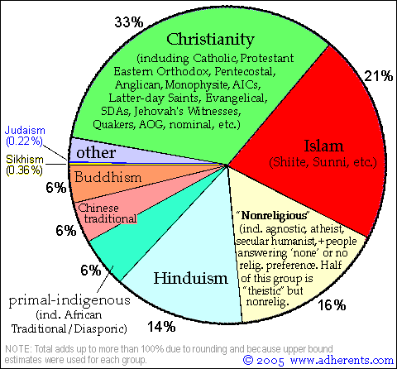
B20 – Largest False Doctrines and/or Major Religious in the World
Listed as Denominations
Catholicism - 1.2 billion
Catholic Church - 1,147 million^{[1]}
Roman Catholic Church (Latin Rite) - 1,129.9 million
Eastern Catholic Churches (Eastern Rite) - 17.1 million
Protestantism - 670 million
Historical Protestantism - 350 million
Baptist churches - 105 million^{[4]}
Southern Baptist Convention - 16.3 million^{[5]}
National Baptist Convention, USA, Inc. - 7.5 million^{[6]}
Churches of Christ - 5 million
Eastern Orthodoxy - 210 million
Autocephalous churches
Russian Orthodox Church - 125 million
Others: 100’s
“Source: http://gospelclarity.com/2010/08/25/the-largest-christian-denominations-in-the-world/
Major Religions of the World Ranked by Number of Adherents

Slide 27
Q&A – 10 mins
The Share – Episode 7

