Slide 1
The Assembling of the Saints Collectively: The Sabbath worship vs. the 1st Day of the week worship Presented by Cedric Stevenson

Slide 2
What is The Sabbath?
The Sabbath beginnings:
1`. After God created the world in six days...
a. He rested on the seventh day - Gen 2:1-2
b. Then He blessed and sanctified the seventh day - Gen 2:3
2. The seventh day later became known as "The Sabbath Day"...
a. From the Hebrew word shabbath, meaning "to rest from labor"
b. The Greek word is sabbaton, and like English, a transliteration of the Hebrew
c. Thus it came to mean "the day of rest"

Slide 3
The Sabbath Commanded of the Israelites
1. The Sabbath is first mentioned in regards to Israel collecting Manna 2. When God actually blessed and sanctified the seventh day as a day of rest - Exo 16:23-30
²³ And he said unto them, This is that which the Lord hath said, To morrow is the rest of the holy sabbath unto the Lord: bake that which ye will bake to day, and seethe that ye will seethe; and that which remaineth over lay up for you to be kept until the morning.²⁴ And they laid it up till the morning, as Moses bade: and it did not stink, neither was there any worm therein.²⁵ And Moses said, Eat that to day; for to day is a sabbath unto the Lord: to day ye shall not find it in the field.²⁶ Six days ye shall gather it; but on the seventh day, which is the sabbath, in it there shall be none.²⁷ And it came to pass, that there went out some of the people on the seventh day for to gather, and they found none.²⁸ And the Lord said unto Moses, How long refuse ye to keep my commandments and my laws?²⁹ See, for that the Lord hath given you the sabbath, therefore he giveth you on the sixth day the bread of two days; abide ye every man in his place, let no man go out of his place on the seventh day. ³⁰ So the people rested on the seventh day. KJV

Slide 4
An Example of The Sabbath Worship
Ezekiel 46
“‘1. This is what the Sovereign Lord says:
The gate of the inner court facing east is to be shut on the six working days,
but on the Sabbath day and on the day of the New Moon it is to be opened.
2. The prince is to enter from the outside through the portico of the gateway and stand by the gatepost.
The priests are to sacrifice his burnt offering and his fellowship offerings.
He is to bow down in worship at the threshold of the gateway and then go out,
but the gate will not be shut until evening.
3 On the Sabbaths and New Moons the people of the land are to worship in the presence of the Lord at the entrance of that gateway.

Slide 5
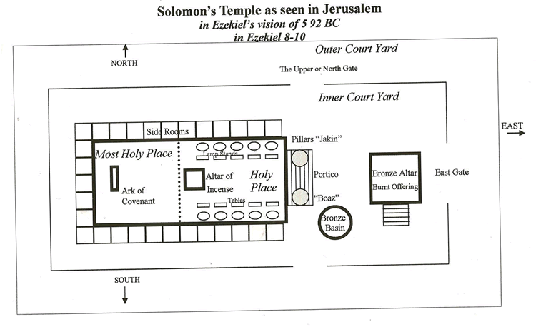
An Example of The Sabbath Worship

Slide 6
The New Covenant Hebrews 8:7-13
⁷ For if there had been nothing wrong with that first covenant, no place would have been sought for another. ⁸ But God found fault with the people and said^{[b]}:
“The days are coming, declares the Lord, when I will make a new covenant with the people of Israel and with the people of Judah. ⁹ It will not be like the covenant I made with their ancestors when I took them by the hand to lead them out of Egypt, because they did not remain faithful to my covenant, and I turned away from them, declares the Lord. ¹⁰ This is the covenant I will establish with the people of Israel after that time, declares the Lord. I will put my laws in their minds and write them on their hearts. I will be their God, and they will be my people. ¹¹ No longer will they teach their neighbor, or say to one another, ‘Know the Lord,’ because they will all know me, from the least of them to the greatest. ¹² For I will forgive their wickedness and will remember their sins no more.”^{[c]}
¹³ By calling this covenant “new,” he has made the first one obsolete; and what is obsolete and outdated will soon disappear.

Slide 7
The New Covenant John 19:28-30
The Death of Jesus
28. Later, knowing that everything had now been finished, and so that Scripture would be fulfilled, Jesus said, “I am thirsty.” 29. A jar of wine vinegar was there, so they soaked a sponge in it, put the sponge on a stalk of the hyssop plant, and lifted it to Jesus’ lips. 30. When he had received the drink, Jesus said, “It is finished.” With that, he bowed his head and gave up his spirit.

Slide 8
Define Pentecost
The day of Pentecost (meaning 50th)is seven weeks after Passover: that is to say, the fiftieth day after Passover inclusive of Sunday. Pentecost may also refer to the 50 days from Passover to Pentecost Sunday inclusive of both. Which is the first day of the week
Let’s read Acts 2

Slide 9
The Assembling of the Saints Collectively
CHRISTIANS ASSEMBLED ON THE FIRST DAY...
1. Expressed both explicitly and implicitly in the NT:
Ac 20:7; On the first day of the week we came together to break bread. Paul spoke to the people and, because he intended to leave the next day, kept on talking until midnight.
I Cor. 16:1-2; Now about the collection for the Lord’s people: Do what I told the Galatian churches to do. 2. On the first day of every week, each one of you should set aside a sum of money in keeping with your income, saving it up, so that when I come no collections will have to be made.

Slide 10
What Christians do when we come together
Worship the father in spirit and truth, (John 4:24)
Pray Eph. 6:18
Sing (uplift our voice to the father) Col 3:16
Receive the word (Preaching) Acts 20:7
Commune (in remembrance of him) 1Cor 11:23-30
To give (Offerings) 1Cor 16:1-2

Slide 11
What Christians do when we come together
Teach Gospel (1 Tim. 3:15) (Matt 28-18-20)
Care for Needy Saints (Rom. 15:25-26)
Encouraging One Another (10:24-25)
Edify the Saints (Eph. 4:11-12)
Mission is NOT:
Social
Recreational
Money-making
Political

Slide 12
Thank you

