Slide 1
New Testament Singing vs. Old Testament Singing and Instruments of music.
Brother Phillip Williams

Slide 2
Old Testament Music
Musical Instruments were used widely for a variety of purposes
Returning Heroes of war were greeted with songs and tambourines Judges 11:34;1 Sam. 18:6
Instruments were used at the Installation of a new of King- I Kings 1:39,40
People used Musicians for Personal enjoyment- Isaiah 5:12; Amos 6:5
Songs were used for the Bereaved in times of sorrow- II Samuel 1:17-18
Songs and instruments were used to worship God- II Samuel 6:5

Slide 3
Is Singing a Requirement of God’s Worship
Singing has always been a requirement of God to worship him. Man must follow the desires of God in how we worship him. When Israel failed to tithe properly, it was robbing God of what was due him and they were guilty of sin ( Malachi 3:8 ). A Christian who fails to worship God properly sins against Him as well.
Moses explains the reason of the deaths of 2 young men who lost their lives while worshipping God. ( Leviticus 10:3 )
Any one who considers singing in worship to be irrelevant should consider God’s reaction to how incense was offered in worship on one occasion in Leviticus chapter 10.

Slide 4
A look at King David
Introduction on Instruments into the Levitical Worship
The Ark of God transported to Jerusalem II Samuel 6:5
King David commands the Levites to appoint singers I Chronicles 15:16
Four Thousand men would praise the Lord with Musical Instruments that David made to praise the Lord. I Chronicles 23: 5
Two hundred eighty skilled singers were instructed in the songs of the Lord I Chronicles 25:7
Hezekiah wrote, we will sing my songs to the stringed instruments all the days of our life in the house of the Lord. Isaiah 38: 20

Slide 5
Instrumental Music Authorized by the Lord in the Old Testament
II Chronicles 29:25 -28
And he set the Levites in the house of the Lord with cymbals, with psalteries, and with harps, according to the commandment of David, and of Gad the King’s sheer, and Nathan the prophet: for so was the commandment of the Lord by his prophets. And the Levites stood with the instruments of David, and the priest with the trumpets. And Hezekiah commanded to offer the burnt offering upon the alter. And when the instruments ordained by David king of Israel. And all the congregation worshipped, and the singers sang, and the trumpeters sounded: and all this continued until the burnt offering was finished.

Slide 6
What should Christians learn from this brief survey of how music was used in the Old Testament?
It is not up to Man to desire whether or not he will use instruments. When God wanted them to be apart of Worship, He commanded it, He made it known.
If God wanted instruments to be included with songs of praise today, he would have commanded its’ use, just as he did in the Old Testament.
In the temple they were required, and not optional. In the church they have not been authorized and are not to be used.

Slide 7
QUESTIONS?
Who is Worship For?
Who are we singing To?
Who is to be Glorified when we sing in Worship?
If singing and instruments were approved in the Old Testament, are they both approved in the New Testament?
What does God say about Music in Worship in the New Testament?

Slide 8
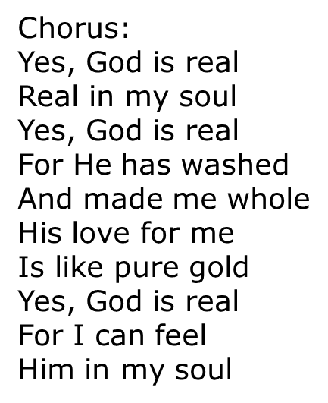
MY GOD IS REAL
There are some things I may not know There are some places I can't go But I'm sure Of this one thing That God is real For I can feel Him deep within
Verse Two: Some folks may doubt Some folks may scorn All can desert And leave me alone But as for me I'll take God's part For God is real and I can feel Him in my heart
Verse Three: I cannot tell Just how you felt When Jesus Took all your sins away But since that day Yes, since that hour God has been real For I can feel His holy power

Slide 9
New Testament Worship Music in the New Testament
What type of Music did the Lord want in the New Testament? Let’s seek scripture for the answer. There are many passages to use in helping us understand, what was required in the New Testament as acceptable Music. Four will be used in this lesson:
1 Corinthians 14:15
1 Corinthians 14:26
Ephesians 5:19
Colossians 3:16

Slide 10
1 Corinthians 14:12-15
Paul is addressing what God’s people are to do in the assembly and it should reflect the oneness of the body. In the assembly we are to exhort and edify one another.
The Corinthians manifested Pride and Diverseness in their assembly. Some wanted to do tings their way and it was not edifying everyone.
Paul wrote a portion of this scripture specifically directed to correct their divisive attitude and behavior. This is why Paul made the statement:
I will Sing with the Spirit
I will Sing with the Understanding ( Mind )
John 4:23,24 Says “ But the hour cometh, and now is, when the true worshippers shall worship the Father in Spirit and in truth. God is a Spirit: and they that worship him must worship in in Spirit and in truth..

Slide 11
11 Corinthians 14:26
How is it then, brethren? When ye come together, everyone of you hath a psalm, hath a doctrine, hath a tongue, hath a revelation, hath an interpretation. Let all things be done unto edifying.

Slide 12
Ephesians 5:19
Let us start at verse 6 and read through verse 20, so we can get a through understanding of verse 19.
How do I sing and make Melody in my Heart?
Is my singing acceptable to God?

Slide 13
Colossians 3:15-17
Am I listening to the words of the song?
Am I Giving Thanks to God ?
Is my Mind Clear when I am singing to the Lord?
Am I edifying my Brother or my Sister if I am just mumbling some words ?
Am I edifying my Brother/ Sister if I am just sitting through the singing listening to others sing ?
Am I Happy to be at Worship ?

Slide 14
By God’s Authority
The authority of God was imparted to his son, Jesus ( Matthew 28: 18,19 ). In turn, Jesus delegated His authority to spiritually –guided men who preached His Message and wrote it down for future generations 1 Thessalonians 2:13, 4:1,2 and 1 Corinthians 14:37. Hebrews 8:6-7, 13
God has NEVER Authorized the use of Instruments in the New Testament Worship.
Matt. 28: 18 says “All power is given unto me in Heaven and in Earth”.
1 Thessalonians 4:1,2 “Teaches us that we are to Walk and Please God”
Hebrews 8:6-7,13 But now Hath he ordained a more excellent ministry, by how much he is the mediator of a better covenant , which was established upon better promises.
V7 For if that first covenant had been faultless, then should no place have been sought for the second.
V 13 In that he saith, A New covenant, he hath made the first Old, Now that which decayeth(obsolete) and waxeth (growing ) Old is ready to vanish away.

Slide 15
How did Instrumental Music find its’ way into Worship? Was it Authorized?
Pope Vitalian in 666 AD is recorded as being the first to introduce an organ into a church worship.

Slide 16
The Organ Controversy
In 1054 the Organ play in worship caused the Catholic Church and the Eastern Orthodox Church led to a split.
In the 1800’s, most Protestant Churches did not use instruments and opposed instrumental music very strongly.

Slide 17
Men who opposed Instrumental Music but were not God’s authoritative Men, had Quotes on music in worship
Martin Luther ( founder of the Lutheran Church )
John Calvin ( founder of the Presbyterian Church )
John Wesley ( founder of the Methodist Church )
Charles Spurgeon ( known as one of the great Baptist preachers, that seated thousands of people in a Metropolitan Tabernacle
Alexander Campbell ( During the Restoration Movement )

Slide 18
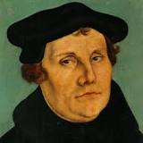
Martin Luther
Founder of the Lutheran church

Slide 19
John Calvin
Founder of the Presbyterian Church

Slide 20
John Wesley
Founder of the Methodist Church

Slide 21
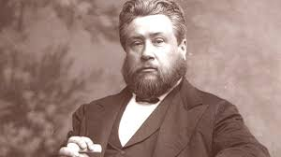
Charles Spurgeon
Known as one of the greatest Baptist Preachers. Preached in a Metropolitan tabernacle in London.

Slide 22
Alexander Campbell
Restoration Movement

Slide 23
Men who were supportive of Instrumental Music but were not God’s authoritative Men, had Quotes on music in worship

Slide 24
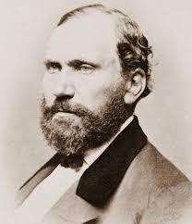
L. L. Pinkerton, Isaac Errett and J.H. Garrison

Slide 25
PSALLO
They said there was support for the word for the use of instruments in the meaning of the word Psallo, but later insisted that they were permitted and not required, to do what God had commanded. They referred to the FEELINGS of devotion AROUSED by INSTRUMENTS in an Emotional appeal for the church to accept them

Slide 26
Resistance to Gods Word
The resistance to instrumental Music is already crumbling in some of the Lords churches today because there are compelling new arguments to change peoples mind, WHY because a growing number of Christians have not learned the lessons of the past.
Lets look at the book of Judges chapter 2
I Samuel 8: 19- 20
Identity of the New Testament Church
Ephesians 5:19 and 11 Peter 1:3

Slide 27
I LOVE TO PRAISE HIS NAME
I love to praise him ( I love to praise his name)
I love to praise him ( I love to praise his name)
I love to praise him ( I love to praise his name)
I love to praise his holy name.
He’s my rock ( He’s my rock, my rock, my sword and shield)
He’s the wheel, (He’s the wheel, in the middle of the wheel)
I know he’ll never, (I know he’ll never, never, let me down)
He’s just a jewel, (He’s just a jewel that I have found)
We’re singing hallelujah, (Hallelujah, hallelujah, I love to praise his name)
Keep singing hallelujah, ( Hallelujah, hallelujah, I love to praise his name)
Oh Hallelujah, (hallelujah, hallelujah, I love to praise his name)
I love to ( I love to praise His holy name)

