Slide 1
THE HISTORY OF THE PENTECOST

Slide 2
THE HISTORY OF THE PENTECOST

Slide 3
THE HISTORY OF THE PENTICOST
7 Biblical Feasts: Leviticus 23
Passover 5. Trumpet Blowing
Unleavened Bread 6. The day of Atonement
First Fruits 7. The Feast of Tabernacles
Pentecost

Slide 4
THE HISTORY OF THE PENTECOST
^{Exodus 3:2-7}
² There the angel of the Lord appeared to him in flames of fire from within a bush. Moses saw that though the bush was on fire it did not burn up. ³ So Moses thought, “I will go over and see this strange sight—why the bush does not burn up.”
⁴ When the Lord saw that he had gone over to look, God called to him from within the bush, “Moses! Moses!”
And Moses said, “Here I am.”
⁵ “Do not come any closer,” God said. “Take off your sandals, for the place where you are standing is holy ground.” ⁶ Then he said, “I am the God of your father,^{[a]} the God of Abraham, the God of Isaac and the God of Jacob.” At this, Moses hid his face, because he was afraid to look at God.
⁷ The Lord said, “I have indeed seen the misery of my people in Egypt. I have heard them crying out because of their slave drivers, and I am concerned about their suffering. ⁸ So I have come down to rescue them from the hand of the Egyptians and to bring them up out of that land into a good and spacious land, a land flowing with milk and honey

Slide 5
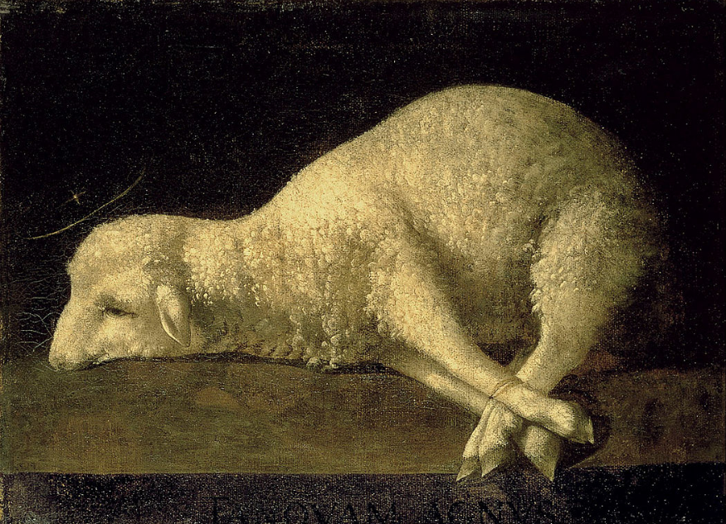
THE HISTORY OF THE PENTECOST
Exodus 12: ⁵ Your lamb shall be without blemish, a male of the first year: ye shall take it out from the sheep, or from the goats: (The blood was then applied to the doorpost of the home, and the lamb was roasted and eaten with unleavened bread and bitter herbs.) 13 And the blood shall be to you for a token upon the houses where ye are: and when I see the blood, I will pass over you, and the plague shall not be upon you to destroy you, when I smite the land of Egypt.

Slide 6
THE HISTORY OF THE PENTECOST
Exodus (Remember the Passover)
13 And the Lord spake unto Moses, saying,
² Sanctify unto me all the firstborn, whatsoever openeth the womb among the children of Israel, both of man and of beast: it is mine.
³ And Moses said unto the people, Remember this day, in which ye came out from Egypt, out of the house of bondage; for by strength of hand the Lord brought you out from this place: there shall no leavened bread be eaten.
⁴ This day came ye out in the month Abib.

Slide 7
THE HISTORY OF THE PENTECOST
The seven feasts or “holy convocations” find there fulfillment in Christ. The first four feasts are already fulfilled, and the latter three will be fulfilled at the coming of Christ:
(1) The Passover speaks of the redemption, which was accomplished on the Cross (1 Pet. 1:18,19) and followed by
(2) The Feast of Unleavened Bread, typical of our justification (2 Cor. 5:21) and sanctification (1 Cor. 5:7)
(3) The feast of Firstfruits was fulfilled in the resurrect of Christ (1 Cor. 15:20)
(4) Pentecost was fulfilled when Christ sent the Holy Spirit to begin the harvest of the church (Act 2:1-4)

Slide 8
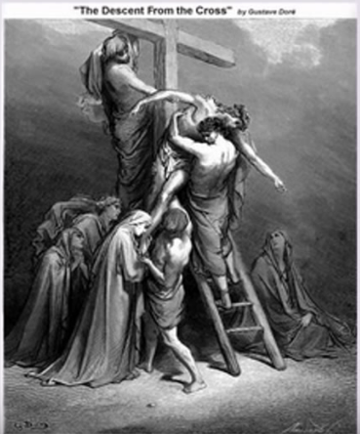
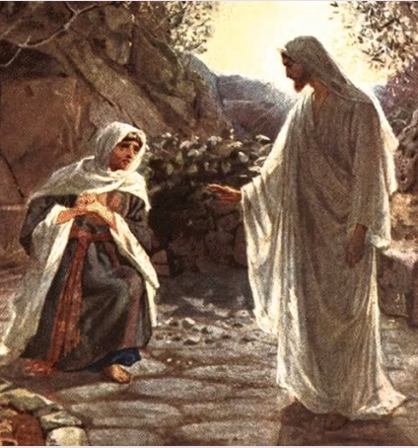
1.Death (Passover) 2. Burial(Unleavened Bread) 3.Resurrection (First Fruit) (Exodus 12:2-13) (John 1:29) (Exodus 12:14) (1 Corp 5:7,8) (Leviticus 23:9) (1 Cor 15:20-26) (John 1:29) (2 Corp 5:21) (I Peter 1:18,19)

Slide 9
THE HISTORY OF THE PENTECOST
When John the Baptist introduced Jesus to the nation, he recognized Christ as the fulfillment of the typical Passover lambs: “Behold the Lamb of God” (John 1:29,36). The Christian not only recognized the fulfillment of the Passover sacrificed by Christ, but also his own responsibility to “keep the feast” by living a sincere and truthful life (1 Cor 5:6-8) (First Reference, Ex. 12:13; Primary Reference, Ex. 12: Lev.1:2.

Slide 10
THE HISTORY OF THE PENTECOST
(5) The Feast of Trumpets will be fulfilled as the rapture of the church (1 Cor. 15:52; 1 Thess. 4:16,17)
(6) The Day of Atonement will be completed seven years later when Christ return (Zech. 12:10; 13:1)
(7) The Feast of Tabernacles will find its final fulfillment in Christ’s thousand-year kingdom on earth (Zech. 14:16) Application: All of the feasts include a Sabbath, reminding Christians of their rest in Christ. (Matt. 11:28,29)

Slide 11
THE HISTORY OF THE PENTECOST
Passover
Unleavened Bread
First Fruits
Pentecost
Trumpet Blowing
The day of Atonement
7. The Feast of Tabernacles
Pentecost
 | First Fruit
Unleaven Bread
 | Passover

Slide 12
1.Death (Passover) 2. Burial(Unleavened Bread) 3.Resurrection (First Fruit) (Exodus 12:2-13) (John 1:29) (Exodus 12:14) (1 Corp 5:7,8) (Leviticus 23:9) (1 Cor 15:20-26) (John 1:29) (2 Corp 5:21) (I Peter 1:18,19)

Slide 13
THE HISTORY OF THE PENTCOEST
The 4th holy day on Israel’s calendar was the festival of weeks, also known as Shavuot in Hebrew, which was originally a harvest festival. Later, the day was also used to commemorate the giving of the Law of Moses at Mount Sinai. “Weeks” come from an expression Leviticus 23:16

Slide 14
THE HISTORY OF THE PENTICOST
Shavuot? Sha·vu·oth ˌSHävo͞oˈōt, SHəˈvo͞oəs
Shavuot. One of the 4 Pilgrimage Festivals. Celebrates the revelation of the Five Books of the (the Old Testament of the Christian Bible) by God to Moses and to the Israelites at Mount Sinai, 49 days (7 weeks) after the Exodus from Egypt. Commemorates the wheat harvesting in the Land of Israel.

Slide 15
THE HISTORY OF THE PENTECOST
Pentecost was one of the Jewish feast days. Only they didn't call it Pentecost. That's the Greek name. The Jews called it the Feast of Harvest or the Feast of Weeks. It is mentioned five places in the first five books—in Exodus 23, Exodus 24, Leviticus 16, Numbers 28, and Deuteronomy 16. It was the celebration of the beginning of the early weeks of harvest.

Slide 16
THE HISTORY OF THE PENTECOST
Pentecost comes from the Greek (Pentēkostē) meaning "fiftieth" (50th) or 50 days. It refers to the festival celebrated on the fiftieth day after Passover.
SHAVUOT. Shavuot is the Hebrew terms meaning “weeks” Shavuot means weeks or the Feast of Weeks.

Slide 17
THE HISTORY OF THE PENTECOST
There are three things you need to know about Pentecost that will help you understand Acts 2.
1. Pentecost was a pilgrim festival.
That meant that according to Jewish Law, all the adult Jewish men would come from wherever they were living to Jerusalem and personally be in attendance during this celebration.
2. Pentecost was a holiday.
No servile work was to be done. School was out. The shops were closed. It was party time.
3. There were certain celebrations and sacrifices and offerings which were prescribed in the Law for the day of Pentecost.
On Pentecost, the High Priest was to take two loaves of freshly baked wheat bread and offer them before the Lord. The wheat bread was made from the newly harvested wheat.
In short, Pentecost in the time of the Apostles was a great and grand harvest celebration. The streets of Jerusalem were clogged with thousands of pilgrims who had come from every point of the compass to celebrate the goodness of God and the bringing in of the wheat harvest.

Slide 18
THE HISTORY OF THE PENTECOST

Slide 20
THE HISTORY OF THE PENTECOST
The Feast of Pentecost occurred (50) days after the feast of Firstfruits (thus Pentecost in Greek) and was regards by later Jewish authorities as the complement or conclusion of the Passover celebration, since it followed the Passover celebrations, since it followed the latter by seven weeks. It lasted one (Deut. 16:9-12), and was a joyous occasion when the entire nation give thanks to a gracious heavenly Father for His abundant gifts of food. This was symbolized by two loaves baked (with leaven) (v. 17) and presented to the Lord, along with sacrificial animals, cereal gifts, and drink offerings. The feast reminded the Israelites that God’s care and control reached into every area of life, making no distinctions between material and spiritual blessings. Pentecost symbolized the thankfulness of a people who were not only grateful for the Firstfruits of the grain harvest but who looked forward to the culmination of the harvest season in the fall. On the feast of Pentecost the Holy Spirit was first poured out on the apostles (Acts 2:1-4)

Slide 21
