Slide 1
FROM THE PASSOVER TO PENTECOST
ACTS CHAPTERS 1 AND 2

Slide 2
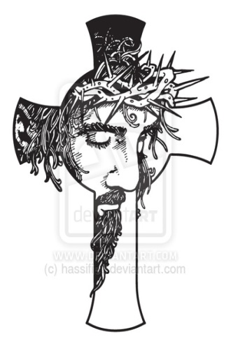
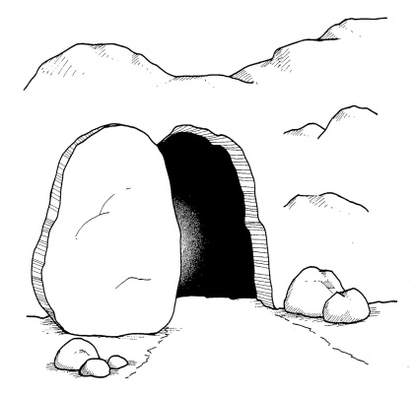
WHAT IS THE GOSPEL? 1 Corinthians 15:1-4, 22; Romans 1:16,17; John3:16,17
THE GOSPEL
“Good News”
AN EVENT OF LOVE
DEATH
RESURRECTION
The Event:
1Co 15:3 For I delivered to you first of all that which I also received, that Christ died for our sins, according to the Scriptures, 1Co 15:4 and that He was buried, and that He rose again the third day according to the Scriptures;
Our Hope
1Co 15:22 For as in Adam all die, even so in Christ all will be made alive.
BURIAL

Slide 3
Transition of Power and Authority
The Kingdom of God / Heaven
GOD
Acts 1:1 The former treatise I made, O Theophilus, concerning all that Jesus began both to do and to teach,
Acts 1:2 until the day in which he was received up, after that he had given commandment through the Holy Spirit unto the apostles whom he had chosen:
Acts 1:3 to whom he also showed himself alive after his passion by many proofs, appearing unto them by the space of forty days, and speaking the things concerning the kingdom of God:
Dan 2:44 And in the days of those kings shall the God of heaven set up a kingdom which shall never be destroyed, nor shall the sovereignty thereof be left to another people; but it shall break in pieces and consume all these kingdoms, and it shall stand forever.
THE SON
ONE
HIS
HOLY
SPIRIT
THE FATHER
Notes:
The kingdom of God consist of what is in Heaven and on earth, seen and unseen worlds.

Slide 4
SOVEREIGNTY OF DEITY
JESUS CHRIST
MATTHEW 16:13-19
LUKE 24:36-49
MATTHEW 28:18-20
MARK 16:15,16
ACTS2
\
OT
ACTS
1
Seen and Heard
Christ Seen Alive, Speaking About The Kingdom
Holy Spirit,
Peter and
Apostles
40 DAYS
The Law
The Gospel
Event
NT
3 DAYS
7 DAYS
Notes:
The Gospel message is what God did because of the Son (completion of His purpose). Heb 5:8-9; I Co.15:1-4, 5-8 Are some witnesses to the resurrection of Jesus.
Acts 1:1-3 seen forty days after the resurrection with many infallible proofs.

Slide 5
God Sends The Holy Spirit John 14:26; Acts 2:1-4
THE
SPOKEN WORD
He.1:1-2
GOD
Mission?________________________________________________________________________________________________________________________________________________________________________
Message?________________________________________________________________________________________________________________________________________________________________________________________________________________
(B.C.)=Before Christ put on flesh
(B&L)=Birth and Life of Christ
(A.D.B.R.)=After the Gospel Event
Bb
B.C.
Faith Walking On The Promises of God
He. 11
Holy Spirit
Jn. 14:23-26
Jn. 16:7-11, 13-15
A.D.B.R.
Fact Talking
Jn. 15:26-27
Christ
Embodied Word
Jn.1:1-4,14,17
B&L
Fact Walking,
The Fulfillment of Prophesy
Ti. 2:11-14

Slide 6
Jesus Sends The Apostles (12) Acts 1:4, 5, 8, 20-22 Lk. 24:44-49
THE
SPOKEN WORD
He.1:1-2
GOD
Mission?_____________________________________________________________________________________________
Witnesses:
Replacement___________
Historical facts__________
Lifestyle_______________
Resurrection___________
Message?_______________________________________________________________________________________________________________________________________________________________________
Bb
A.D.B.R.
Fact Talking
Jn.15:26-27
B.C.
Faith Walking On The Promises of God
He.11
Holy Spirit
Jn.14:23-26
Jn.16:7-11
Christ
Embodied Word
Jn.1:1-4,14,17
A.D.B.R.
Fact Talking &
Faith Walking
Ac.2:14-47
Fruit Producing
Mk.16:15,16
The Apostles
Jn.16:13
2 Co.5:11-21
B&L
Fact Walking,
The Fulfillment of Prophesy
Ti.2:11-14

Slide 7
CHRIST HAS ALL POWER AND AUTHORITY IN HEAVEN AND ON EARTH
The Kingdom of God / Heaven
GOD
Acts 2:16 but this is that which hath been spoken through the prophet Joel:
Acts 2:17 And it shall be in the last days, saith God, I will pour forth of My Spirit upon all flesh: And your sons and your daughters shall prophesy, And your young men shall see visions, And your old men shall dream dreams:
Acts 2:18 Yea and on My servants and on My handmaidens in those days Will I pour forth of My Spirit; and they shall prophesy.
Acts 2:19 And I will show wonders in the heaven above, And signs on the earth beneath; Blood, and fire, and vapor of smoke:
Acts 2:20 The sun shall be turned into darkness, And the moon into blood, Before the day of the Lord come, That great and notable day.
Acts 2:21 And it shall be, that whosoever shall call on the name of the Lord shall be saved.
THE SON
ONE
HIS
HOLY
SPIRIT
THE FATHER
Notes:
The kingdom of God consist of what is in Heaven and on earth, seen and unseen worlds.

Slide 8
HOW CAN ONE OBEY THE GOSPEL? Romans 6:3-6
Crucified
DEATH
New Lifestyle
DEATH
RESURRECTION
Rom 6:3 Do you not know that as many of us as were baptized into Jesus Christ were baptized into His death? Rom 6:4 Therefore we were buried with Him by baptism into death, so that as Christ was raised up from the dead by the glory of the Father; even so we also should walk in newness of life.
Rom 6:5 For if we have been joined together in the likeness of His death, we shall also be in the likeness of His resurrection; Rom 6:6 knowing this, that our old man is crucified with Him in order that the body of sin might be destroyed, that from now on we should not serve sin.
BURIAL

Slide 9
SOVEREIGNTY OF DEITY
CHRIST
KINGSHIP
HEADSHIP
The Son Of God
Mt.28:19-20
Cl.1:12-23
UNIVERSAL KINGDOM
Israel By Faith
ACTS2
Christian Age Acts 2:41,47
ACTS 1
Christ’s
Kingdom
Reign From Heaven
CHURCH
HS
OT
1 Co. 3:16,19
Gl. 3:2,3,14
NT
Gentiles Of Faith
And
The Prophets
Notes:
Final Coming: “Therefore you also be ready, for the Son of Man is coming at an hour when you do not expect Him” (Mt 24:44). Therefore, since all these things will be dissolved, what manner of persons ought you to be in holy conduct and godliness, looking for and hastening the coming of the day of God. Our realization that an end is coming should stimulate gospel living (2 Pt 3:11). Our gospel living should set us apart from this present world. Our understanding that this world will be dissolved away should encourage the desire that the end of this world come soon (2 Pt 3:12).
Paul wrote, “But concerning the times and the seasons, brethren, you have no need that I should write to you” (1 Th 5:1).

Slide 10
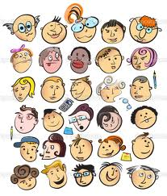
The Body Of Christ Acts 2
The Head
CHRIST
Ro.10:17
Jn.12:48
The Body
Acts 2:41-47: The Lord Jesus controls the activities of His body
The Church is His Body (Ep.1:22,23) and He is the Head of the Body, the Church
One Body with many members (1Co.12:12-14)
Acts 4:1-4 (five thousand men heard & believed)
Acts 6:1-7 (the number of disciples multiplied)
Acts 8:1-4 (persecution scattered the church throughout the regions and men and women were put in prison)
CANADA
AFRICA
AUSTRALIA
CARIBBEAN
SOUTH AMERICA
USA
CENTRAL AMERICA
ASIA
EUROPE
Notes:
All Christians are religious, but not all religious people are Christians. Remember, fellowship is first vertical, and then it is horizontal.
Acts 2:47

Slide 11
SOVEREIGNTY OF DEITY
CHRIST
Christian Age Acts 2:41, 47
KINGSHIP
HEADSHIP
UNIVERSAL KINGDOM
Mt.28:19-20
Cl.1:12-23
ACTS2
ACTS 1
Christ’s
Kingdom
Reign From Heaven
CHURCH
HS
THE PEOPLE, (EKKLESIA)
ARE IN THE KINGDOM,
(BASILEIA)
THE KINGDOM, (BASILEIA)
IS IN THE PEOPLE, (EKKLESIA)
NT
Notes:
Final Coming: “Therefore you also be ready, for the Son of Man is coming at an hour when you do not expect Him” (Mt 24:44). Therefore, since all these things will be dissolved, what manner of persons ought you to be in holy conduct and godliness, looking for and hastening the coming of the day of God. Our realization that an end is coming should stimulate gospel living (2 Pt 3:11). Our gospel living should set us apart from this present world. Our understanding that this world will be dissolved away should encourage the desire that the end of this world come soon (2 Pt 3:12).
Paul wrote, “But concerning the times and the seasons, brethren, you have no need that I should write to you” (1 Th 5:1).

Slide 12
The Apostles They Write As The Holy Spirit Speaks 2 Pt.1:20-21; Jn.20:30,31; 2 Ti.3:16,17
THE
SPOKEN WORD
He.1:1-2
GOD
Mission?_________________________________________________________________________________________________________________________________________________________________________________________________
Message?__________________________________________________________________________________________________________________________________________________________________________________________________________________________________________________
Bb
B.C.
Faith Walking On The Promises of God
He.11
Holy Spirit
Jn.14:23-26
Jn.16:7-11
A.D.B.R.
Fact Talking
Jn.15:26-27
A.D.B.R.
Fact Talking &
Faith Walking
Ac.2:14-47
Fruit Producing
Mk.16:15,16
Christ
Embodied Word
Jn.1:1-4,14,17
The Apostles
Jn.16:13
2 Co.5:11-21
Today
Fact Talking &
Faith Walking
Hb.11:1,6
Fruit Producing
Mt.28:19,20
Scriptures
1Co.2:12,13
Jude 3
B&L
Fact Walking,
The Fulfillment of Prophesy
Ti.2:11-14
Reminder For All
Jn.12:48

