Slide 1
Is Baptism Essential?
I’ve Been Baptized Already

Slide 2
Is Baptism Essential?
The Open Bible Study is, in my opinion, the best tool for house-to-house teaching.
We shorten the title of the Open Bible Study Lessons to simply: O.B.S.
If we are going to be consistent and on a progressive track to understanding the whole plan of God, then we should learn how to effectively use this lesson and not stray too far from its pattern.
For the sake of addressing the topic given to me, we will study the area of the lesson that pertains to baptism.

Slide 3
Is Baptism Essential?
In the worksheet portion of the O.B.S. there is a section called “Looking Back.”
In this section, you will find six questions that will shape the initial question of weather or not baptism is essential in the mind of the student.
In the blue colored lesson of the O.B.S., questions 2-7 deal with baptism. This is where we will topically answer the question of baptism’s essentiality.

Slide 4
Is Baptism Essential?
Mark 16:15-16 “And he said unto them, Go ye into all the world and preach the gospel to every creature. He that believeth and is baptized shall be saved; but he that believeth not shall be damned.”
Preaching and teaching is very important in helping your student to see the Lord’s plan of salvation.
We see that salvation is promised to those that believe and are baptized.
Notice that if a person doesn’t believe then they will not be baptized and ultimately damned.
I Peter 3:21 “The like figure whereunto even baptism doth also now save us (not the putting away of the filth of the flesh, but the answer of a good conscience toward God).”

Slide 5
Is Baptism Essential?
The worksheet portion of the O.B.S. entitled: “Write Your Sins on the Cross” helps us to understand our sinful state and our total dependence on Jesus.
Romans 6:23 “For the wages of sin is death; but the gift of God is eternal life through Jesus Christ our Lord.”
Ezekiel 18:4 “Behold, all souls are mine; as the soul of the father, so also the soul of the son is mine: the soul that sinneth, it shall die.”
If we don’t have our sins remitted, then we cannot enjoy eternity with God.

Slide 6
Is Baptism Essential?
Acts 2:37-47
The sinners on that day heard the word, believed what they heard, repented of their sins and obeyed the command to be baptized.
Their sins were forgiven at baptism.
They received the gift of the Holy Ghost.
They were added to the church of those who were being saved.
Acts 22:16 “And now why tarriest thou? Arise, and be baptized, and wash away thy sins, calling on the name of the Lord.”
The only remedy for sin is the blood of Jesus Christ.

Slide 7
Is Baptism Essential?
Ephesians 4:4-5 “There is one body, and one Spirit, even as ye are called in one hope of your calling; one Lord, one faith, one baptism,”
There is one baptism that was valid then and there is one baptism that is valid today.
Act 2:41 “Then they that gladly received his word were baptized: and the same day there were added unto them about three thousand souls”
Acts 2:47 “Praising God, and having favor with all the people. And the Lord added to the church daily such as should be saved.”

Slide 8
Is Baptism Essential?
The Lord added those that were baptized to the church of those who were being saved.
One baptism of believers being added to one church in that day and time.
Satan realized that he could not stop the church from coming into existence but he can confuse the minds of men by making multiple denominations and diluting the power and importance of baptism.
There was no other church available for men and women to be added to but the Church of Christ.
Eph. 5:23 “For the husband is the head of the wife, even as Christ is the head of the church: and he is the savior of the body.”
Colossians 1:18 “And he is the head of the body, the church who is the beginning, the firstborn from the dead; that in all things he might have the preeminence.”

Slide 9
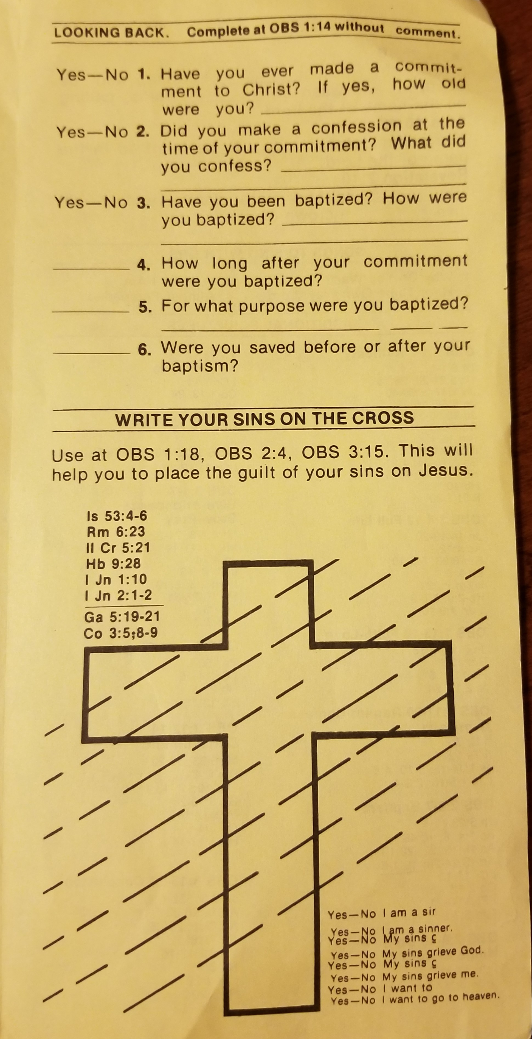
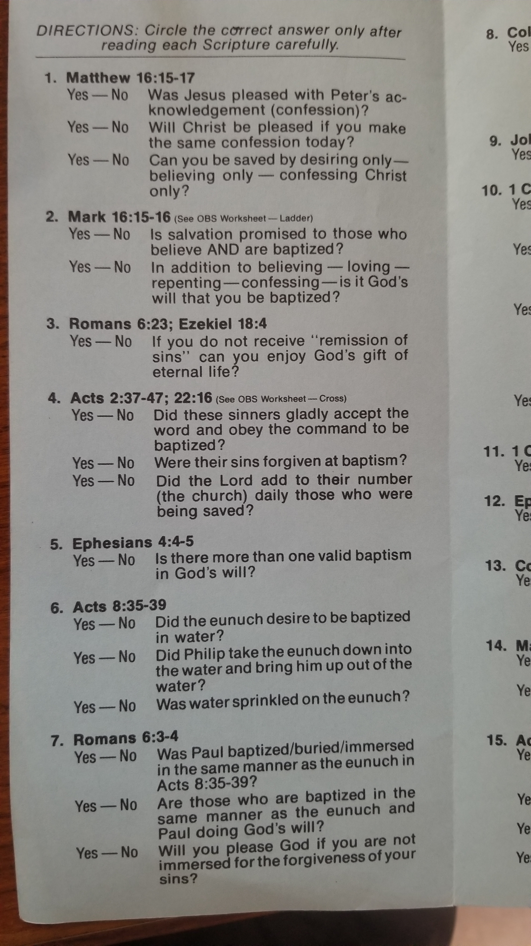
Is Baptism Essential?

Slide 10
I’ve Been Baptized Already
The question of a need to be re-baptized occasionally arises when teaching the O.B.S.
There are many denominations out there that also baptize their believers. When we follow the bible’s teachings, it makes this question more understandable and the needs very clear.
We discussed the essentiality of baptism: It saves, it washes our sins away, we receive the gift of the Holy Ghost, there is only one baptism, and it adds us to the church the body of Jesus; the Church of Christ.
We also talked about the role of Satan in confusing mankind and duping them out of salvation.
Now let’s talk about the need to be re-baptized.

Slide 11
I’ve Been Baptized Already
[Act 19:1-7 KJV] 1 And it came to pass, that, while Apollos was at Corinth, Paul having passed through the upper coasts came to Ephesus: and finding certain disciples, 2 He said unto them, Have ye received the Holy Ghost since ye believed? And they said unto him, We have not so much as heard whether there be any Holy Ghost. 3 And he said unto them, Unto what then were ye baptized? And they said, Unto John's baptism. 4 Then said Paul, John verily baptized with the baptism of repentance, saying unto the people, that they should believe on him which should come after him, that is, on Christ Jesus. 5 When they heard [this], they were baptized in the name of the Lord Jesus. 6 And when Paul had laid [his] hands upon them, the Holy Ghost came on them; and they spake with tongues, and prophesied. 7 And all the men were about twelve.

Slide 12
I’ve Been Baptized Already
John’s baptism was a valid baptism.
Mark 1:1-15
John had authorization from the Lord Himself to prepare the way for His Son.
John was written in the Prophets.
Matthew 3:3 “For this is he that was spoken of by the prophet Esaias saying, The voice of one crying in the wilderness, Prepare ye the way of the Lord, make his paths straight.”
Matthew 3:5 “And there went out unto him all the land of Judaea, and they of Jerusalem, and were all baptized of him in the river Jordan, confessing their sins”

Slide 13
I’ve Been Baptized Already
John baptized with the baptism of repentance.
[Mar 1:4 KJV] John did baptize in the wilderness, and preach the baptism of repentance for the remission of sins.
[Luk 3:3 KJV] And he came into all the country about Jordan, preaching the baptism of repentance for the remission of sins;
[Act 13:24 KJV] When John had first preached before his coming the baptism of repentance to all the people of Israel.
There would become a time when an individual would have to be baptized time and time again.

Slide 14
I’ve Been Baptized Already
Jesus’ baptism is for the remission of sins.
[Act 2:38 KJV] Then Peter said unto them, Repent, and be baptized every one of you in the name of Jesus Christ for the remission of sins, and ye shall receive the gift of the Holy Ghost.
Remission-The cancellation of a debt, charge, or penalty; Forgiveness of sins.
Jesus’ baptism takes care of the constant need, because of sin, to be re-baptized.
[Tit 3:5 KJV] Not by works of righteousness which we have done, but according to his mercy he saved us, by the washing of regeneration, and renewing of the Holy Ghost;
[John 3:3-5 KJV] Jesus answered and said unto him, Verily, verily, I say unto thee, Except a man be born again, he cannot see the kingdom of God. 4 Nicodemus saith unto him, How can a man be born when he is old? can he enter the second time into his mother's womb, and be born? 5 Jesus answered, Verily, verily, I say unto thee, Except a man be born of water and [of] the Spirit, he cannot enter into the kingdom of God.

Slide 15
I’ve Been Baptized Already
[Act 8:15-24 KJV] 15 Who, when they were come down, prayed for them, that they might receive the Holy Ghost: 16 (For as yet he was fallen upon none of them: only they were baptized in the name of the Lord Jesus.) 17 Then laid they [their] hands on them, and they received the Holy Ghost. 18 And when Simon saw that through laying on of the apostles' hands the Holy Ghost was given, he offered them money, 19 Saying, Give me also this power, that on whomsoever I lay hands, he may receive the Holy Ghost. 20 But Peter said unto him, Thy money perish with thee, because thou hast thought that the gift of God may be purchased with money. 21 Thou hast neither part nor lot in this matter: for thy heart is not right in the sight of God. 22 Repent therefore of this thy wickedness, and pray God, if perhaps the thought of thine heart may be forgiven thee. 23 For I perceive that thou art in the gall of bitterness, and [in] the bond of iniquity. 24 Then answered Simon, and said, Pray ye to the Lord for me, that none of these things which ye have spoken come upon me
Simon, who had been baptized, did not need to be re-baptized for his sin. He needed to repent.

Slide 16
I’ve Been Baptized Already
Acts 19:5 “When they heard this, they were baptized in the name of the Lord Jesus.”
Your baptism is based on your teaching. When they followed John they were baptized under John. Now that Jesus has established His Church we should follow Him and be baptized in His name.
Denominations follow the Bible very loosely as it pertain to baptism.
They were sensitive enough to the commands of Christ that they made the immediate adjustment.
In that day there were only one place to be added as a follower of Jesus. The Church of Christ.

Slide 17
I’ve Been Baptized Already

